Slide 1
National 4/5 Administration
Admin practices
OUTCOME 1.2- Customer care

Slide 2
Learning Intentions
To understand the key features of customer service
Give examples of good and bad customer service

Slide 3
What is a customer?
Identify the customers for the following organisations:
-Hospital
-School
-Supermarket
It may well be better to think about a customer as anyone that you would interact with and has expectations of the organisation.

Slide 4
Customer Service
Customers are people who have needs and expectations.
Customer service is about meeting and often exceeding, these needs.
What do you think happens when customers needs are not met…?

Slide 5
What do customers want?
Customers can take the time to shop around for the best deal.
They can be more selective about how and where their needs are met.
With competition and prices being so fierce, organisations need something to give them the competitive edge, something to attract customers.
The importance of customer service should never be overlooked!

Slide 6
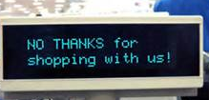
Activity 1
Has there ever been a time you have received good or bad customer service?
Think about why it was good or bad

Slide 7
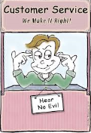
Bad customer service
With your bad customer service example:
Did you complain?
If so, what happened?
If not, what would you have liked to have happened if you did complain?

Slide 8
Complaints Procedure
Complaints
Complaints should be treated seriously and recorded
Complaints should be handed by trained staff
The result of the complaint should be communicated to the customer in a timely manner
Time limits for dealing with compaints should be established
Complaints should be acknowledged and the customer should be kept informed

Slide 9
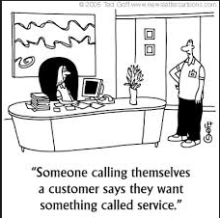
Activity 2

Slide 10
Mission statements

Slide 11
Learning Intention
Investigate the purpose of a mission statement
Recognise examples of mission statements

Slide 12
Mission Statements
A lot of organisations will have a mission statement
It sets out the main aims of the organisation and explains how they will be met
A good mission statement will tell a customer about an organisation in a few sentences

Slide 13
Example Mission Statement

Slide 14
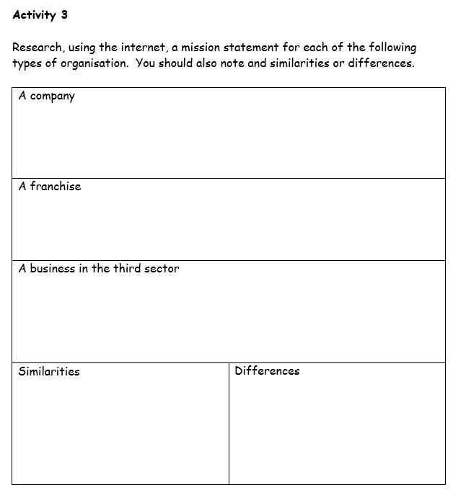
Activity 3
Remember to look for the similarities and differences

Slide 15
Customer Care Strategy
Organisations will have a separate written statement of principles relating to customer service
Produced in order to ensure that –
the customer gets what they want
to the standard that they want it
at the quality they want and at a price that is acceptable.
As a customer for any shop, can you think of anything you expect when purchasing or hoping to purchase something?

Slide 16
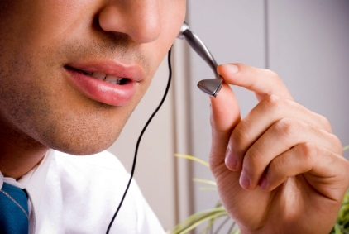
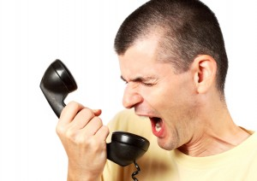
Customer Care Strategy
The strategy will usually outline the organisations plans for:
ensuring the quality of customer care
Customer Care Policy / Customer Service statements
Customer focus groups
Guarantees/Warranties
measuring and testing that customers’ needs are being met
Mystery Shoppers
Comment cards / feedback forms / online customer surveys
making sure that service level agreements are in place
Agreements between departments in the business, staff guidelines
dealing with customer complaints
Formal procedure for dealing with complaint. Customer know how to complaint and how it should be deal with.
Employees have a standardised/consistent approach to dealing with complaints
Notes:
Link to RBS Customer Charter video

Slide 17
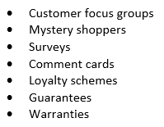
Review of Notes & Activity 6
Review your Customer Services Notes on the network before undertaking this task.
Read pages 10-12 and then decide how to present your information
You can also gather information/graphics online to enhance your work

Slide 18
The role of the admin assistant

Slide 19
The Admin Assistant
It is often an admin assistant who will be the first person a customer has to deal with.
It is important that the admin assistant is aware of all the procedures and policies that they should be following.
When dealing with external customers it is important to keep the relationship formal:
-Although some customers don’t mind being addressed by their first name, this should always be checked first

Slide 20
The Admin Assistant
The Admin Assistant should not step outside the remit of their job.
It may seem appropriate to make a promise to a customer but if you can’t keep that promise and need to go back on it later, it will only make the situation worse.
All organisational procedures should be followed correctly to avoid any issues..

Slide 21
Activity 4
Complete the activity by answering true or false for statements regarding customer care.
Refer to page 4 of notes for advice

Slide 22
How do organisations keep customers happy?

Slide 23
Market Research
It is important for organisations to find out what their customers think about them and about the level of service they receive.
Organisations receive feedback from their customers so they can evaluate what they are doing well and what needs improved on.

Slide 24
Feedback
There are two main ways for an organisation to carry out market research –
Customer Focus Groups
Mystery Shopper

Slide 25
Customer Focus Groups
Small groups of customers who meet to provide an organisation with feedback on their goods or services
Happen face-to-face
Feedback received from customers is instant
Any issues can be clarified there and then
The main issue with a customer focus group is the cost involved which means they are not held very often.

Slide 26
Mystery Shopper
Used by many organisations to check on the level of service and care given by the organisation.
Pretend to use the organisation as if they were a normal customer
Record and report on the experience they had with the organisation.

Slide 27
Mystery Shopper
Staff within the organisation will be given positive or negative feedback based on the report provided by the mystery shopper
Any negatives can then be looked at to see how they can be resolved so they don’t happen again in the future.

Slide 28
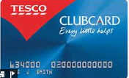
Loyalty Schemes
Can you think of any loyalty schemes?
Loyalty schemes are designed to reward customers for being loyal to an organisation.
They are intended to try and get customers to remain with an organisation by giving something back to the customer.

Slide 29
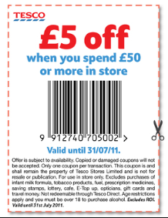
How does it work?
When a customer buys something from an organisation they receive points on a card.
After a period of time these points can be redeemed for more goods or services or the points are turned in to vouchers that the customer can spend with the organisation.

Slide 30
Mrs Smith
Scenario:
Mrs Smith buys the same bread, milk and shampoo each week she shops at Tesco. What products do you think she has money off that is included with her vouchers…

Slide 31
How does the organisation use this information?
They give the organisation a very clear picture of who their customers are, what they spend money on, how much they spend and how often they use the organisation.

Slide 32
Review of Notes & Activity 6
Review your Customer Services Notes on the network before undertaking this task.
Read pages 10-12 and then decide how to present your information
You can also gather information/graphics online to enhance your work

Slide 33
Internet Research – Loyalty Schemes

Slide 34
Benefits of good customer service

Slide 35
The Benefits of Good Customer Service
It is important that customers feel as if they are being treated well.
Providing good customer service can bring many benefits to an organisation :

Slide 36
Having good customer service can give an organisation a competitive edge in the market
The internal customers, employees, feel more motivated and are therefore more productive
A happy workforce means a reduction in staff turnover
If an organisation develops a good reputation, this will attract new customers and new staff
Benefits of Good Customer Service
This in turn would lead to an increase in sales and profits
If customers feel satisfied with the service they have received, they are likely to be loyal to the organisation and also recommend it to friends
Attracting new customers could mean that the organisation increases its market share
Notes:
Team Task – whiteboards
No 1’s – writers (write team responses)
No 2’s – reporters (report back to rest of class)
No 3’s – timekeeper (5 minutes – use online stopwatch)
No 4’s – motivator (keep team on track – must come up with at least 5 reasons)

Slide 37
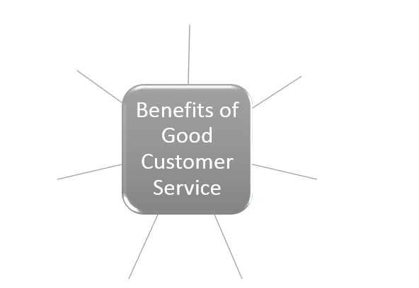
Activity 5
Notes:
Demo how to complete this page in task booklet
Activity 5 to be completed
Up to and including Activity 7 should be completed/finished off today.

Slide 38
MYSTERY SHOPPER challenge

Slide 39
Mystery Shopper Challenge
Identify suitable quality checks
Discuss in your teams what areas of service you will comment upon
Grading system – 1 to 5, Excellent – Poor??
Other information to be gathered that would be useful
Develop a FORM that a mystery shopper would complete
BE THE MYSTERY SHOPPER!!
Your homework for next week
Form must be designed/printed by Friday
Have an idea of where you could carry out your secret mission ☺
Hand in on Monday
Notes:
Where will you be going at the weekend?
Out shopping with folks?
In the town with friends at weekend?
At the gym/football/swimming pool?
Go to the dentist, doctor, hairdressers, mcdonalds/burger king, cinema………..
Don’t want everyone to do Sainsbury’s (that’s my shop) or subway!
Would be good to get a variety of different places
If you have a particular place in mind then you will maybe have more specific questions

Slide 40
Mystery Shopper Form
Essential Details
Name of shopper (that’s you!)
Name of business
Location/Address of Business
Date
Time
Served by
Reason for visit/purchase
Approx number of customers
Quality Checks
(Grade/Score & Comments)
Greeted on arrival/welcomed
Time taken to be served
Helpfulness of staff
Quality of product/service received
Appearance/décor/cleanliness
Toilets

Slide 41
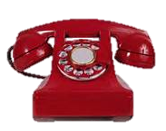
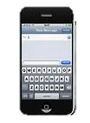
Communication with customers

Slide 42
Face to Face
A letter
WHAT METHODS OF COMMUNICATION DOES AN ORGANISATION USE TO COMMUNICATE WITH CUSTOMERS?
Telephone call
E-mail
A text
Notes:
Starter activity
In pairs come up with methods each
Use lollipops to pick a few answers from pairs

Slide 43
Face to Face
Communicating Face to Face allows for:
Body language and tone of voice can be interpreted correctly…why is this important?
The organisation can receive immediate feedback from a customer
Helps to build a relationship with the customer and this leads to loyalty from the customer.

Slide 44
Telephone
This has become so popular nowadays that we now have organisations dedicated to this.
Customers are able to deal with organisations from the comfort of their own home and at a very low cost as these companies usually have a Freephone number.
Usually have to go through a number of automated options and then placed in a queue. This can lead to a number of angry customers.
0800 111 211
Notes:
Discuss in A & D in pairs

Slide 45
Written
Many customers still like to put any complaint they may have in writing.
This method of communication can be very effective as a record is kept and time is taken by the customer to read a reply and understand it.

Slide 46
E-mail
Email is now a popular method of communication with customers.
One email can be sent to a vast number of people at the same time
The tone used in an email is less formal than would be needed in a letter
They can be sent and received 24 hours a day
It is a relatively cheap method of communication
Notes:
Discuss A in pairs

Slide 47
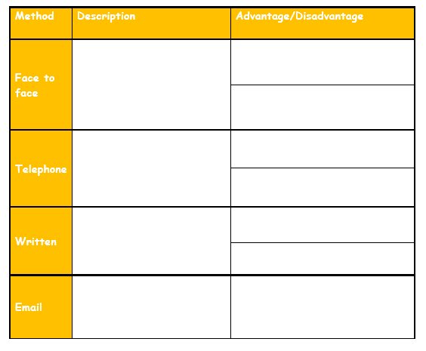
Complete

Slide 48
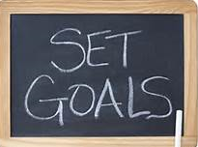
The Importance of customers in reaching Objectives

Slide 49
Why are customers important?
Customers buy goods and services
=
Profit for organisations

Slide 50
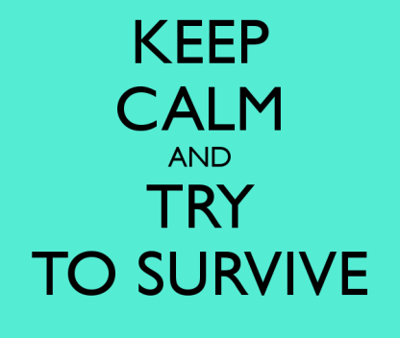
To survive
Maximise Profit
Objectives of an Organisation
Provide a good quality produce/service resulting in customer satisfaction
=
Returning customers

Slide 51
Complete Activity 9
Review your Customer Services Notes on the network before undertaking this task.
Read pages 15 & 16

Slide 52
Impact of poor customer service

Slide 53
Importance of Customer Service
The survival of the organisation is dependent on the customer.
As repeat custom is important, it is essential that customers are satisfied with the service they receive.

Slide 54
Decrease in customer loyalty
Demotivated and demoralised staff
Bad publicity
Impact of Poor Customer Service
Loss of competitive edge
Failure to attract new customers
Increase in complaints

Slide 55
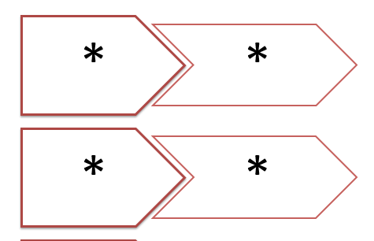
Activity 10
Notes:
Demo how to complete this page in task booklet
Activity 10 to be completed

