Slide 1
2019 Exams

Slide 2
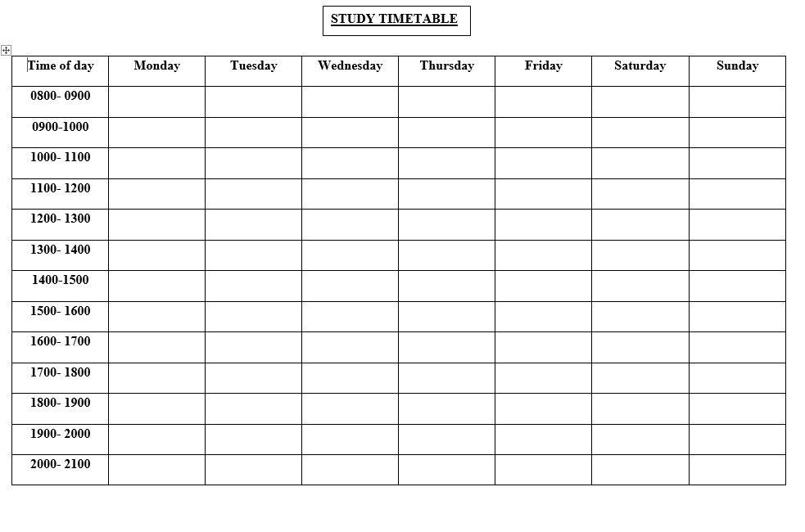
Revision
It is not too late!
If you haven’t started yet start now!
Your teachers can help with revision materials and you can use a study timetable to plan your revision.

Slide 3
Timetables
Today you will receive your personal exam timetable.
Please check that a) your details are correct and b) you are entered for the exams you expect. (This should be correct as you should have already checked this prior to the holidays!)
Make sure you know where your exam is taking place and the time it starts.
You will also see the seat number you must sit in for this exam. This will also be displayed on the day of the exam on a board outside the exam.

Slide 4
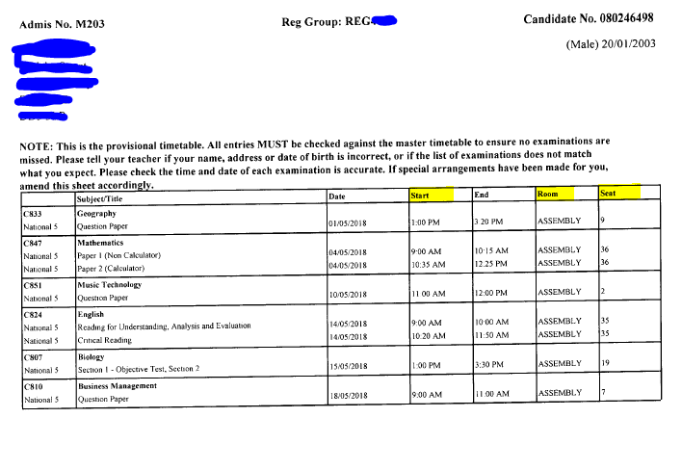

Slide 5
Study Leave
Study leave starts on Tuesday 30th April for anyone sitting one or more timetabled SQA exam.
The last day of study leave will be Tuesday 28th May.
All pupils in S4/5 should return to school on Wednesday 29th May.
If you have an exam out with study leave you may study at home the day before your exam.
Staff are here to help- come in and ask.
If you are in school you must be in uniform

Slide 6
On Exam day
Arrive early!
Be outside the exam room at least 10 minutes before the exam is due to start.
If you are late, you must report to the teacher or lecturer in charge of SQA exams. They will let you know if you can still enter and sit the exam.

Slide 7
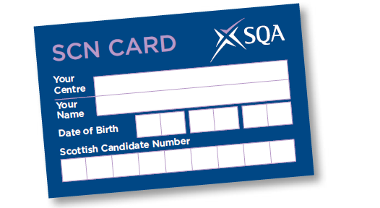
In the Exam
Check with your teachers what you are allowed to take into the exam room- for most exams it will only be a pencil/ pen/ rubber/ ruler and your completed Scottish Candidate card. You are not allowed to share any equipment during an exam.
Bags are left at the front of the room or as instructed by the Invigilators.

Slide 8
Leaving the exam room
If you finish early or have done as much of the exam as you can, you can ask the invigilator for permission to leave by raising your hand.
If the exam is longer than one hour, the invigilator may allow you to leave after 30 minutes.
If the exam is one hour or less, are not allowed to leave before the end.
You must give your answer booklet, question paper and any data booklets to the invigilator before you leave. You could lose all marks for the paper concerned if you don’t give your answer booklet to the invigilator before leaving the exam room.

Slide 9
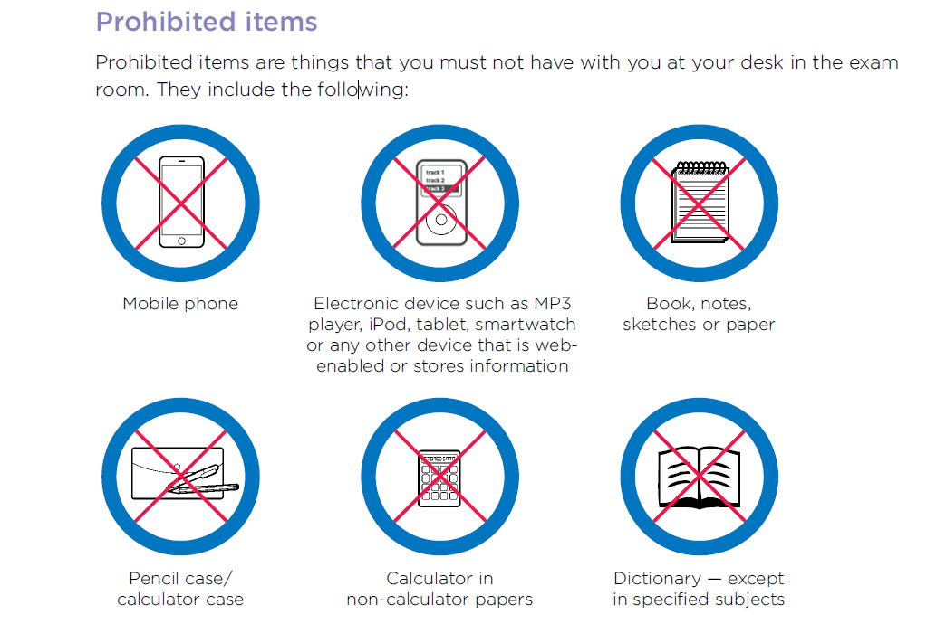
Please do not bring these items into school. If you do please leave them in your locker or if they are in your bag they must be turned off. If your phone goes off during the exam you may end up being removed from the exam and receiving no award!

Slide 10
If you are ill on the day of your exam:-
Contact the school first thing to make them aware
You may need to get a medical certificate which may need to be submitted to the SQA.
Your Guidance Teacher and Mrs Barbour will liaise with you and your parents/ carers if this is the case.
The school may be able to request Exceptional Circumstances for the exam you missed. This needs to be done within 10 days of the exam and can only happen if you have
experienced a valid exceptional circumstance
completed all other parts of the course
had an estimated grade submitted by their centre
If you sat your exam but feel that an exceptional circumstance affected your performance on the day you must let Mrs Barbour know as soon as possible.

Slide 11
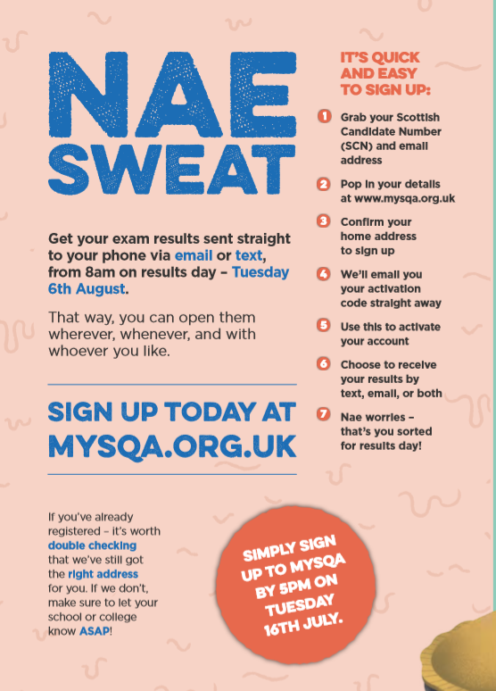
Results

Slide 12
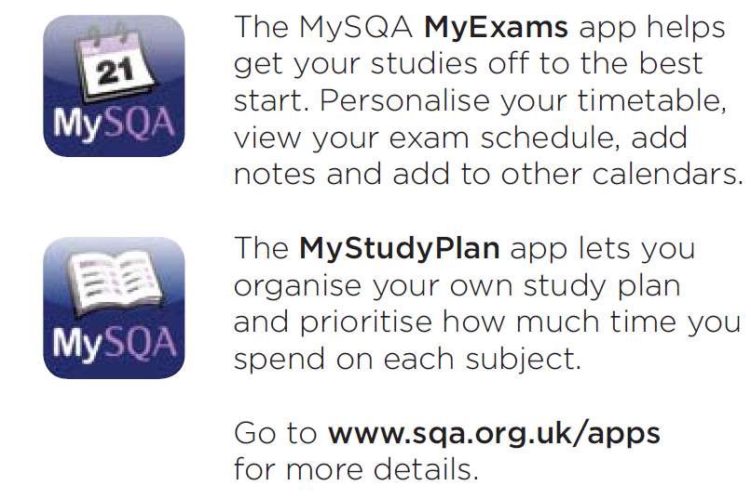
SQA Apps you can download
Check your own timetable from school as times may be slightly different from the SQA website!

Slide 13
Good Luck!

