Slide 1
brightsolid
An employers perspective: The importance of Soft Skills
Andrew Bond

Slide 2
A bit about me:
Studied Law at Dundee University
Recent Graduate
Hired by brightsolid in July
Brightsolid are a Dundee based IT company

Slide 3
What is the most important thing that brightsolid look for in the young workforce?

Slide 4
Soft skills

Slide 5
Examples of Soft Skills: Communication

Slide 6
Teamwork

Slide 7
Organisation and time management

Slide 8
How to gain soft skills

Slide 9
You have to keep building on Soft Skills

Slide 11
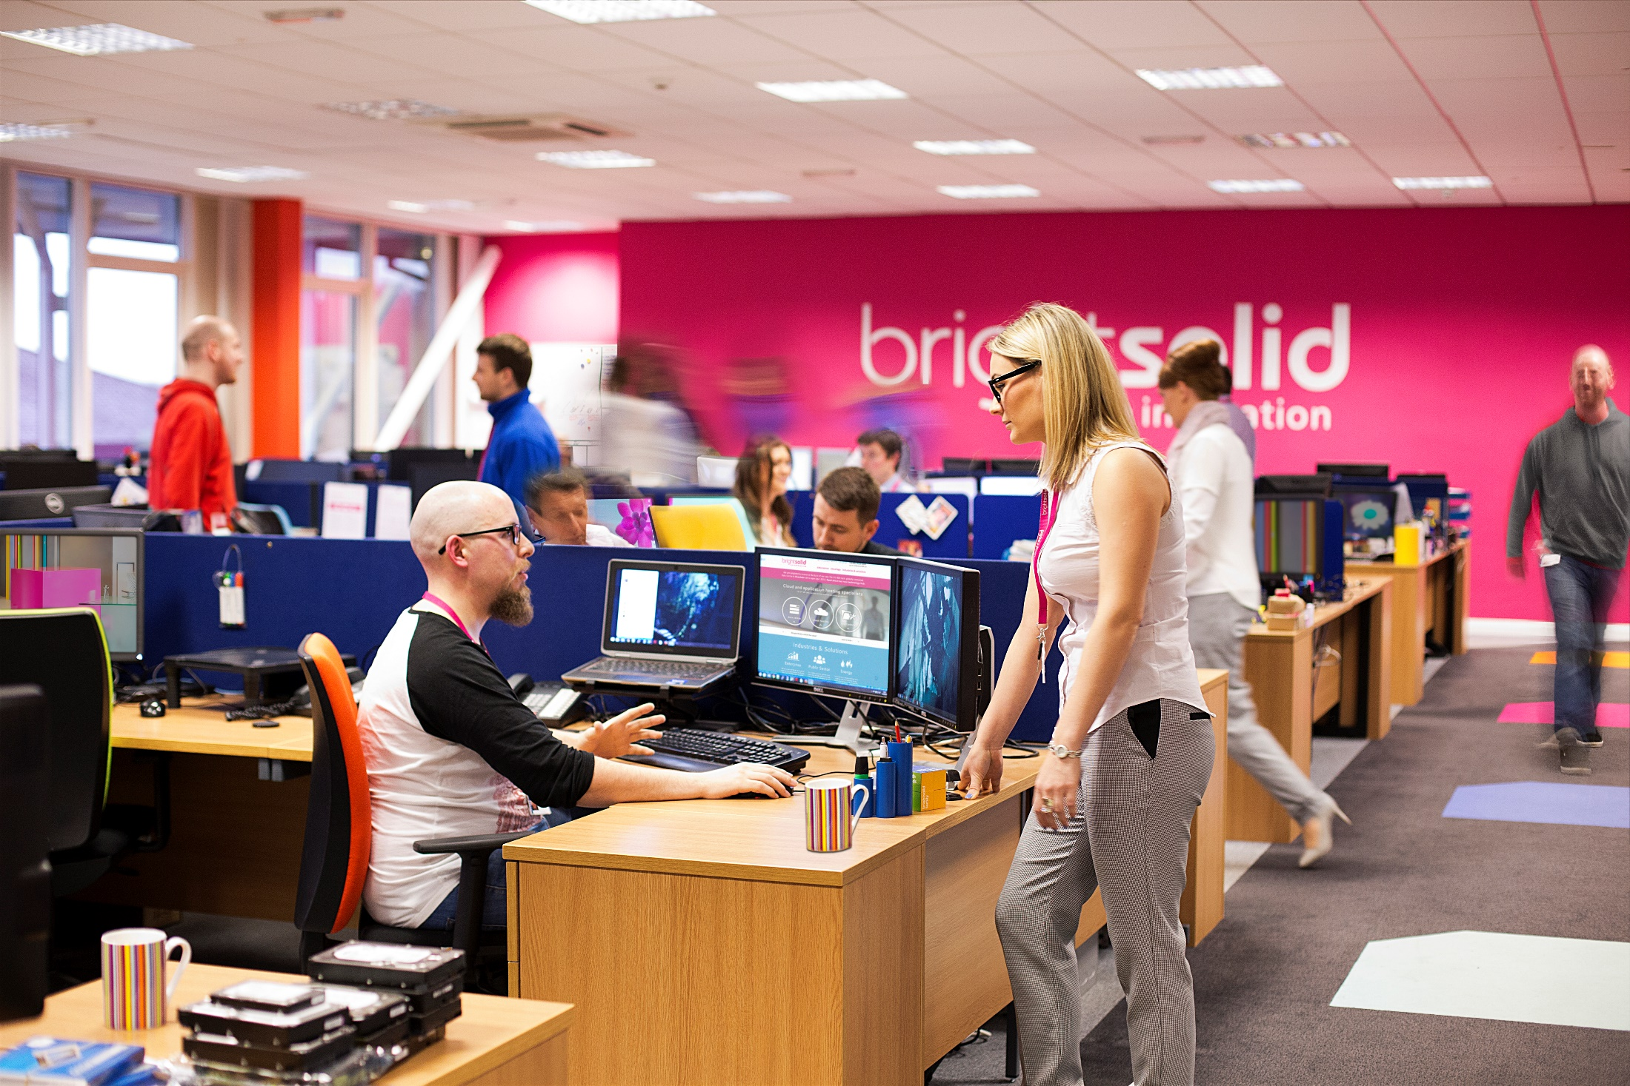
abond@brightsolid.com

