Slide 1
Senior Phase choices
Developing Scotlands Young Workforce
Notes:
Good evening, for this section I would like to give you an outline of some of the options for pupils we have either recently introduced, or will be offering for the first time this year
The choice available to pupils moving into S4/5/6 next year are linked to the key recommendations identified in the Wood Report. This was commissioned by the government and aims to ensure that pupils at school have the opportunity to :
access a wider range of qualifications including vocational qualifications
develop key employability skills and
Improve their awareness and understanding of industry
Central to this is the notion of developing employability- it aims to ensure that pupils can access the labour market with the skills and range of qualifications sought by potential employers

Slide 2
Employability
‘Traditional’ university route is the most suitable route for some pupils and in some areas
Degree route doesn’t guarantee employability
Other (non traditional) routes to degree level courses
Employability skills and vocational qualifications support access to degree level courses
Almost half our pupils don’t follow the university route
Some employers prefer vocational qualifications over academic
Employers highlight 21st Century skills (soft skills)
Notes:
There are a number of contexts for these developments, one is the significant changes in the labour market & another is feedback from employers.
We currently have high levels of youth unemployment at the same time that employers are unable to fill vacancies and skills shortages exist. This has led to a review of how we are preparing pupils
For many pupils , what I will refer to as the traditional route- progression through school, onto university and into employment is the most suitable option and will remain so. That has implications for the choices they are about to make regarding specific subjects
However, this option is no longer the guarantee that it might have been the past. (Graduates working in low skilled, low paid employment)
Pupils can now access degree level courses through routes other than the traditional academic highers (for example via HNCs and HNDs) which may be more appropriate / or more successful given potential cut backs in the university sector and funding arrangements for these courses.
The degree route is definitely the best option for some pupils. But even for those pupils who wish to follow that route, having only academic qualifications from school alone may not be enough, for example almost all applicants applying for medicine will probably have achieved 5 As at Higher but applicants may require other vocationally based experiences such as relevant work placements to enhance their personal statements and secure an interview.
Currently just under half our pupils don’t follow the university route. Other routes such as vocational qualifications or modern apprenticeships might be more appropriate for some rather than accumulating academic qualifications
Increasingly some employers prefer to recruit through a more vocational route- feel recruits more suited to their needs- ie accountancy
A key finding from feedback we as a school have from employers is that they are increasingly highlighting the importance of what are referred to as 21st century skills or soft skills as major factor in their recruitment processes.
As a result of all of these developments we are increasing the range of options and providing wider pathways to enhance the employability of pupils as they progress through the senior phase.
We believe this provides a wider range of choices and a more personalised curriculum which offers greater relevance for a wider range of pupils than what was seen as the traditional model.
So what does this look like?

Slide 3
Options for Senior Phase-1
’Traditional’ qualifications (Nat4/ Nat5/ Higher)
Skills for Work courses
School / College options
Notes:
These are the range of options available as pupils move into the different stages of S4/5/6
We have ‘traditional’ qualification- ie nat5 higher etc
Skills for work courses – as well as content cover key employability skills- main options are tourism and hospitality and early education and child care
We offer college link options for a number of years

Slide 4
School/ College options (S4/5/6)
Automotive Skills (N4)
Website/Graphic Design and Development (N5)
Creative Industries (L4)
Construction Crafts (N4&N5)
Childcare and Development (Higher)
Dance (Higher)
Early Education and Childcare (N4&N5)
Engineering Skills (N4&N5)
Hairdressing & Beauty (N4&N5)
Business Skills (L6)
Engineering Technician (L6)
ICT and Digital Technologies (L6)
Laboratory Skills (L6)
Practical Science (L5)
Social Services & Health care (L6)
Social Services and Childcare (L6)
Notes:
This is the current list of options on offer as part of this program;
These are available for all pupils moving into fourth fifth and sixth year
These courses are delivered at the relevant college campus- transport pupils to these
We timetable these to fit in with the exisiting school timetable- in place of 1 of their school based subjects
All these subjects are offered at SCQF levels 4-6 which is comparable to national 4, 5 and higher
Highlight the handout that gives an indication of how different types of qualifications compare
These options widen the range of subjects available to our pupils

Slide 5
Options for Senior Phase-2
Flexible Pathways
Employability transition program (s4)
Employability linked courses
  NPA courses
  Advanced Engineering Program
Industry linked certification
Apprenticeship options
HNC options- timetabled & infill
Flexible work placements
Notes:
We also have a number of newer options to provide more pathways for pupils at Grove For some
S4 pupils we offer an employability transition program aimed at developing employability skills, providing vocational certification and developing career management skills- mainly for pupils already working with kick it kick of project
We offer courses more closely aligned to enhance employability- these tend to be more focused on career standards for specific industries
We offer industry standard certification that would enable pupils who gain these to access employment directly
We are also offer apprenticeship pathways to secure full time apprenticeships in a number of areas
Finally we also offer more vocational courses such as HNC directly related to particular careers
I’d like to expand on some of these options

Slide 6
Notes:
This year we will again be offering NPAs in computer games design and cyber security- both areas of significant potential growth in the labour market
Dundee has an established reputation already in the computer games industry
All the indications are that cyber security will be a massive area for job growth
These are not limited to pupils with backgrounds in computing- they give for example pupils with skills in art and music an opportunity to deploy these skills in a vocational context

Slide 7
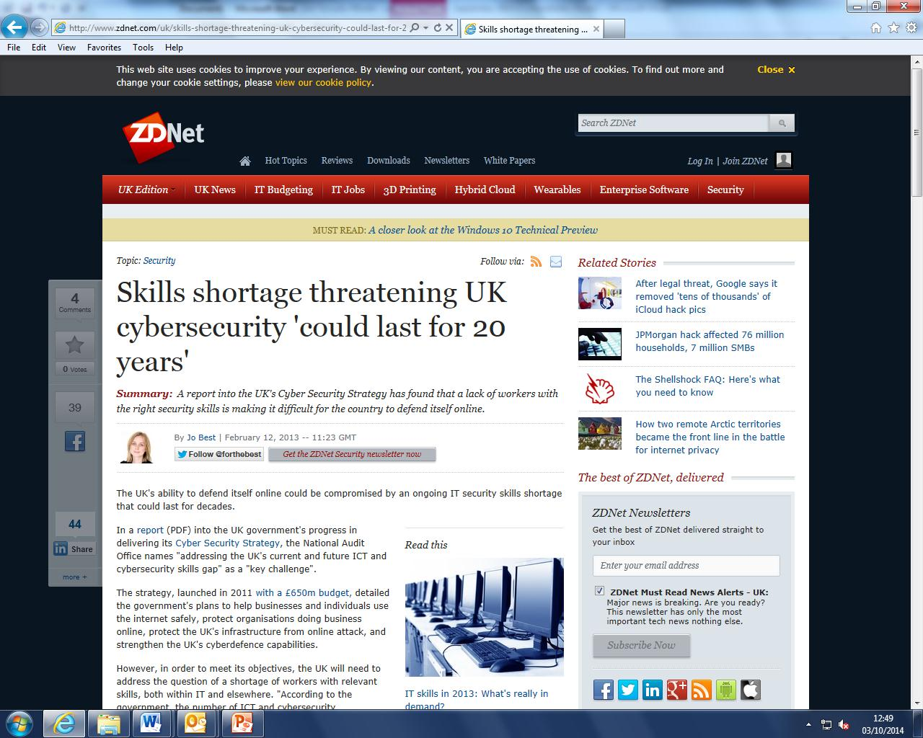
Notes:
These courses also focus not just on the content but how they will be delivered-
we have already established links with universities and colleges and this year
we have had pupils working with staff and students from local universities as well as employers from related areas.
We have also had some of our pupil enhancing their skills through working with students in High schools in the USA

Slide 8
Advanced Engineering Program
S6 pupils with background in engineering science or similar
Design, manufacture and test a fully functioning R.O.V.
Working with Employers, College and University staff
Entered for Gold Crest Award
Entered for international competition (Marine Advance Technological Competition)
Notes:
A new option for pupils starting next year will be our advanced engineering program.
This will be available for pupils in S6, they will be involved designing, manufacturing and testing an ROV submersible, working with engineering firms, and universities
This option will also enable participants to apply & extend their knowledge and understanding as well as develop key skills
etc

Slide 9
Industry linked qualifications
Fitness Industry Training Academy
  Life Guard Qualification
  Fitness Instructor Qualification
Coaching Academy
  SFA coaching qualifications
  SSF Coaching modules (SCQF Accredited from session 2017-18)
Notes:
A second feature we introduced last year are our industry linked qualifications
The two main option are what we call the Fitness Industry Training Academy and our Coaching Academy- each is the equivalent of a subject when making choices
So for example as part of the Fitness Industry Academy pupils would complete the National Pool Lifeguard Qualification (NPLQ). This is the recognized lifeguard qualification in the UK & Ireland. On successful completion of the course you will be fully qualified to work as a Pool Lifeguard

Slide 10
Apprenticeship pathways
Foundation Apprenticeships
Apprenticeship pathways (1 year program)
  Electrical & Plumbing Pathway
Foundation Apprenticeships (2 year programs)
  Social Services and Healthcare
  Social Services (Children & Young People)
  ICT & Digital Technologies
  Business Skills
  Laboratory Skills
  Engineering Technician
Notes:
A significant pathway for pupils is our apprenticeship options – both the apprentice pathway in plumbing and electrical (which is a 1 year program) and foundation apprenticeships (which are two year programs).
Both options enable pupils to gain qualifications and work based learning and experience
The aim of both is to enable young people to progress into full time employment or apprenticeships and have been developed for areas where there is a demand for recruits

Slide 11
Electrical & Plumbing pathway
Pathways in 2 areas: Plumber and Electrician
2 days per week in school
2 days per week at Dundee & Angus College
1 day per week on placement with employer
Partnership between Grove Academy, Dundee & Angus College, National Training Federations, local employers
Notes:
If we take the plumbing/electrical pathway as an example; pupils involved in the apprenticeship program in electrical and plumbing would spend-
School- maths English and practical electronics
College- relevant vocational qualification linked to knowledge and skills required for plumbing or electricians

Slide 12
Different options and outcomes
Traditional school subjects
College Pre app course
Electrical/ Plumbing
Pathway
Academic subjects
No vocational subjects
No vocational skills
No relevant experience
No knowledge of the industry
Academic subjects
Vocational qualifications
(NPA level 5)
No industry certification
No experience
General industry understanding
Academic subjects
Vocational qualifications
(NPA Level 5)
Industry certification
Relevant experience
Detailed industry understanding
Employability skills
Employer reference
Notes:
this slide illustrates the potential benefit of this approach
From experience pupils who complete the pathway are a more attractive proposition for potential employers
If you would like further information on the opportunities via the foundation apprenticeship option I would recommend attending the workshop on offer from Elaine walls from Skills development Scotland

Slide 13
HNC options
HNC Computing (2 year program – S5)
HNC Engineering Systems ( 2 year program- S5)
HNC in-fill opportunities
  Join existing college courses
  Dependent on spaces
  Extraction from normal school timetable
Notes:
Finally we have a number of HNC options
Two of these are timetabled
HNC+ advanced Higher
Dundee & Angus College have also offered the possibly of our pupils joining exisiting
college courses if space allows in a number of HNC area

Slide 14
Employability
Academic qualifications
Vocational qualifications
Key employability skills (soft skills)
Awareness and understanding of industry
Career management skills
Notes:
Overall these developments in the senior phase seek to enhance the employability options for pupils, providing opportunities to gain
academic qualifications
vocational qualifications and
industry certification and
allowing pupils to develop key skills and
extending understanding of specific careers and of industry
to prepare pupils for the transition to the labour market
Increasingly the norm for pupils in S4/5/6 as we further develop this approach will be a blended learning approach. This may mean pupils in S4/5/6 have learning experiences in school, at college, on work placement and could involve working with college or university lecturers and students as well as employers and other agencies.
Further information is available from the course choice booklet which can be found on the school website, for anyone who does not have internet access there are a limited number of paper copies that can be collected after this session
At this point I will pass you onto Simon Hewitt from Dundee and angus college

Slide 15
Developing employer links
Andy.creamer@dundeecity.gov.uk
01382 436800
Notes:
Before I pass you over to Mr Hewitt
we are looking to engage employers and develop links in as many areas as possible.

