Slide 1


Learn@ D&A
Simon Hewitt
Vice Principal (Curriculum & Attainment)
12th January 2017
Certain projects managed by Dundee and Angus College are supported by European funding.

Slide 2

What education feels like..
Learn@D&A

Slide 3

About the College…
15000 Total Students across all modes (5400 Full Time)
213 Full Time Courses ranging from SCQF Level 2-9
2100 Students @ SCQF Level 7 and above
One of the top performing Colleges in Scotland:
  78% pass rate (National 71%)
  Best College in Scotland for Success in 16-19 year olds
Learn@D&A

Slide 4
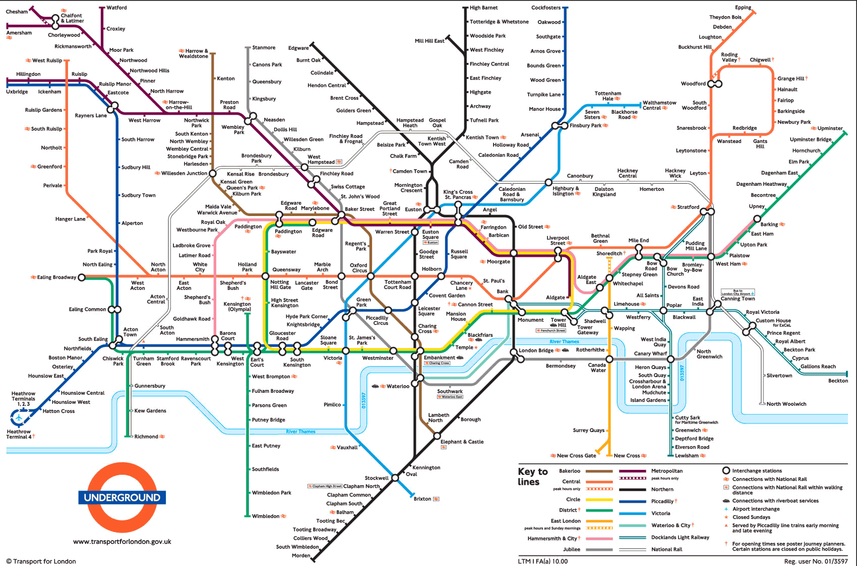
So which pathway is best???
Learn@D&A

Slide 5
So how does it work…
HNC (SCQF Level 7) & HND (SCQF Level 8)
  Developed by Scottish Qualifications Agency in partnership with Scottish Colleges, Universities and Industry
  Mix of practical and theory
  On-going assessment (essays, observations, exams, projects, work placements)
  Linked to professional bodies/certifications
  Advanced Entry into Year 2 and Year 3 of University
  Step off points to employment
Learn@D&A

Slide 6
HN Subject Areas…
  Art & Design
  Administration and IT
  Advertising and PR
  Acting and Performance
  Accounting
  Animal Care
  Applied Sciences and Applied Biological Sciences
  Architectural Technology
  Beauty Therapy
  Built Environment
  Business
  Care
  Computing & Computer Arts
  Dance
  Engineering (Systems and Civil)
  Events Management
  Fitness and Sport Coaching
  Hairdressing
  Hospitality Management & Professional Cookery
  Interactive Media
  Photography
  Retail
  Social Sciences
  Travel and Tourism
Learn@D&A

Slide 7
Established Pathways with Universities…
Also known as articulation agreements/pathways
  What are they?
  What are the benefits?
  Local Agreements (88) with Dundee, Abertay, St. Andrews and the University of Highlands and Islands
  National Agreements (49) with Robert Gordon, Glasgow Caledonian, Napier, Aberdeen, Open University
Learn@D&A

Slide 8

Learn@D&A

Slide 9




