Slide 1

Looking AFTER YOUR MENTAL HEALTH
DURING SCHOOL CLOSURE AND OUTBREAK
Promoting Positive Mental Health @ Grove

Slide 2
What can we do?
We know that during this period of social distancing and uncertainty it’s really important that you look after your mental and emotional wellbeing as well as your physical health.
It is understandable that you, your friends or family might be experiencing stress and various worries at this time.
There are things that we can all do to help and look after ourselves to stay both physically and mentally well.

Slide 3



Have a routine
Establish a daily routine. Routines provide structure and purpose.
Balance your weekly routine so you have a good mix of work (activities that have to be done), rest and leisure.
Think about the regular activities that are most important to you. What are the important elements to these? Can you adapt them to carry out in the home? For example, instead of a class, following an online strength and balance routine.
Set daily goals to provide purpose and a sense of achievement. This might include working through that list of the things you keep meaning to do but never get round to?
Your day-to-day routine has likely changed, whether that's because school has closed or your family is working from home.
Keeping to regular routines and schedules as much as possible and/or creating new ones that include learning, fun activities and relaxing is really important.
Make sure you plan some time for looking after yourself, whether it's reading a book, playing a game or doing some meditation

Slide 4

Keep Learning
One of the great things that you can focus on and built into your routine is keeping up with your online school-work.
It will work as a distraction from worries and stress.
It will give you goals and a sense of achievements so that you can enjoy other things more too. We all need some challenges that keep our brain ticking.
It is a great way to stay connected with your friends and your teachers. You can share your learning and help each other with work.
You will have less stress when we return to school
Remember also to take breaks

Slide 5
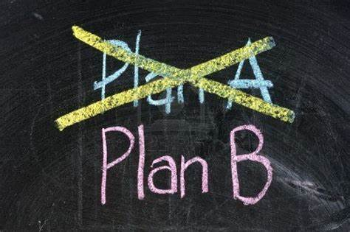

Have a plan and Find alternatives
It's always good to have a plan in place, even if you're not sure you'll use it.
If you think you may need a little extra support for your work or your health, know who to get in touch with and how.
It’s also important to be flexible and get creative to try to find other ways of doing things.
If you're feeling upset because an event you were looking forward to was cancelled, lots of people are now offering virtual ways to enjoy things.
Lots of musicians are live-streaming concerts, you can visit museums across the world virtually and you can watch e-sports if you're missing the football or rugby. Take a look at our beginners guide to getting into e-sports.

Slide 6





Stay connected
Talk to the people who make you feel better. This could be your family or your friends.
If you can, try to get some virtual face-to-face time through apps like FaceTime or Skype. Or set up some new group chats on Facebook Messenger, Snapchat or WhatsApp.
Being part of community like school and clubs can help us feel better overall so find ways to stay connected online like school website, Glow or Twitter

Slide 7

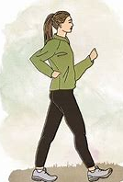

Keep yourself healthy
Getting your basic needs right will help you feel a lot better.
Make sure you're eating as healthy as possible, with plenty of fruit and vegetables, and make sure you're drinking enough water to support your immune function and energy levels. For more information see the BDA website.
Try to get some exercise and avoid staying still too long.
Follow the latest government advice but if you can still go outside and keep away from other people, do so and be active and exercise (yes, going for a walk still counts).
You can also do lots of workouts from your home – NHS and YouTube has a whole bunch of free ones you can try. Exercise and regular movement will maintain fitness and strength. If you are working from home, take breaks and eat away from your “desk.”

Slide 8

Have a good sleep routine
Sleep is really important for our mental and physical health.
Make sure you're getting enough sleep
Avoiding caffeinated drinks such as tea and coffee in the late afternoon and evening
Take a bath /shower
Use blackout curtains
Listening to gentle music
Deep breathing exercise
For more info: https://www.sleepscotland.org/education/sound-sleep/

Slide 9
Things to avoid
Try not to use alcohol, drugs or tobacco to cope with the way you're feeling. All of these things have a negative impact on your mental and physical health. Find out more over on the Choices for Life site.
Speculation and rumours can swirl online, which can make you feel worried or scared. Stick to getting your information from reliable sources. For COVID-19 information, the World Health Organisation website, the NHS website and the UK Government website will be the most up-to-date and accurate.
Remember that it’s fine to not check the news or scroll through endless updates each day. Take some time out and put your phone down for a while. Have a look at #PowerPause campaign for ideas on how to take a break from your screen.

Slide 10
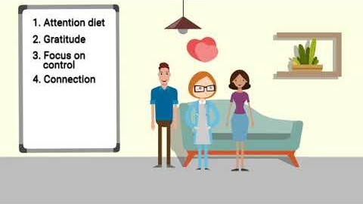
Feeling overwhelmed or Worried?

Slide 11
Managing stress and worries
In this situation, worrying thoughts are normal and it will be difficult to suppress them.
When you are experiencing worries or stress, it’s important and helpful to know what you can control and what you cannot.
You can then focus on what you can control and can do.
Strategies that might help include changing our relationship with those thoughts by noticing them and using strategies such as: • Distraction • Worry time (postpone your worries and set a limited time in a day to think them). • Mindfulness.
You can find out more about the strategies from Grove Signpost here

Slide 12

Talk to someone
If you're finding things particularly difficult, there are lots of services that can help.
Samaritans is open 24/7. You can call them on 116 123 or email them at jo@samaritans.org.
Give us a SHOUT also provide a free text service 24/7 for people feeling anxious, worried or stressed. Just text 85258.
Breathing Space is open 6pm to 2am Monday - Thursday and 24 hours a day on the weekends (Friday 6pm to Monday 6am). You can call them on 0800 83 85 87. If you are a British Sign Language user you can contact them via their online BSL-interpreting video relay service (VRS).
Childline is open 24/7. You can call them 0800 1111 for free even if you don’t have credit on your mobile phone. They also have an online service where you can chat with a counsellor about whatever's worrying you.

Slide 13
Get expert advice
There are lots of mental health charities that provide really useful advice that can help you if you're struggling.
The Mental Health Foundation are providing support to address the mental health aspects of the Coronavirus outbreak alongside other official organisations.
See Me Scotland have lots of advice specifically for young people.
The NHS also has lots of useful tips that can help you look after your mental wellbeing.
You can also get support and information through COOL2TALK (https://cool2talk.org/). Young people (age 12-26) can post any health & well being question & get a response within 24 hours. The 121 counselling will run Monday, Wednesday & Thursday 8-9pm.

