Slide 1

Managing sleep
Introduction to sleep and tips for how to get better sleep

Slide 2

Importance of sleep
Having a good night sleep will help us maintain our wellbeing both physically, mentally and emotionally.
You know and notice that if you don’t get a good night sleep, you are affected physically (e.g. feeling tired), mentally (e.g. feeling less alert and difficult to concentrate) and emotionally (e.g. irritation and experiencing feelings more intensely or challenging to manage)
At this time, during the outbreak and school closure, there are a lot of changes and stress that you have been experiencing; therefore, it is understandable that your sleep may be affected in some ways.

Slide 3
Sleep Facts and Myths quiz
How much do you know about sleep?
Take a true/false quiz to find out more about sleep
(from silvercloud programme)
SKIP

Slide 4
You can catch up on sleep if you miss some the night before.
True
False

Slide 5
You can catch up on sleep if you miss some the night before.
False
You cannot catch up on sleep the day after a bad night sleep. In fact sleeping-in longer will disrupt your sleep cycle and affect your sleep negatively for the following night. It also isn't possible to catch up on sleep you have lost during the week at the weekend. It is best to try to avoid napping in the daytime and stick to your normal routine, even at the weekends
Next

Slide 6
Watching tv or listening to music in bed can help you to drop off.
True
False

Slide 7
Watching tv or listening to music in bed can help you to drop off.
False
Some people without a sleep problem may find this helpful. However, these are stimulating activities and can affect your ability to drop off to sleep. When you have a sleep problem, you need to make sure that you are using your bed only for sleep. This helps your body to associate your bed just with sleeping.
Next

Slide 8
Avoiding blue light, such as the light from a tablet or mobile phone before bed will help with sleeping.
True
False

Slide 9
Watching tv or listening to music in bed can help you to drop off.
True
Blue light, more than any other light, has been found to be a particular problem for sleeplessness. It supresses your body's production of the hormone melatonin, which helps you to achieve sleep. Reducing exposure to blue light sources before bed is important for improving sleep.
Next

Slide 10
8 hours is the magic amount of sleep we need each night.
True
False

Slide 11
8 hours is the magic amount of sleep we need each night. True or False?
False
Sleep requirements vary from person to person. On average, most adults need between 7-9 hours per night to function at their best, across the age spectrum. There is no specific magic number. What matters is how efficient your sleep is and that you wake up feeling refreshed.
Next

Slide 12
Teenagers need more sleep than adults.
True
False

Slide 13
Teenagers need more sleep than adults.
True
During adolescence, teens experience a biological shift to a later sleep/wake cycle. On average, teenagers need 8-10 hours sleep, although again, this varies from person to person. The most important thing is a consistent sleep pattern on school/work days and at weekends, to keep their body clock in sync.
Next

Slide 14
Sleep is good for my body and health but it doesn't affect my intelligence.
True
False

Slide 15
Sleep is good for my body and health but it doesn't affect my intelligence.
False
The effects of sleep loss can often be quite physically apparent. However, some of the most subtle consequences involve on mental processes like learning, memory, judgment and problem solving. Sleep gives the brain time to encode new learning and memory pathways. People who are well rested are better able to learn more likely to remember what they have learned.
Next

Slide 16
Sleep is a period of inactivity for the body.
True
False

Slide 17
Sleep is a period of inactivity for the body.
False
At night, our bodies and brains are actually very busy. A range of function occur at night. During sleep, harmful toxins that build up in the brain during the day are cleansed away. We consolidate memories during sleep. Conservation, repair and growth takes place.
Next

Slide 18
Being tired in the daytime means you need more sleep.
True
False

Slide 19
Being tired in the daytime means you need more sleep.
False
This depends on your individual circumstances. Many people feel tired in the afternoon, due to the body's natural circadian rhythm, despite sleeping well. However, not having a good sleep routine can also make you feel tired in the daytime. Tiredness during the daytime could be a sign that you need better sleep efficiency or a better sleep routine, if you are also managing to sleep but not waking up refreshed, or struggling to get to sleep in the first place.
Next

Slide 20
We need less sleep as we age.
True
False

Slide 21
We need less sleep as we age.
False
It is a common misconception that we need less sleep as we age. Older adults still need on average 7-9 hours sleep per night to function optimally.
Next

Slide 22
In general, most people tend to be satisfied with the amount of sleep that they get every night.
True
False

Slide 23
In general, most people tend to be satisfied with the amount of sleep that they get every night.
False
If you are struggling with your sleep, you are not alone. In a large sleep survey (Dreams 2016), a staggering 63.1% of people reported not getting enough sleep. From the same survey, only 8% were able to say that they wake up feeling refreshed.
Next

Slide 24
Benefits of sleep
According to Sleep Scotland, Sleep allows our bodies to carry out functions that are vital for our physical and mental wellbeing, leading to a whole range of benefits:
  Healthy growth
  Positive mood and sociability
  Better mental health
  Being able to concentrate and doing better at school
  Enjoying life
  Improved immunity and better recovery from illness
  Healthy weight
For more info visit: https://www.sleepscotland.org or https://www.sleepstation.org.uk/articles/

Slide 25

How to get a good night sleep

Slide 26

Sleep at regular times
First of all, keep regular sleeping hours. This programmes the brain and internal body clock to get used to a set routine.
Most adults need 7-9 hours of sleep, while most teenagers need 8-10 hours every night. By working out what time you need to wake up, you can set a regular bedtime schedule.
It is also important to try and wake up at the same time every day. While it may seem like a good idea to try to catch up on sleep after a bad night, doing so on a regular basis can also disrupt your sleep routine.

Slide 27

Make your bedroom sleep-friendly
Your bedroom should be a relaxing environment. Experts claim there's a strong association in people's minds between sleep and the bedroom. Make sure your bed and mattress is comfortable.
However, certain things weaken that association, such as TVs, smartphones and other electronic gadgets. Keep your bedroom just for sleep.
Keeping room temperature between 18C and 24C would help. Keeping your feet warm enough is also important.
Your bedroom ideally needs to be dark, quiet and tidy. Fit some thick curtains if you do not have any or use eye mask.
If you're disturbed by noise, consider investing in double glazing or, for a cheaper option, use earplugs.

Slide 28


Go outdoor and Be active during the day
Getting adequate exposure to daylight during the day can help keep your body clock and melatonin levels in check.
In the mornings, daylight triggers the production of a hormone called cortisol, which wakes us up and makes us feel alert. At the end of the day, when it starts to get dark, our cortisol levels drop and another hormone, melatonin (sometimes known as the ‘sleepy hormone’), increases helping us to feel ready for sleep.
Try to schedule in some time outdoors every day while following the latest government guidelines. Just going for a walk will help improve sleep two-fold: it can help regulate your body clock and exercising also leads to deeper and more restful sleep.
Moderate exercise on a regular basis can help relieve some of the tension built up over the day. But make sure you do not do vigorous exercise, such as running, too close to bedtime, as it may keep you awake.
Find out more about how to get active your way and NHS fitness video

Slide 29

Think Healthy habits for your body
Cut down on caffeine
Cut down on caffeine in tea, coffee, energy drinks or colas, especially in the evening. Caffeine interferes with the process of falling asleep, and also prevents deep sleep. Instead, have a warm, milky drink or herbal tea.
Do not over-indulge
Too much food or alcohol, especially late at night, can interrupt your sleep patterns. Alcohol may help you to fall asleep initially, but it will disrupt your sleep later on in the night.
Do not smoke
Nicotine is a stimulant. People who smoke take longer to fall asleep, wake up more frequently, and often have more disrupted sleep.

Slide 30
Have a Bedtime routine to unwind & relax
If you have difficulty falling asleep, a regular bedtime routine will help you wind down and prepare for bed.
Your routine depends on what works for you, but the most important thing is working out a routine and sticking to it.
There are lots of ways to relax:
  A warm bath (not hot) will help your body reach a temperature that's ideal for rest
  Writing "to do" lists for the next day can organise your thoughts and clear your mind of any distractions
  Relaxation exercises, such as light yoga stretches, help to relax the muscles. Do not exercise vigorously, as it will have the opposite effect
  Relaxation CDs/audio clips work by using a carefully narrated script, gentle hypnotic music and sound effects to relax you
  Reading a book or listening to the radio can relax the mind by distracting it but be careful not to stimulate your mind

Slide 31
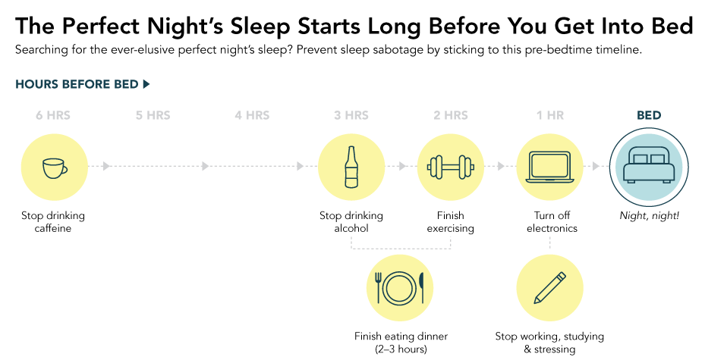

Slide 32
How to Calm Your Worries and Sleep Better
If you cannot sleep, get up
  If you cannot sleep, do not lie there worrying about it. Get up and do something you find relaxing until you feel sleepy again, then go back to bed.
Write away your worries
  If you tend to lie in bed thinking about everything you have to do tomorrow, set aside time before bedtime to make plans for the next day. The aim is to avoid doing these things when you're in bed, trying to sleep.
The NHS Apps Library has sleep apps that can help you.

Slide 33
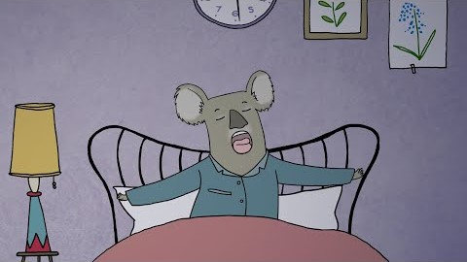
https://youtu.be/FulTaDhEtDY

Slide 34

Relaxation Techniques
There are different types of relaxation techniques that could help the body and mind to unwind.
You can try one called progressive muscle relaxation.
There are a number of apps designed to help with sleep. See the NHS Apps Library
You can also try the link below:
https://www.sleepscotland.org/new/wp-content/uploads/2019/10/Relaxation-techniques.pdf
https://youtu.be/9GURt2pvdAg

Slide 35
Sleep checklist
Check out the list to see if you can improve your sleep in any way.
Use the link below:
https://www.sleepscotland.org/new/wp-content/uploads/2019/10/How-to-sleep-well-checklist.pdf

Slide 36

Talk to someone
If you continue to have a problem with sleep that is affecting your daily life, contact your GP.
If you're finding things particularly difficult, there are lots of services that can help.
Samaritans is open 24/7. You can call them on 116 123 or email them at jo@samaritans.org.
Give us a SHOUT also provide a free text service 24/7 for people feeling anxious, worried or stressed. Just text 85258.
Breathing Space is open 6pm to 2am Monday - Thursday and 24 hours a day on the weekends (Friday 6pm to Monday 6am). You can call them on 0800 83 85 87. If you are a British Sign Language user you can contact them via their online BSL-interpreting video relay service (VRS).
Childline is open 24/7. You can call them 0800 1111 for free even if you don’t have credit on your mobile phone. They also have an online service where you can chat with a counsellor about whatever's worrying you.

