Slide 1

Grove Academy
Primary to Secondary Transition
Information Evening
Wednesday 20 January 2016
Notes:
Good Evening and Welcome to Grove.

Slide 2

Programme for this evening
Grove Academy
Our Values: Honesty, Respect, Responsibility, Fairness, Determination
The Transition Process
About Grove Academy
Parent and Carer visit to departments
Finish at 8pm

Slide 3
Partnership
Pupils
School staff
Parents and carers
Grove Academy
Our Values: Honesty, Respect, Responsibility, Fairness, Determination

Slide 4
Supporting the Process
Peer Supporters and S6 Buddies
Support for Learning and Guidance Teachers
Tutors Teachers and Pupil Support Workers
School Support Workers
Grove Academy
Our Values: Honesty, Respect, Responsibility, Fairness, Determination

Slide 5
Timetable of Events-January to May
Parent and Carers Information Evening
S2 Peer Supporter visits
Pupil Transition Information Team
SfL and Guidance liaison
Guidance Teacher visit P7s
Grove Academy
Our Values: Honesty, Respect, Responsibility, Fairness, Determination

Slide 6
Timetable of Events- June onwards
S1 Induction days 6, 7, 8 June
Parent and Carer Information Evening, 8 June
August- PSHE and Tutor Time Programme
Grove Academy
Our Values: Honesty, Respect, Responsibility, Fairness, Determination

Slide 7
The roles people play
P7 Pupils
Primary and secondary school staff
and pupils
Parents and carers
Grove Academy
Our Values: Honesty, Respect, Responsibility, Fairness, Determination

Slide 8
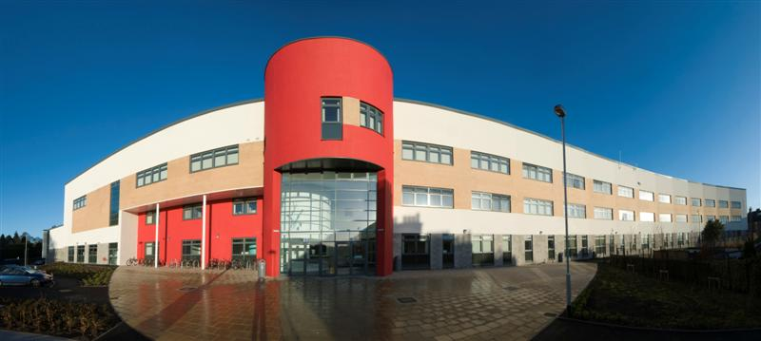
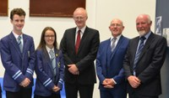
New Environment
New Classmates
New subjects
New opportunities
Grove Academy
Our Values: Honesty, Respect, Responsibility, Fairness, Determination

Slide 9
Curriculum for Excellence
S1-3
Broad General Education
S4-6
Senior Phase
Grove Academy
Our Values: Honesty, Respect, Responsibility, Fairness, Determination

Slide 10
Curriculum Areas
Primary
Languages/Literacy
Mathematics/Numeracy
Health and Wellbeing
Sciences
Expressive Arts
Secondary
English
German/French
Mathematics
Social Education
Tutor Time
HE
PE
Science
Art and Design
Music
Drama
PE
Grove Academy
Our Values: Honesty, Respect, Responsibility, Fairness, Determination

Slide 11
BGE Curriculum
Subject S1 S2
English 4 4
German/French 3 3
Mathematics 4 4
Science 4 3
Social Subjects 3 4
Computing 1 1
Business Enterprise 1 1
Technical 1 2
HE 2 1
Art and Design 2 1
Music 1 2
PE 2 2
RMPE 1 1
Social Education 1 1
30 30
Grove Academy
Our Values: Honesty, Respect, Responsibility, Fairness, Determination

Slide 12
Curriculum Areas
Primary
Social Subjects
Technologies
Religious and Moral Education
Secondary
Geography
History
Modern Studies
CDT
HE
Computing
Business Studies
RMPE
Grove Academy
Our Values: Honesty, Respect, Responsibility, Fairness, Determination

Slide 13
BGE Curriculum
Subject S3
English 4
German/French 3
Mathematics 4
1 Science 2
1 Social Subjects 2
1 Technology 2
1 Expressive Arts 2
plus 3 from these 4 categories 6
PE 2
RMPE 1 10 subjects plus core
Social Education 1
IDL 1
30
Grove Academy
Our Values: Honesty, Respect, Responsibility, Fairness, Determination

Slide 14
Senior Phase
6 Courses in S4
5 courses in S5
A meaningful curriculum in S6 (minimum 4 courses)
EMPLOYABILITY
SQA Courses (Nat 4, Nat 5, Higher, Advanced Higher)
Apprenticeships Pathways (Plumbing/Electrical/Finance/ Engineering/ Social Care))
D & A College Link courses
HNC (Computing) / HND
Ethical Hacking and Cyber Security (NPA)
Life-saving and Fitness Instructor Awards
Childcare
Grove Academy
Our Values: Honesty, Respect, Responsibility, Fairness, Determination

Slide 15
Typical S1 Day
Wednesday
Tutor Time Mrs Tonner
Period 1 German Miss Smith
Period 2 Modern Studies Miss Dow
Interval
Period 3 Music Miss Gordon
Period 4 Technical Mr Bell
Lunch
Period 5 English Miss Gunning
Period 6 Science Mr Sultan
Grove Academy
Our Values: Honesty, Respect, Responsibility, Fairness, Determination

Slide 16
Important Areas
Grove Academy
Our Values: Honesty, Respect, Responsibility, Fairness, Determination
Home Learning
Assessment/Reporting
Discipline
Uniform

Slide 17
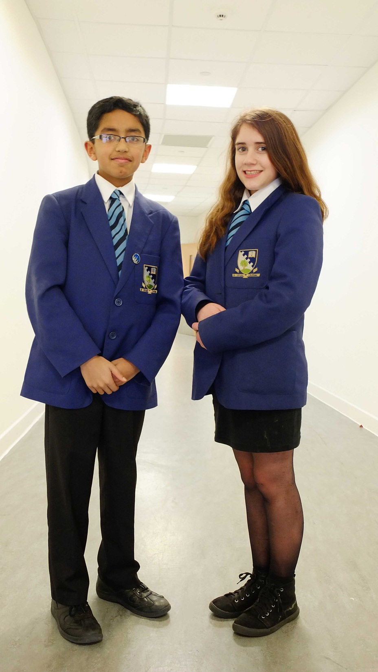
Grove Academy
Our Values: Honesty, Respect, Responsibility, Fairness, Determination

Slide 18
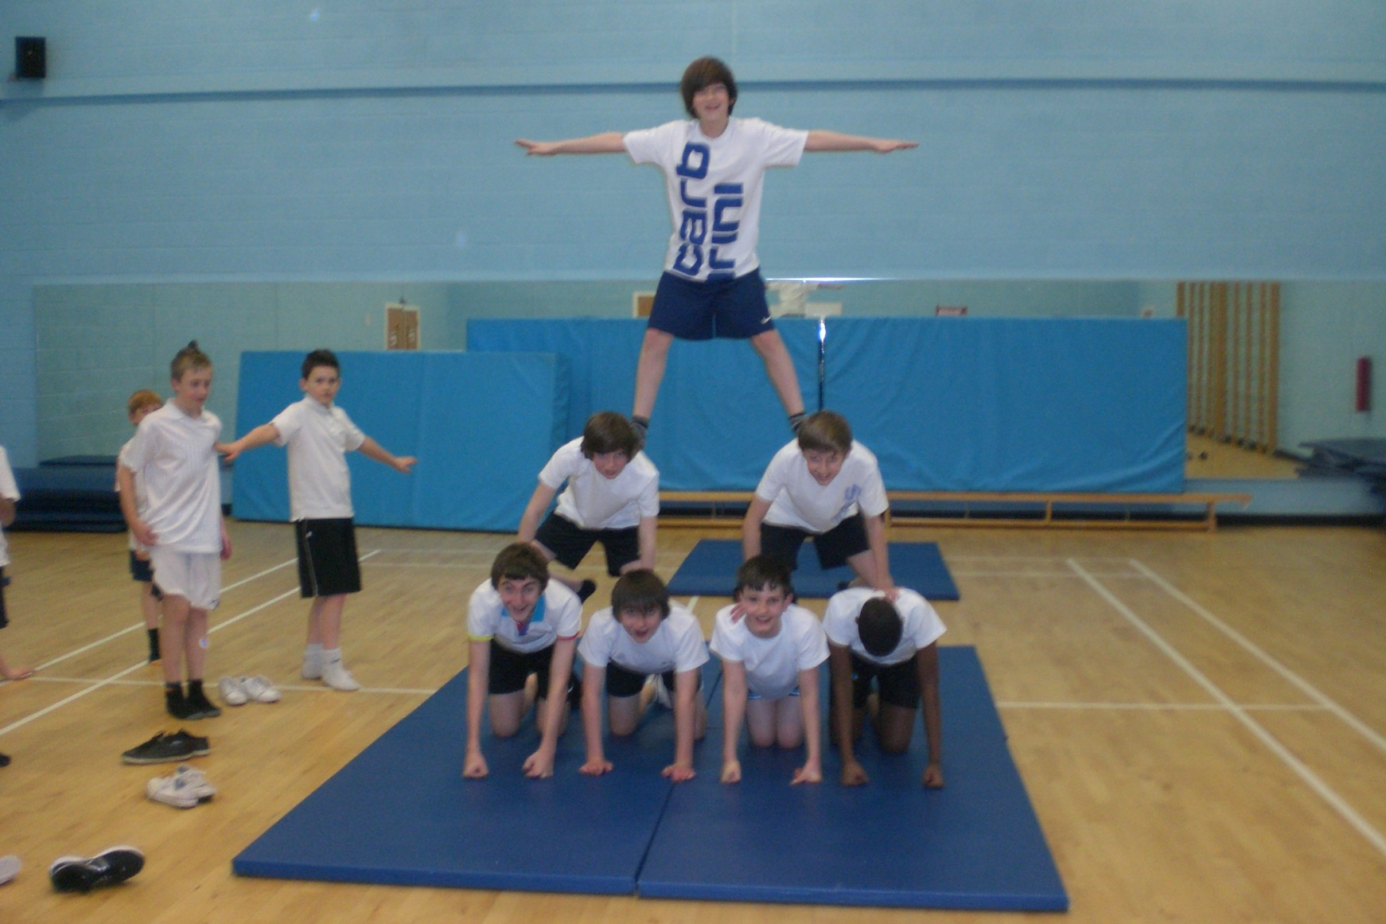
Grove Academy
Our Values: Honesty, Respect, Responsibility, Fairness, Determination

Slide 19
Extra-Curricular Activities
Grove Academy
Our Values: Honesty, Respect, Responsibility, Fairness, Determination
Music
  Instrumental tuition
  Regional orchestras and bands
  School orchestras, bands, choirs and ensembles
  Music Festival
  School shows
Sports
Hockey Football Badminton
Basketball Volleyball Netball
Dance Athletics Cricket
Swimming Rugby Golf
Tennis Fitness Gym House Competitions

Slide 20
Extra-Curricular Activities
Duke of Edinburgh Award
Science Club
Creative Writing
Code Club
Peer Supporters
Computer Club
Chess Club
Scripture Union
Debating
Eco schools
Grove Academy
Our Values: Honesty, Respect, Responsibility, Fairness, Determination

Slide 21
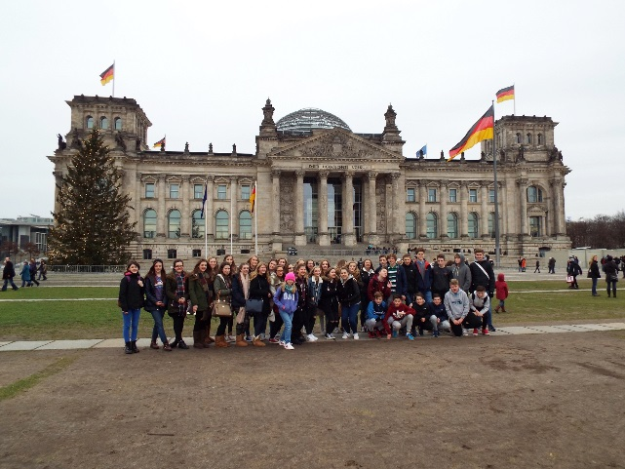
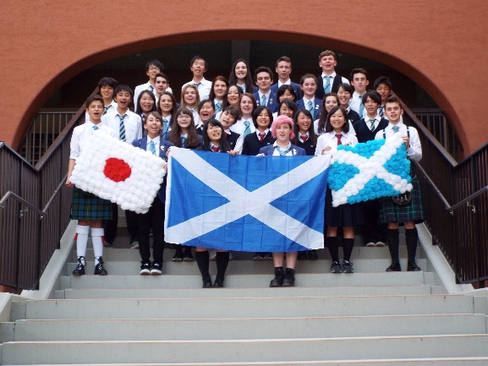
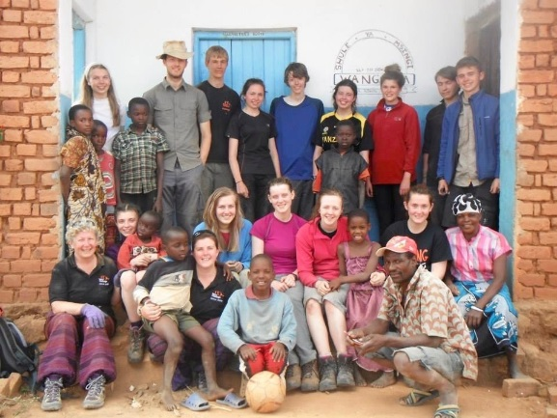
Foreign Excursions
S3 German/RMPE Trip to Berlin
S3/5 Music/ Modern Studies Trip to USA
Art and Design/Modern Studies/ Music Trip to London
Auschwitz
Japan Exchange
Kenya Exchange
World Challenge/CAMPS
Grove Academy
Our Values: Honesty, Respect, Responsibility, Fairness, Determination

Slide 22
Trips
Theatre Visits
Film Showings
Field Trips
Subject Conferences
University Lectures
Grove Academy
Our Values: Honesty, Respect, Responsibility, Fairness, Determination

Slide 23
PERFORMANCE IN NATIONAL EXAMINATIONS
S4 (2014) – New National Qualifications (N4/5)
National 4: Pass rates
2014 2015
  National: 93% 93%
  Dundee: 94% 90%
  Grove Academy 90% 90%
National 5: Pass rates (A-C)
  National: 81% 80%
  Dundee: 81% 77%
  Grove Academy 92% 91%
Grove Academy
Our Values: Honesty, Respect, Responsibility, Fairness, Determination

Slide 24
SQA Results
S5 | 2011 | 2012 | 2013 | 2014 | 2015
1+ Higher | 76 | 70 | 68 | 69 | 75
3+ Higher | 49 | 49 | 49 | 48 | 51
5+ Higher | 28 | 27 | 26 | 28 | 29
Grove Academy
Our Values: Honesty, Respect, Responsibility, Fairness, Determination
Notes:
Down a bit on last year – BUT quality of the 55% @ 5+ Credits was not great – many Grade 2s – kind of expected.
Still 3rd best results ever. 5 + Highers could all be at C – 4 Highers at A and and Int 2 at A – do not count, but actually more points 240 cf 330

Slide 25
Leavers’ Destinations
Grove Academy 95.7%
Dundee 91.11%
Scotland 92.57%
Grove
  Higher Education 55.91%
  Further Education 24.73%
  Employment 12.37%
  Training 1.61%
  Voluntary Work 1.08%
Grove Academy
Our Values: Honesty, Respect, Responsibility, Fairness, Determination

Slide 26
Pupil Achievements
Burgess Short Story Competition
Instrumentalist of Year - 3 out of 6 finalists
Vocalist of the Year - Michael Strachan + 4 other finalists
National Youth Jazz Orchestra – 2 pupils
Grove Academy
Our Values: Honesty, Respect, Responsibility, Fairness, Determination

Slide 27
Pupil Achievements
  Dundee Cross-Country and Athletics Champions
  S3/4 Basketball Champs
  S/6 girls’ netball won regional Championships (6th year in row)
  Football – all years won the Cup!
  Andrew Merry won U18 Scottish schools Aquathon
  Our dance Group “Explosion” won National schools Dance Competition
Grove Academy
Our Values: Honesty, Respect, Responsibility, Fairness, Determination

Slide 28
Pupil Achievements
Calum Garden – captain of the U15 Scotland Cricket team
Niamh Harper – represented Scotland and UK at Sailing
Keir Robb – in GB squad for Downhill Ski-ing
Hamish Rice – Scotland U16 Hockey squad
Kerry Nicol – Scotland U18 Hockey squad
Michael King – represented Scotland in Diving
Raymond Paterson – represents Scotland in Trampolining
Mark Smith –Scotland U18 International squad
Jessica Scott- U12 Scotland In-line Puck Hockey Squad
Grove Academy
Our Values: Honesty, Respect, Responsibility, Fairness, Determination

Slide 29
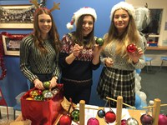
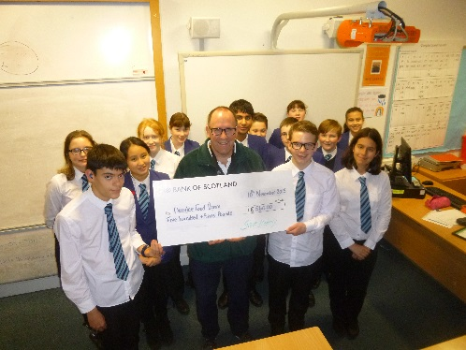
Pupil Achievements
  Joe Grundy and Heather Taylor Waterfront Project
  Christmas Fayre
  Cyclathon £500 for Dundee Food Bank
Grove Academy
Our Values: Honesty, Respect, Responsibility, Fairness, Determination

Slide 30
Values
School Improvement
  Improve Attainment and Wider Achievement
  Improve the Impact on Learners
  Improve the delivery of the Curriculum
  Improve Self-Evaluation
Grove Academy
Our Values: Honesty, Respect, Responsibility, Fairness, Determination

Slide 31

Vision
Grove Academy
Our Values: Honesty, Respect, Responsibility, Fairness, Determination

Slide 32

Values
Grove Academy
Our Values: Honesty, Respect, Responsibility, Fairness, Determination

Slide 33
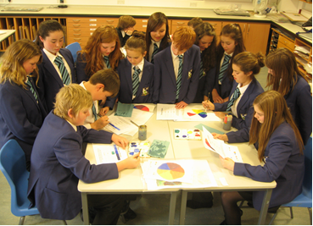
Values
Grove Academy
Our Values: Honesty, Respect, Responsibility, Fairness, Determination

Slide 34
Values
Grove Academy
  Thank you for listening.
  Questions?
  grove@dundeecity.gov.uk
Grove Academy
Our Values: Honesty, Respect, Responsibility, Fairness, Determination

