Slide 1

Positive mental health
Polly jones
Dundee Educational psychology service
March 2017

Slide 2
Setting the scene
Most of us will experience periods of stress, anxiety, or depression at certain times in our lives.
It’s a normal response to adverse life-events, periods of pressure or distressing experiences.
1 in 4 people will experience some kind of mental health problem in the course of a year.

Slide 3
Never had it so good?
http://www.abc.net.au/4corners/stories/2015/11/16/4350533.htm [2.15]
Family breakdown
Pressure to have money, the perfect body and lifestyle due to an increasingly materialist culture
Increased use of photoshop creating unachievable standards of beauty and fitness
24 hr social networking, FOMO, ‘need’ to maintain an online presence
Exposure to inappropriate online content from a young age including pornography
Increasing sexual pressures /early sexualisation
Bullying on and offline
Exposure to violence, sexism in online games and music videos
Fear of crime/terrorism, rolling news
University entry more competitive and expensive, less clarity or security about employment options.

Slide 4
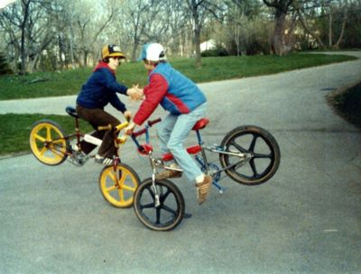
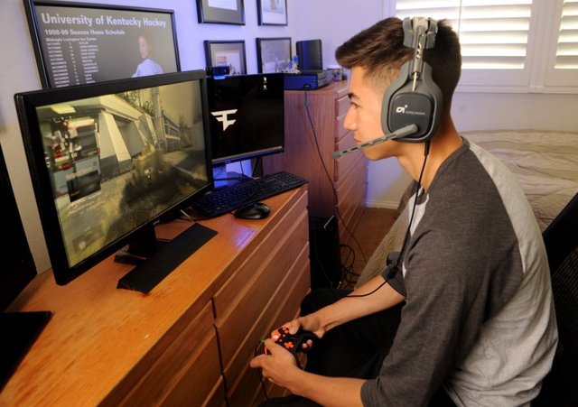

Slide 5
Pornography
1.4 million people under the age of 18 in the UK visited porn sites in one month in 2015 (Department of Culture, Media and Sport, 2016)
90% of young people have smartphones, the most common way of accessing internet pornography today. 40% of young people admit to viewing porn on their own or friends’ phones
Online porn content is often more extreme in terms of sexual practices, and even violent, with women in the films reacting neutrally or with simulated enjoyment.
The more often young people seek out online porn, the more likely they are to have a "recreational" attitude toward sex--specifically, to view sex as a purely physical function like eating or drinking.
Studies have also found a relationship between porn use and the belief that it wasn't necessary to have affection for people to have sex with them http://www.apa.org/monitor/nov07/webporn.aspx

Slide 6
So...

Slide 7
"Happiness is not something ready made. It comes from your own actions"
- Dalai Lama

Slide 8
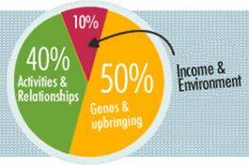
Happiness is not set in stone
Although our genes influence about 50% of the variation in our personal happiness, our circumstances (like income and environment) affect only about 10%.
As much as 40% is accounted for by our daily activities and the conscious choices we make. So the good news is that our actions really can make a difference

Slide 9
Mental Health:
A state of wellbeing in which the individual realises his or her own abilities, can cope with the normal stresses of life, can work productively and fruitfully and is able to make a contribution to his or her community.
World Health Organisation
Definition adopted by Scottish Executive in ‘The Mental Health & Wellbeing of Children & Young People: A Framework for Promotion, Prevention & Care’

Slide 10

What is good mental health?
People who are mentally healthy have:
A sense of contentment
A zest for living, the ability to laugh and have fun.
The ability to deal with stress and bounce back from adversity= RESILIENCE
A sense of meaning and purpose, in both their activities and their relationships.
The flexibility to learn new things and adapt to change.
A good balance between work and play, rest and activity, etc.
The ability to build and keep fulfilling relationships.
Self-confidence and high self-esteem.

Slide 11
The concept of resilience
Being mentally healthy doesn't mean never going through bad times and having emotional problems.
Disappointments, loss, and change are normal parts of life which can cause sadness, anxiety, and stress.
But people with strong mental health are better able to adapt, adjust and bounce back from adversity. This is called resilience.
Notes:
https://www.youtube.com/watch?v=_y97VF5UJcc

Slide 12
Resilience
1. the capacity to recover quickly from difficulties; toughness.
2. the ability of a substance or object to spring back into shape; elasticity.
synonyms: flexibility, suppleness, plasticity, elasticity, springiness, give.

Slide 13
Resilience videos
https://www.youtube.com/watch?v=1v9XeApSYNY resilience and coping for parents of teens
https://www.youtube.com/watch?v=KF2hQ0XLf6U explaining resilience and coping to teenagers

Slide 14
Resilience and attainment
Personal resilience predicts educational performance better than IQ, because it protects cognitive ability (concentration, memory, decision making and important executive skills).
Even relatively mild levels of psychological distress can have a negative impact on cognitive function and performance

Slide 15
Notes:
Where are you? Your family? Your child?

Slide 16
Risk factors
Genetic make-up e.g. a family history of mental illness
Severe, traumatic early life experiences including abuse
Living in poverty
Severe family conflict and poor communication within families
Cognitive vulnerability - negative patterns of thinking, perfectionism, fixed mindset, negative self-talk, a habit of worry and rumination (repetitive negative thinking)
Intolerance of uncertainty and inflexibility (sometimes due to a developmental disorder such as autism) along with certain behavioural patterns (avoidance or withdrawal)
Chronic, accumulative stress such as a loss, divorce, domestic violence, unemployment, job dissatisfaction, a chronic medical condition…..
Sense of helplessness and hopelessness
Chronic poor sleep
Misuse of substances (especially with a family history of mental illness)
Notes:
concept of a risk factor from a fixed, specific circumstance or life stress to a broader, more general phenomenon that may be modifiable, or malleable, and related to a developmental phase
Risk factors are those characteristics, variables, or hazards that, if present for a given individual, make it more likely that this individual, rather than someone selected at random from the general population, will develop a disorder
Risk factors can reside with the individual or within the family, community, or institutions that surround the individua

Slide 17
Risk Factors
Gender
In the prenatal period and first 10 years of life, boys are more likely than girls to be vulnerable to both physical and psychosocial stressors. In the second decade, girls appear to be more vulnerable to psychosocial stressors, and in early adulthood men once again appear to be more vulnerable (Werner and Smith, 1992)
Werner, E. E.; Smith, R. S. (1992) Overcoming the Odds: High Risk Children from Birth to Adulthood. New York, NY: Cornell University Press.

Slide 18
Protective factors
Easy temperament
The presence of a supportive adult and a positive warm bond between parent and child in early childhood
Good interpersonal relationships, a strong sense of self
A positive cognitive style (which can be learned). Think good, feel good
Emotional literacy (the ability to manage emotions and understand the relationship between mood, thoughts and behaviour)
Regular exercise and good social support (the right kind for you!)
Hobbies and interests and skills

Slide 19
Lots of tools to assess risk/protective factors
Getting It Right for Every Child (GIRFEC) well-being indicators: SHANARRI and the ‘My world’ triangle
Maslow’s hierarchy of needs
Boing Boing’s resilience framework (a not-for-profit organisation which supports resilience-based practice)
Human Givens emotional needs audit
Action for Happiness 10 keys
Bounce Back
etc
Common themes between them

Slide 20
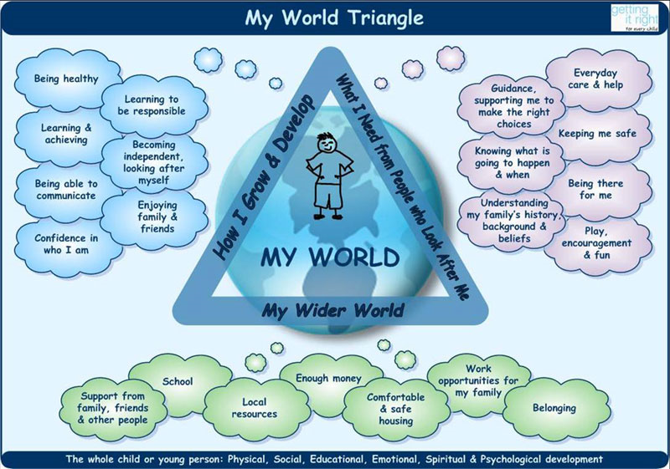

Slide 21
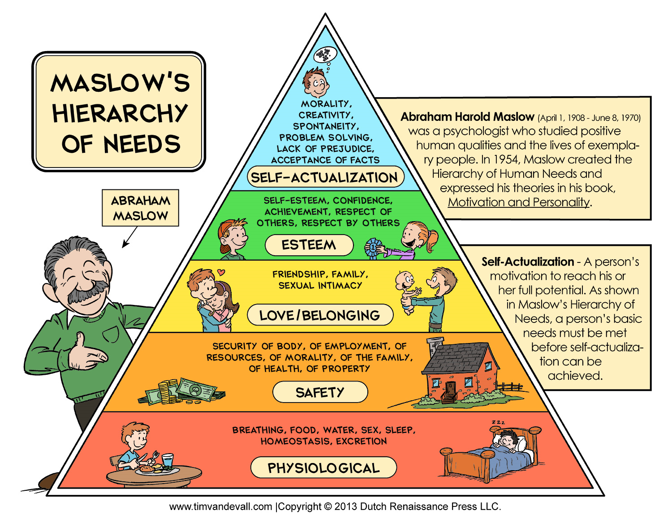

Slide 22
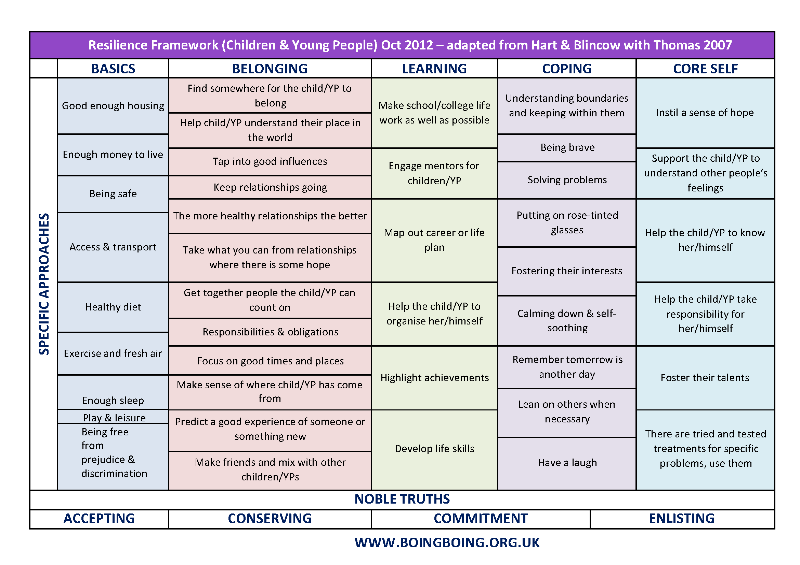

Slide 23
Human Givens Therapy emotional needs
Security — safe territory and an environment which allows us to develop fully
Attention (to give and receive it) — a form of nutrition
Sense of autonomy and control — having volition to make responsible choices
Emotional intimacy — to know that at least one other person accepts us totally for who we are, “warts 'n' all”
Feeling part of a wider community
Privacy — opportunity to reflect and consolidate experience (more if you are introverted)
Sense of status within social groupings
Sense of competence and achievement
Meaning and purpose — which come from being stretched in what we do and think.

Slide 24
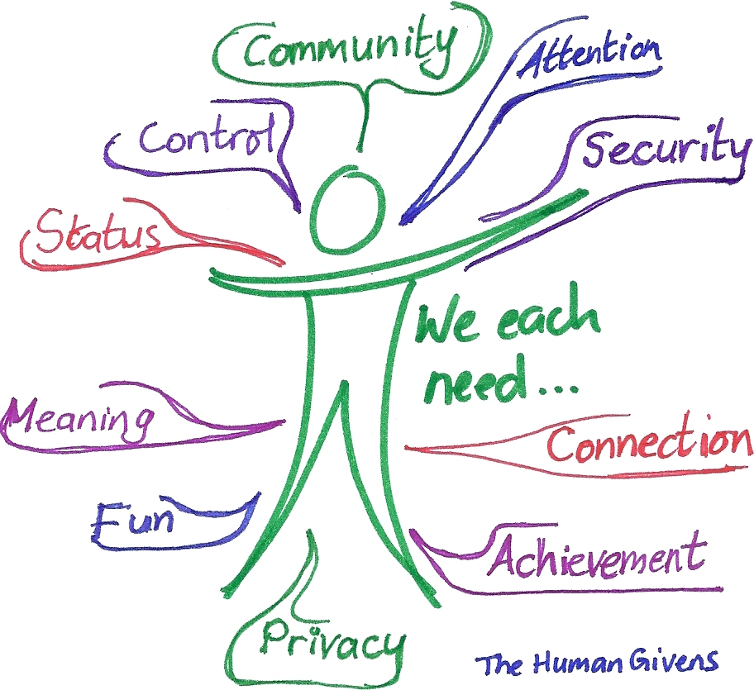

Slide 25
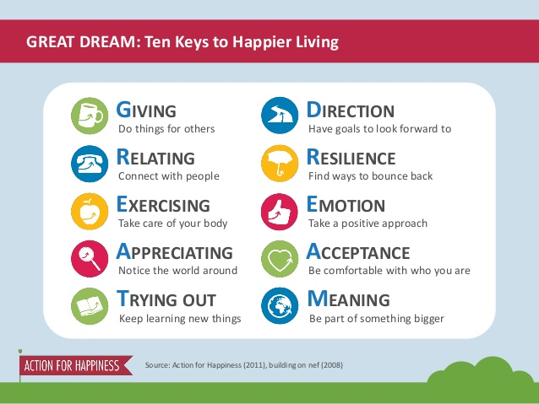

Slide 26

“The pursuit of meaning and engagement are much more predictive of life satisfaction than the pursuit of pleasure.
Peterson, Park & Seligman (2005)
Notes:
Much more than happy clappy! Positive Psychology has seen a shift in emphasis from ‘happiness’ towards meaning and purpose.

Slide 27
Bounce Back framework
Bad feelings always go way again.
Other people can help you feel better if you talk to them
Unhelpful thinking makes you feel more upset (and you can change it).
Nobody is perfect. Mistakes help you learn (growth mindset)
Concentrate on the good things and have a laugh (helpful thinking habits, gratitude)
Everybody feels sad and worried sometimes, not just you
Blame fairly- how much of what happened was because of you, how much was because of others and how much was because of bad luck or circumstances?
Accept the things you can’t change, but try to change what you can (and know the difference!)
Catastrophising exaggerates your worries. Don’t believe the worst possible picture.
Keep things in perspective. It’s only one part of your life.

Slide 28
Activity: Energy Exercise
On your own, think about your life in energy terms. Think about the situations, places, people and activities that inspire you and give you energy, the things that make you feel great to be alive. Think also about those aspects that least energise and inspire you.
Most Energising, Inspiring
Least Energising, Inspiring
Notes:
5 minutes

Slide 29
Sleep
Poor sleep is linked to a greater risk of obesity, lower immunity, a lack of emotional control, poor school performance, and mental health issues.
Adolescents need about 9 hours of sleep a night. The vast majority do not get that amount, particularly on weeknights.
Blue light emitted by smartphones, tablets and TVs is known to reduce the production of melatonin, the hormone that makes us feel sleepy
Fizzy drinks high in sugar and caffeine also make it harder for children to switch off at night
GET SCREENS OUT OF BEDROOMS AT NIGHT TIME.

Slide 30
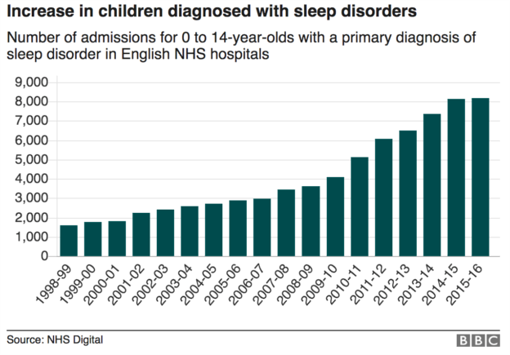

Slide 31
Sleep
Make bedrooms a sleep haven. Keep cool, quiet and dark. Try eyeshades, earplugs or blackout curtains. Let in bright light in the morning to signal your body to wake up.
Avoid caffeine close to bedtime.
Establish a bed and wake-time and stick to it, coming as close as you can on the weekends. A consistent sleep schedule allows your body to get in sync with its natural patterns.
Don’t eat, drink, or exercise within a few hours of your bedtime. Don’t leave homework for the last minute.
Avoid any screen time in the hour before you go to bed. Stick to quiet, calm activities
Do the same things every night before you go to sleep, to teach your body the signals that it’s time for bed.
Try taking a bath or shower (this will leave you extra time in the morning), or reading a book.
Try keeping a diary or to-do list. If you jot notes down before you go to sleep, you’ll be less likely to stay awake worrying or stressing.

Slide 32
Think Good, Feel Good
Thinking traps http://youth.anxietybc.com/thinking-traps
‘Red’ to ‘green’ thoughts http://www.child-youth.friendsparentprogram.com/red-thoughts-green-thoughts
Growth mindset https://www.youtube.com/watch?v=KUWn_TJTrnU

Slide 33
Things to try as a family
Screen detox
Good sleep hygiene
Get outside
Connection -fun and laughter
Positive problem-solving
Talking. There’s no substitute. Connect with what THEY enjoy
Challenge thinking traps
Promote and model a growth mindset
Random Acts of Kindness
Three blessings exercise

Slide 34
Parents survival guide from Young Minds
http://www.youngminds.org.uk/for_parents/parents_guide

Slide 35
Further reading and resources
http://www.handsonscotland.co.uk/ helping children flourish/help with troubling behaviours
www.anxietybc.com/youth understanding anxiety, lots of practical tools
http://www.youngminds.org.uk/ charity committed to improving the emotional wellbeing and mental health young people, wide range of resources and a helpline
http://www.cool2talk.org/ a safe online space for advice for teens
www.rewardfoundation.org understanding effects of porn on healthy development
www.cwmt.org.uk Charlie Waller Trust- raising awareness, fighting depression
https://www.papyrus-uk.org/ prevention of youth suicide
https://www.helpguide.org/articles/emotional-health/improving-emotional-health.htm 6 Strategies to Boost Mood, Build Resilience, and Increase Happiness
http://www.actionforhappiness.org/ movement of people committed to building a happier and more caring society
Notes:
Look at flourishing sections – charated strengths, confidence, creativity, emotional balance

Slide 36
Further reading
Boing Boing resilience framework http://www.boingboing.org.uk/images/stories/resilience%20framework%20-%20children%20and%20young%20people%20new%20v2.png
www.anxietybc.com advice and resources for parents and young people on manging anxiety
http://www.nhs.uk/Livewell/Childrenssleep/Pages/bedtimeritual.aspx
Assess your happiness
a) Your overall level of happiness with life (General Happiness Survey):
www.authentichappiness.sas.upenn.edu/tests/GeneralTest_t.aspx?id=250
b) Your current mood (Positive and Negative Affect survey, PANAS):
www.authentichappiness.sas.upenn.edu/tests/SameAnswers_t.aspx?id=286
http://ppc.sas.upenn.edu/ positive psychology centre that scientifically studies strengths that enable people and communities to thrive and produced the https://www.authentichappiness.sas.upenn.edu/

