Slide 1

Shiell st. community garden
Summary 2018

Slide 2

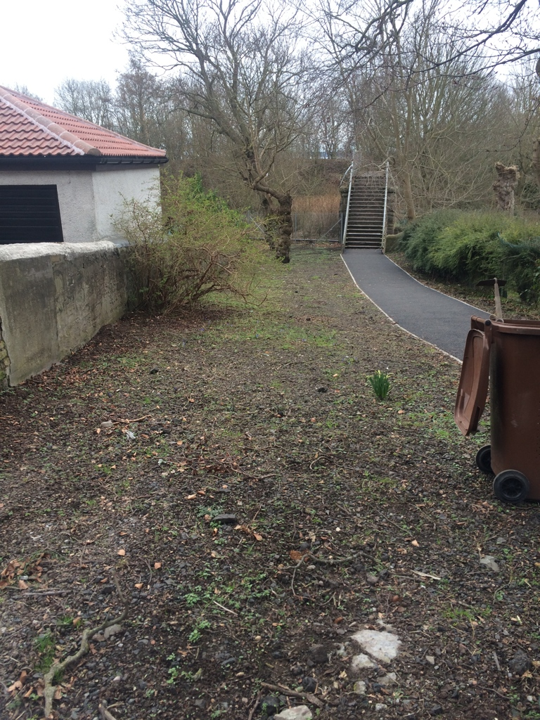
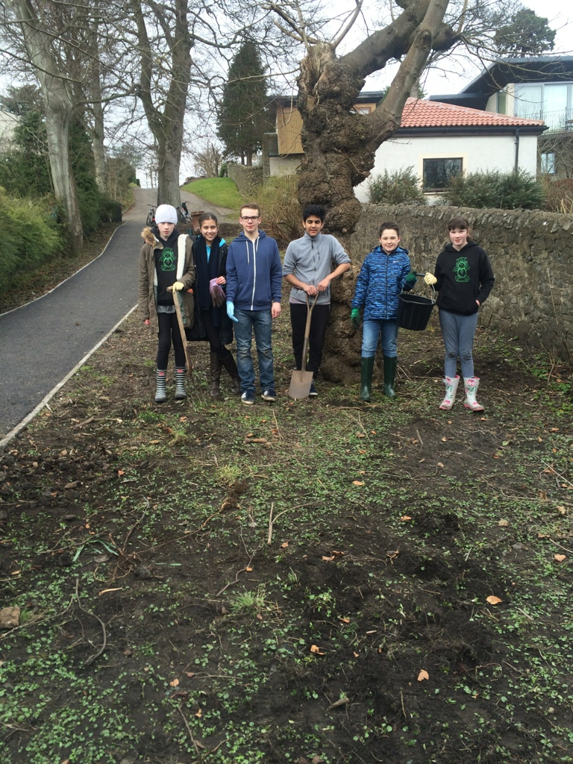
Starting off – we take over this patch of land
The land after we cleared it.
The team of helpers.

Slide 3
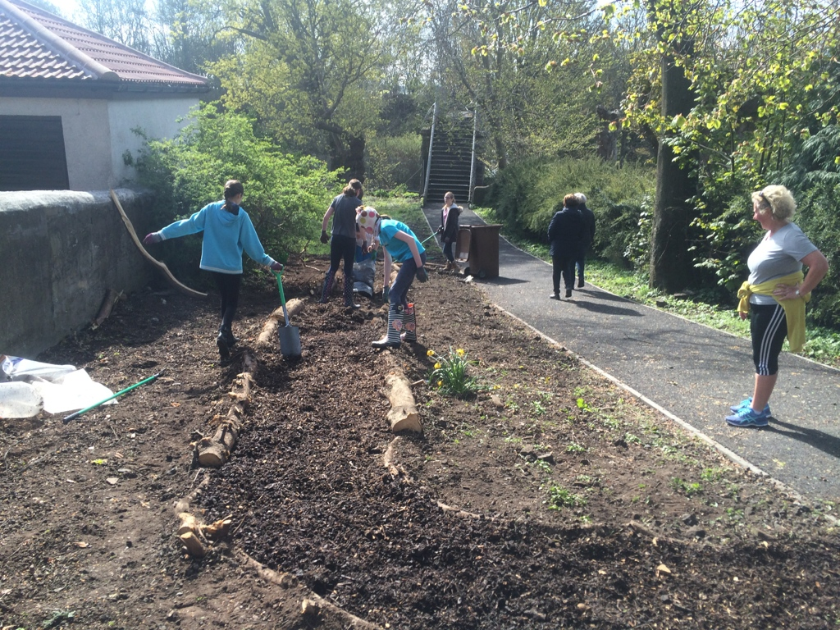
Next - We add a path
This is us busy making the path.

Slide 4
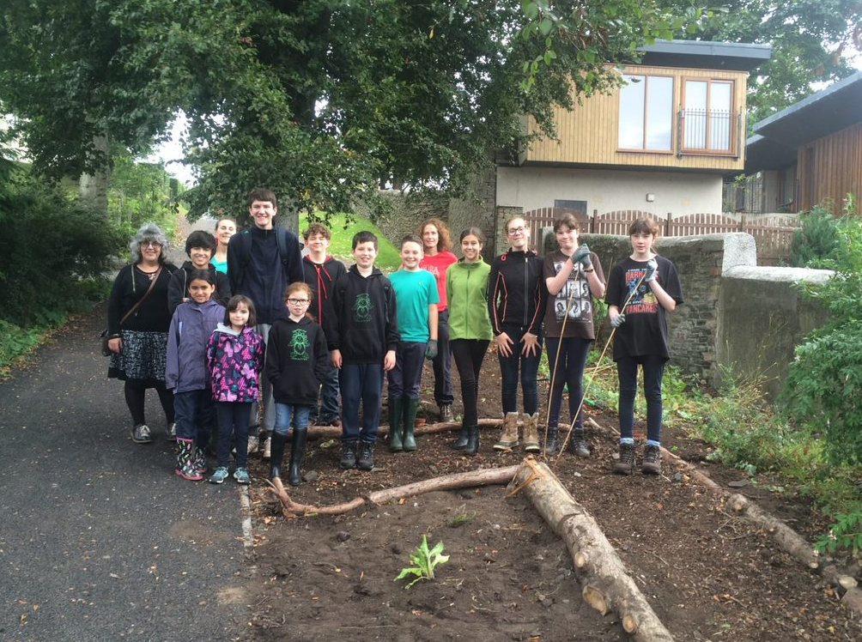
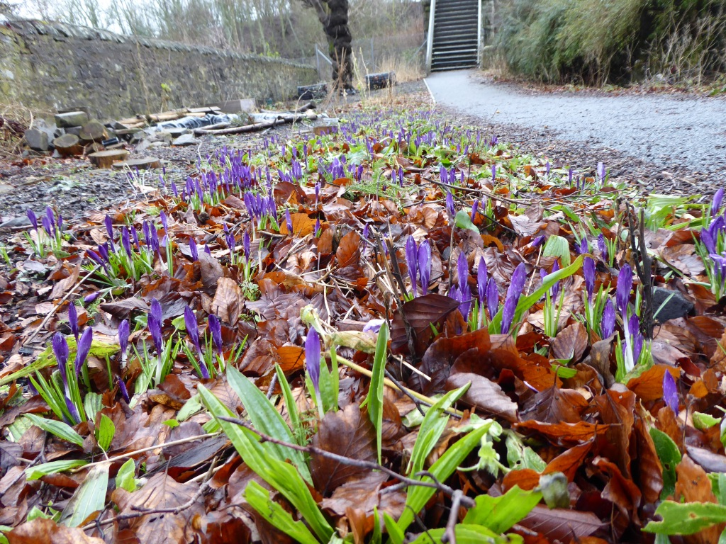
We worked with the ‘nature nutters’
This is us with the ‘Nature Nutters’.
The Crocuses next Spring.

Slide 5
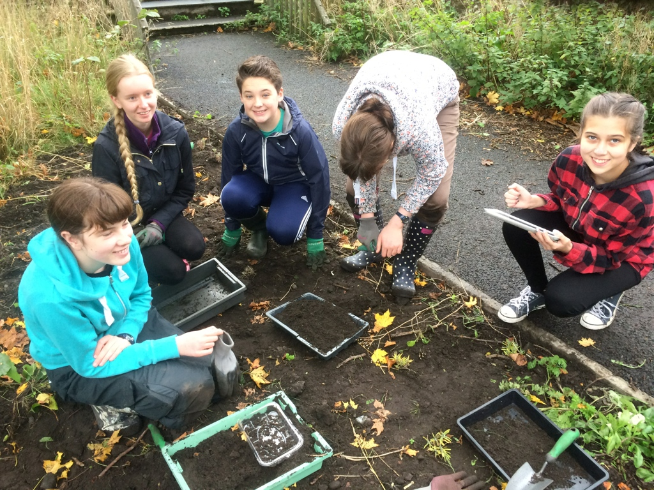
We took part in the what's under your feet survey
Taking part in the survey.

Slide 6
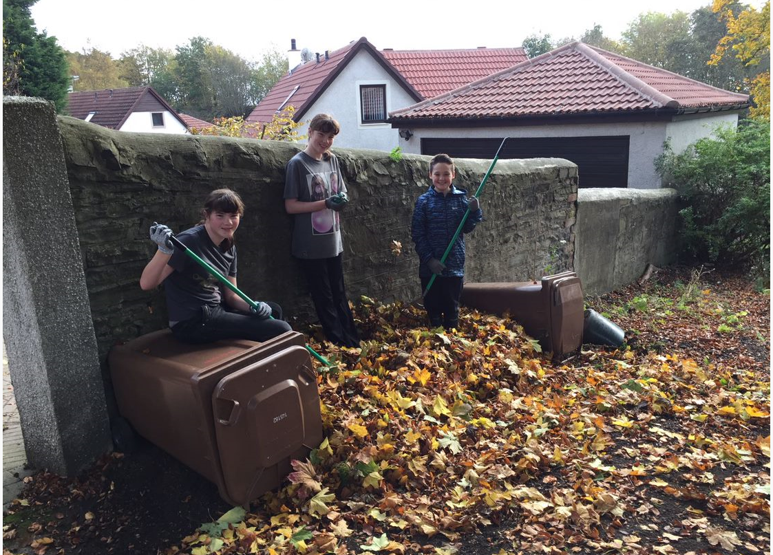
In autumn, we had to clear lots of leafs
The leaf’s once we had finished.

Slide 7
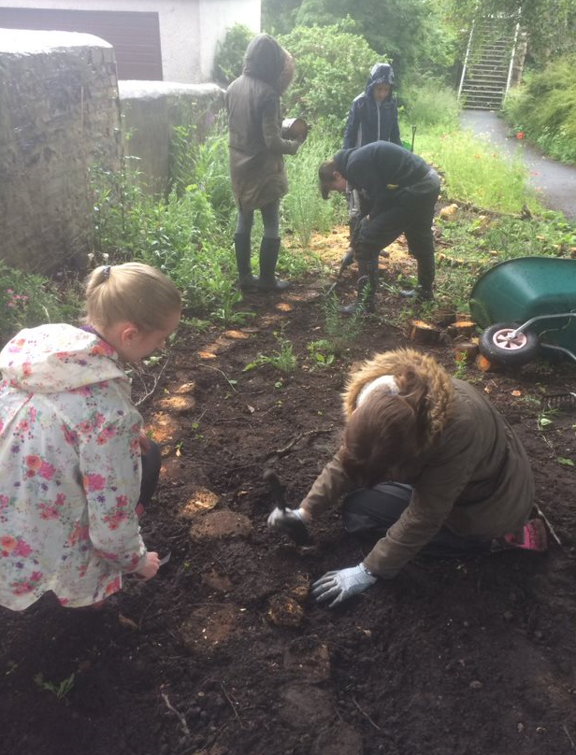
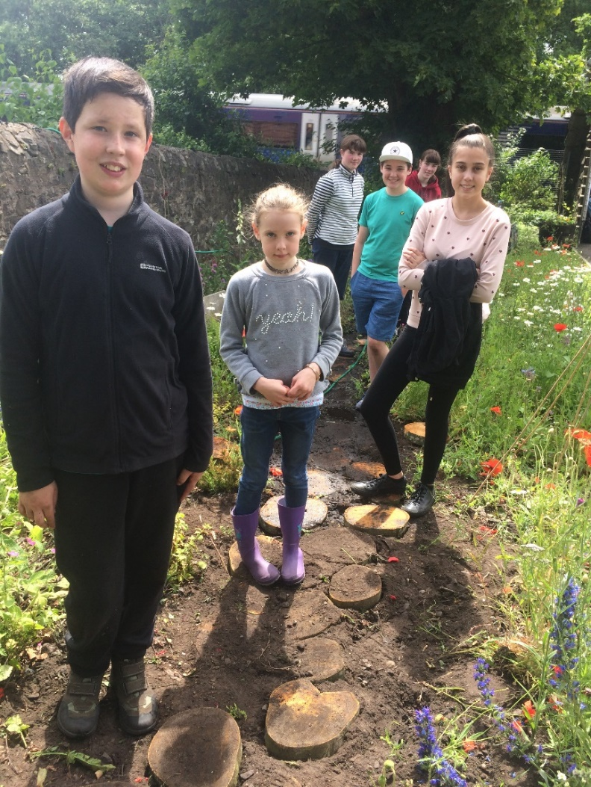
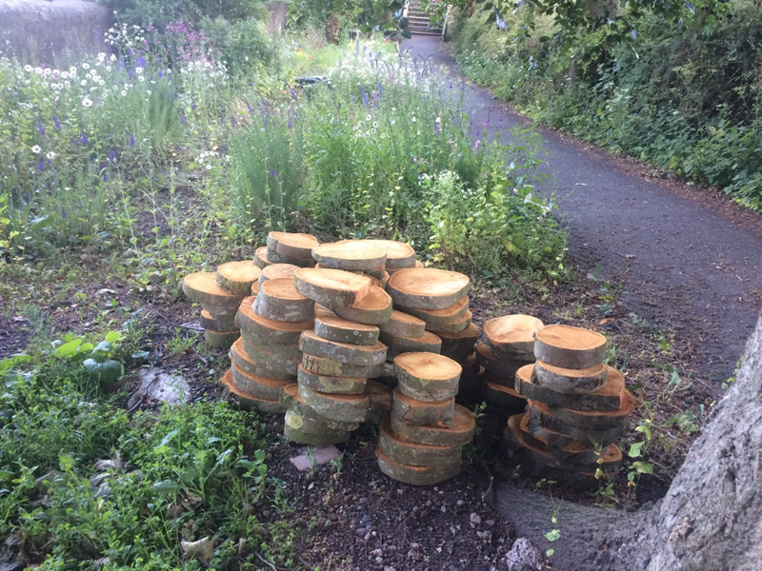
New path – made with the same wood
More sliced wood given by DCC to
Let us lengthen our path.
Making the Path.
The finished path.

Slide 8
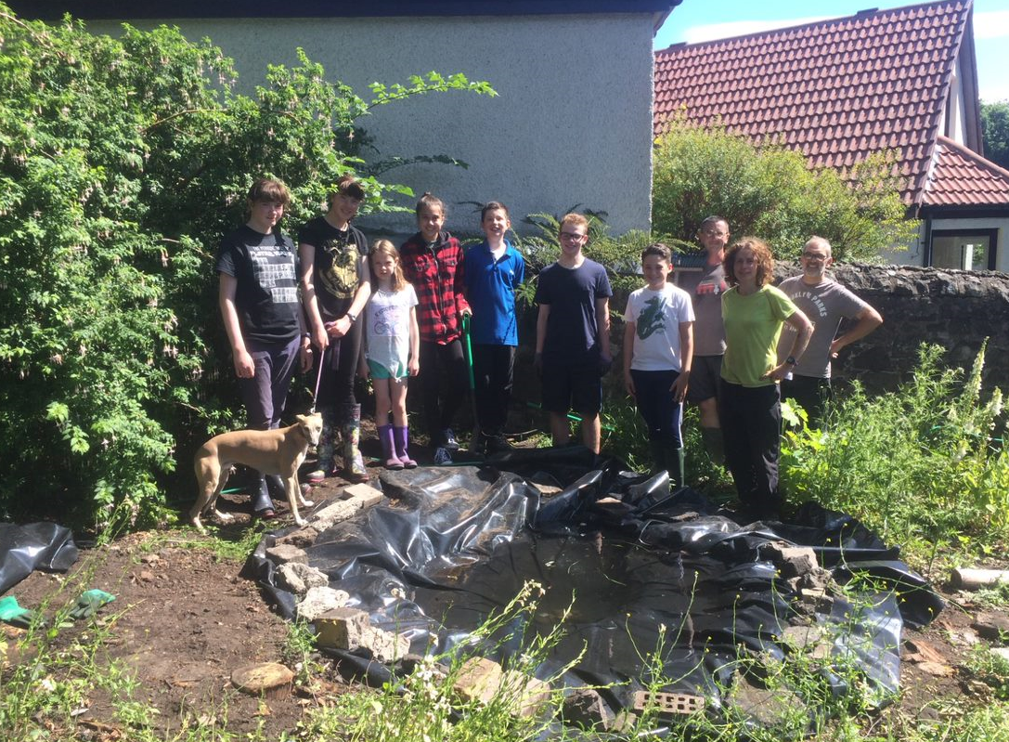
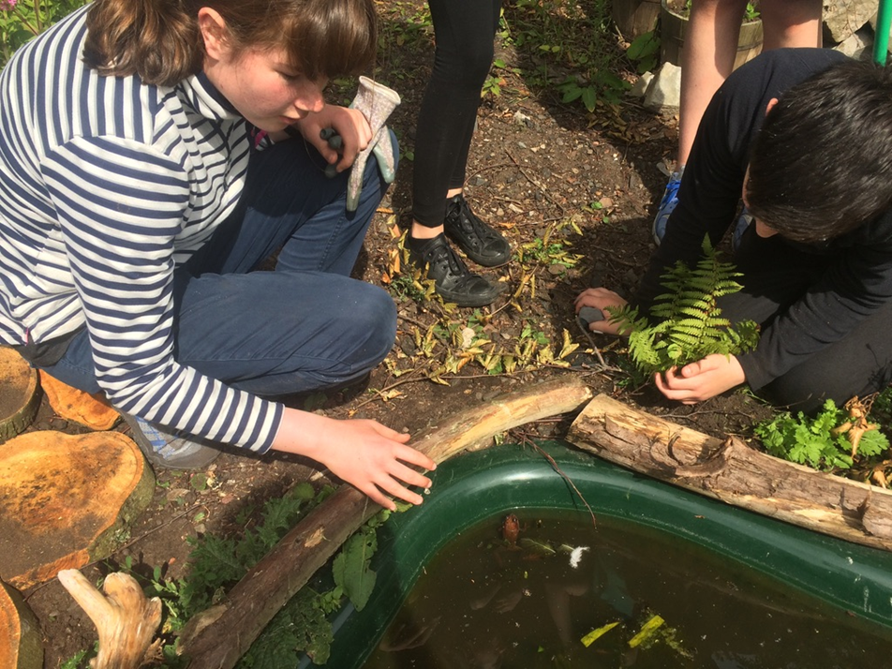
We added a New pond earlier this year
Lucy & Monty with a frog we found in the new pond.
The team with the old pond which kept leaking.

Slide 9
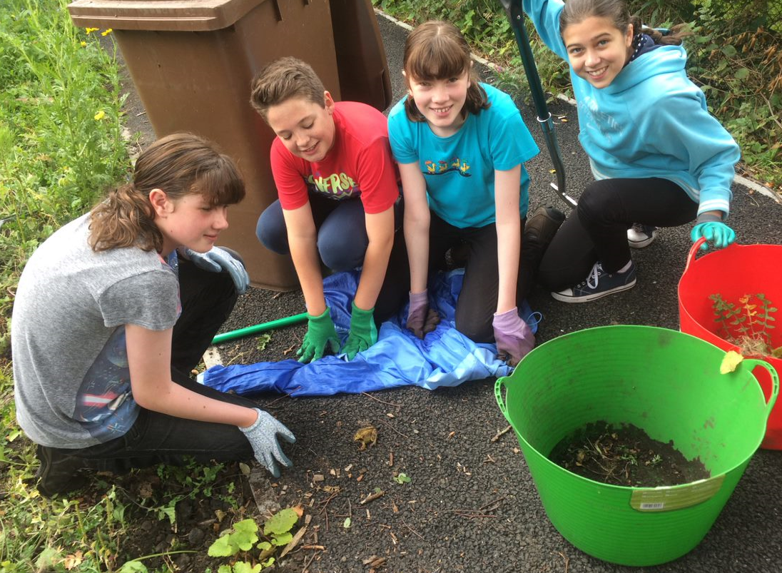
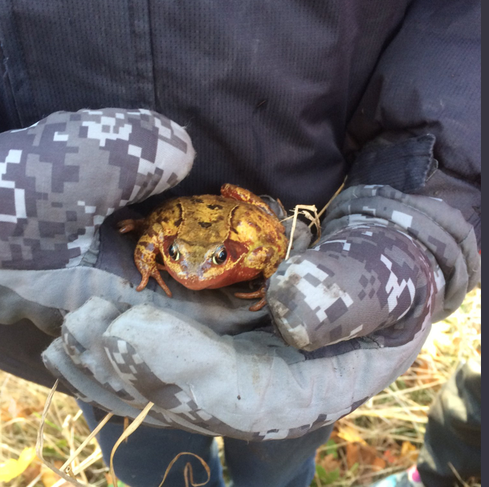
Wildlife – Minibeasts, plants & birds
The team with the frog we found.
A close up of the frog.

Slide 10
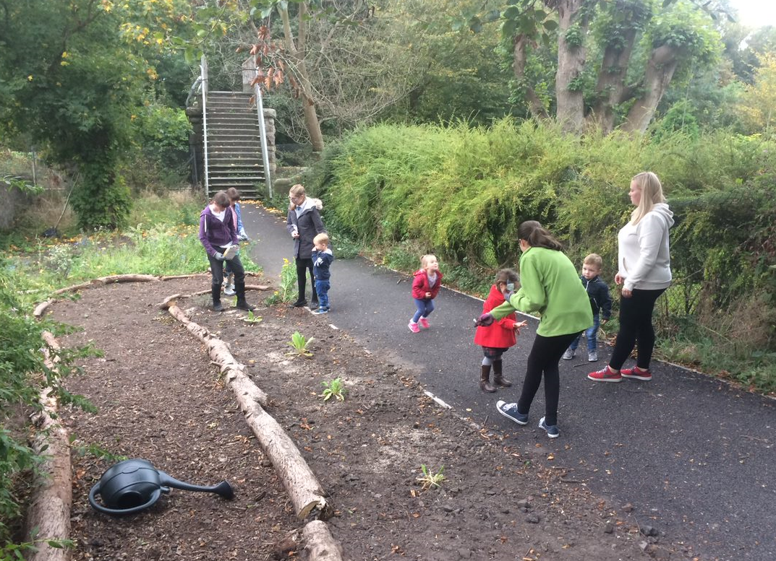
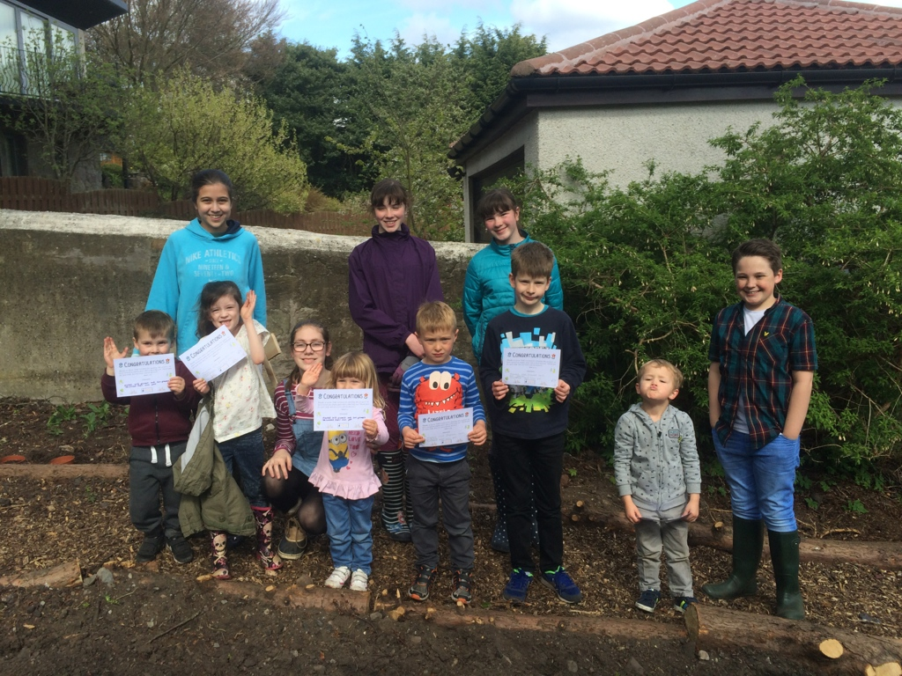
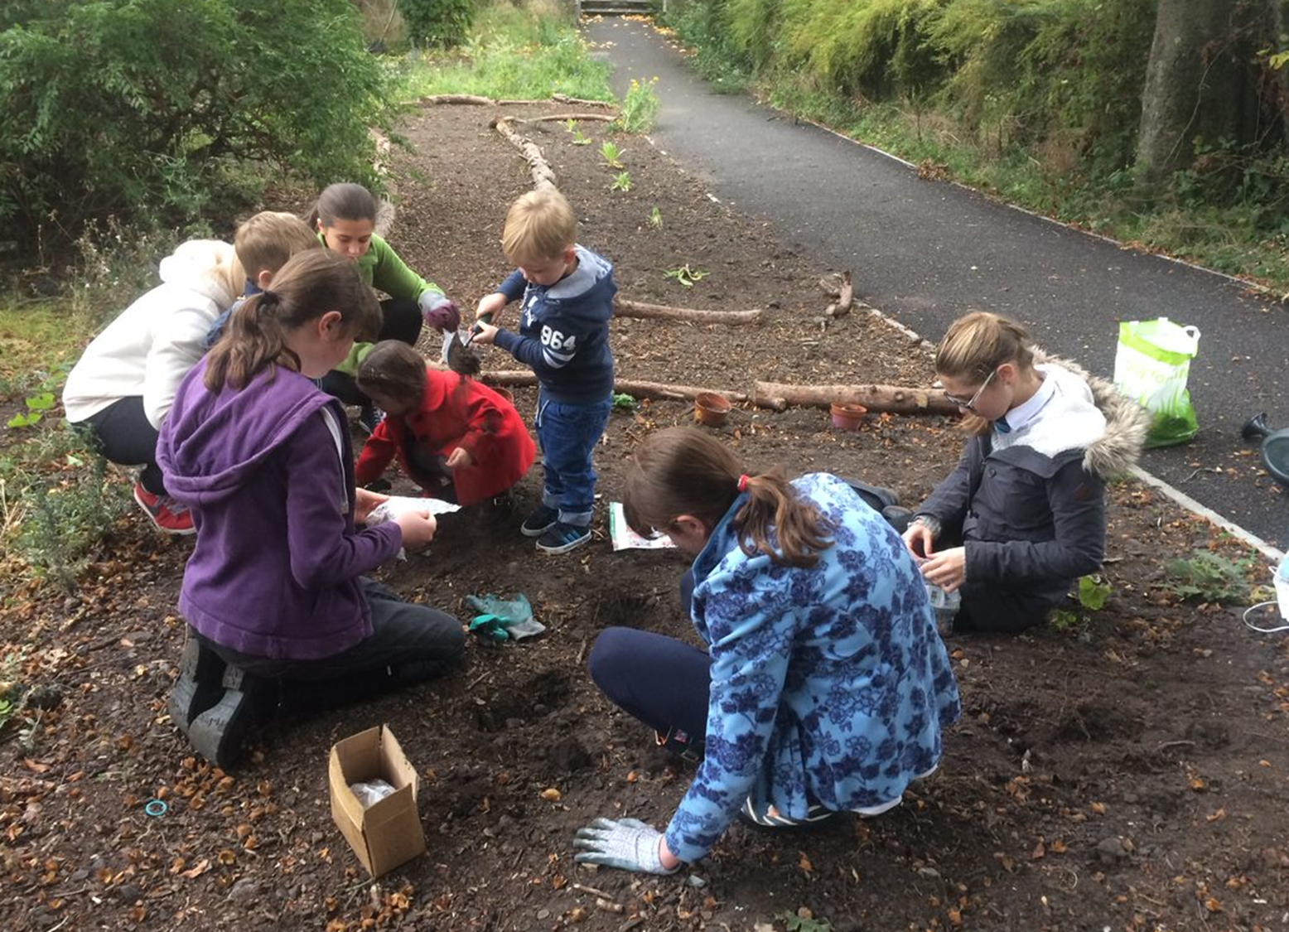
Working with the ‘great beginnings’ nursery
The Nursery with their new certificates.
The nursery busy gardening with us.

Slide 11
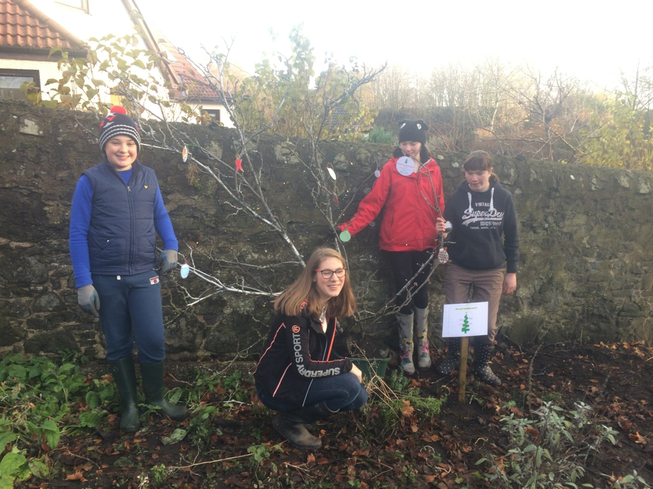
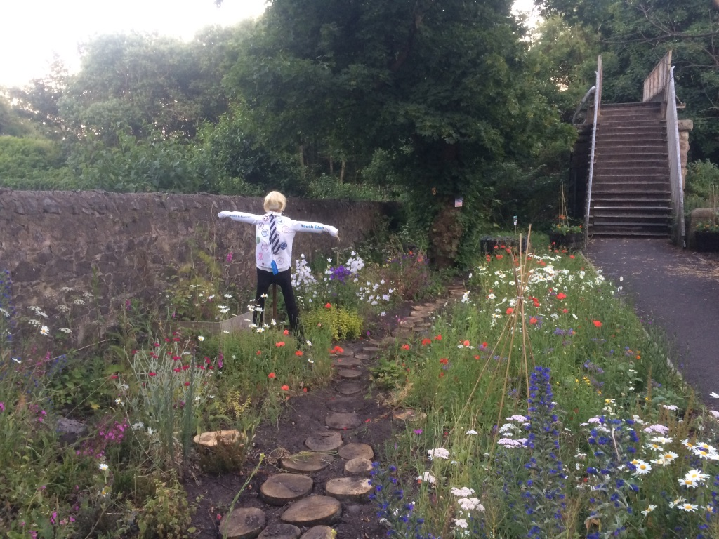
taking part - scarecrow & Christmas tree trail
Our Christmas Tree for the Trail.
Our Scarecrow for the Trail.

Slide 12
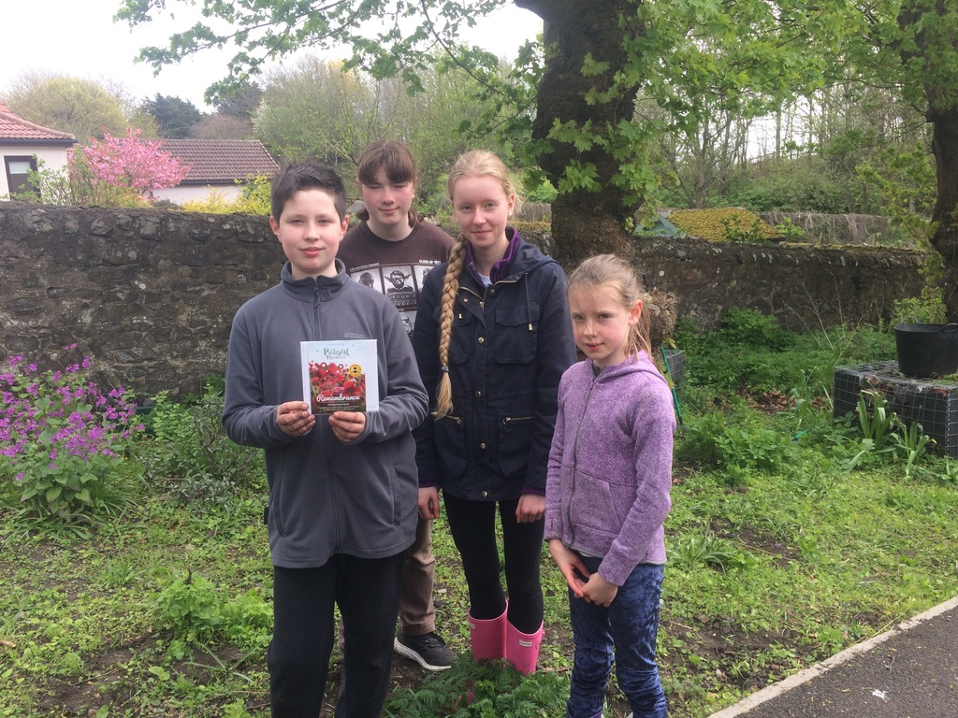
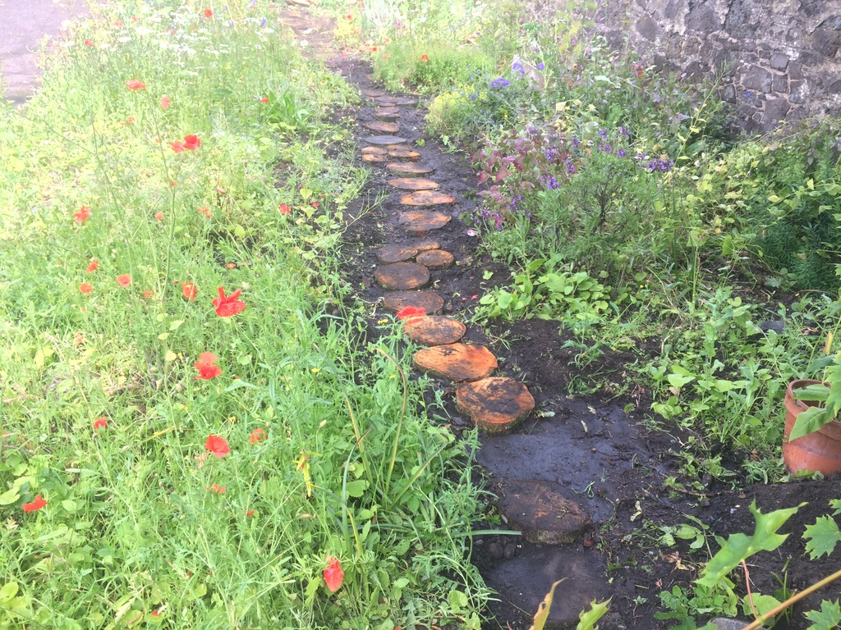
Remembrance day – planting poppies
Planting the Poppy Seeds.
The Poppies and our path.

Slide 13
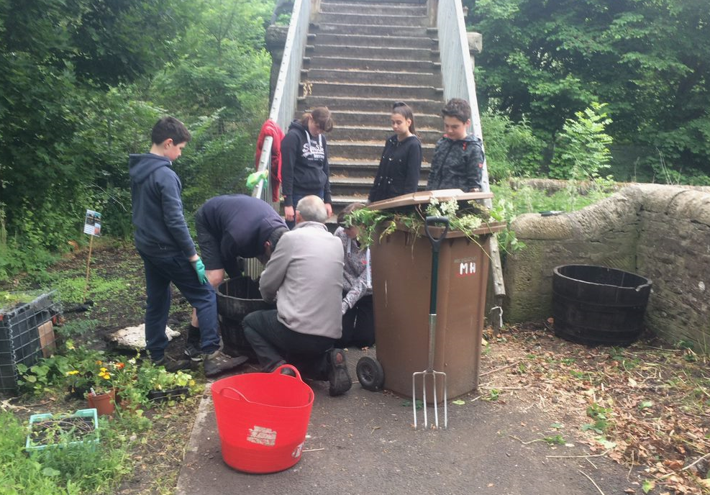
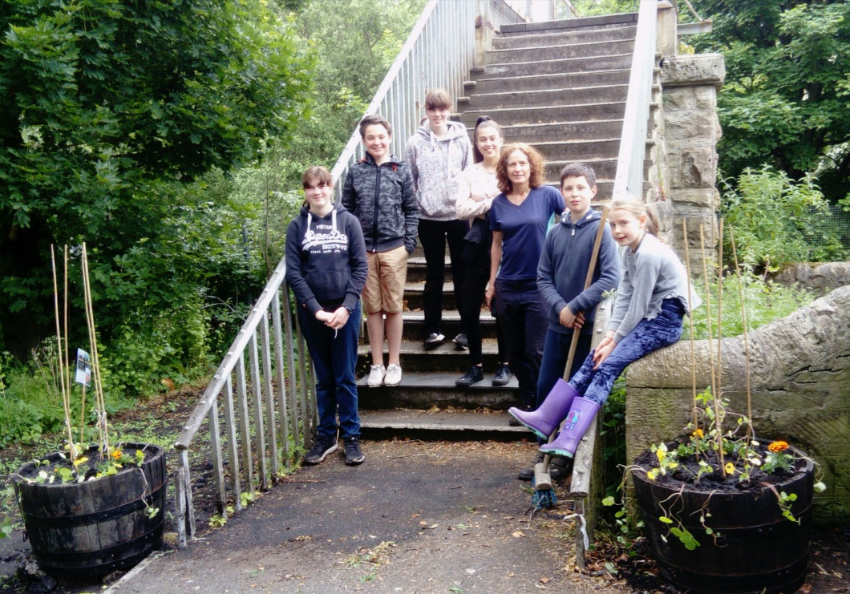
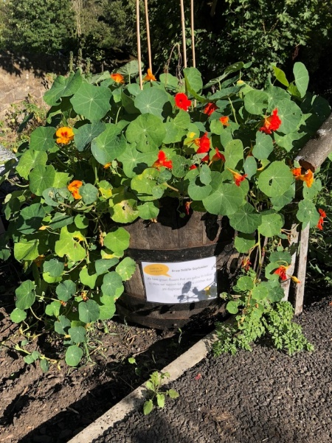
WE SUPPORTED THE GROW GOLD CAMPAIGN
Clearing the land for the barrels.
The ‘team’ once we were finished.
The flowers in September.

Slide 14
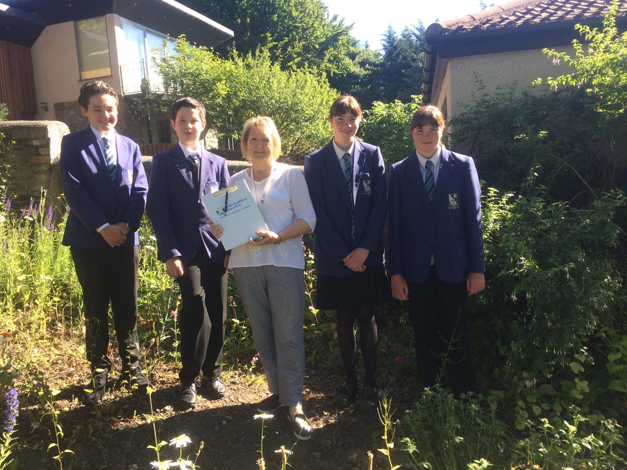
Meeting the ‘It’s your neighbourhood’ ASSESSOR
This was us meeting with our assessor, Jennifer.

Slide 15
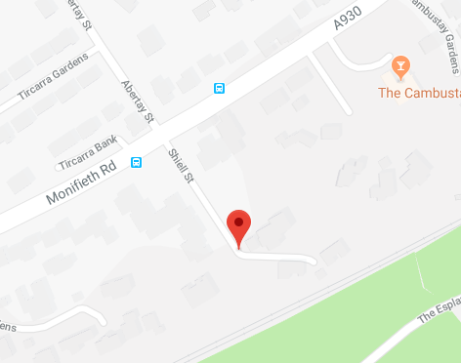
Thanks for listening
Why not keep UpToDate?
Website: www.broughtyferrygardens.info
Twitter: GreenGrowers@ShiellStGarden
Find Shiell St. Community Garden:
Shiell Street
Broughty Ferry
Angus
DD5 2TB

