Slide 1


Applications to Higher Education
Universities & Colleges Admissions Service

Slide 2

UCAS Apply 2019
UCAS Apply is the online system for University applications.
Key features include:
One application per admissions cycle
Applicants can make up to five choices in their application (some restrictions apply)
Universities cannot see which other course choices have been made
Applications are entirely online – visit ucas.com
Notes:
To register with Apply takes 10 minutes, then the applicant is able to log in and out of their form as much as they want to before completing it. To register they will need the school/college BUZZ word – you may give it out now?
Personal details – information about the applicant, nationality, nominated access (if parents wish to help and talk to UCAS or uni’s directly) and how we contact them. A section alongside this is additional information – ethnicity, care, parents’ background questions – remind parents that not all information will be used to make decisions, some is used for statistical purposes.
Student finance – if filled in we’ll remind students to apply for this and pre-populate some fields in their application with data from Apply.
Choices – students can make up to five choices. The exception is where students can only make four choices for most medicine, dentistry or veterinary medicine/science courses, although the remaining choice(s) can be used for any other subject. Students can also only apply to study one course at either Oxford and Cambridge – not both.
Education - is the area where most errors take place so take care eg know which BTEC you’re taking.
Employment – can be marked blank, and it is paid employment only.
Students send form to school/college they then send it to UCAS after the reference and checking. UCAS sends it to universities within 24-48 hours.
Remind them about mandatory fields, many are not so you don’t need to fill them in, and the ‘?’ contains help text for each box.

Slide 3
Registering with Apply
You will need to enter a ‘buzzword’ when you first register to allow you to link your application to school;
grove2019
You will then be asked to join a group within school;
Select your Guidance Teacher from the menu.
Notes:
To register with Apply takes 10 minutes, then the applicant is able to log in and out of their form as much as they want to before completing it. To register they will need the school/college BUZZ word – you may give it out now?
Personal details – information about the applicant, nationality, nominated access (if parents wish to help and talk to UCAS or uni’s directly) and how we contact them. A section alongside this is additional information – ethnicity, care, parents’ background questions – remind parents that not all information will be used to make decisions, some is used for statistical purposes.
Student finance – if filled in we’ll remind students to apply for this and pre-populate some fields in their application with data from Apply.
Choices – students can make up to five choices. The exception is where students can only make four choices for most medicine, dentistry or veterinary medicine/science courses, although the remaining choice(s) can be used for any other subject. Students can also only apply to study one course at either Oxford and Cambridge – not both.
Education - is the area where most errors take place so take care eg know which BTEC you’re taking.
Employment – can be marked blank, and it is paid employment only.
Students send form to school/college they then send it to UCAS after the reference and checking. UCAS sends it to universities within 24-48 hours.
Remind them about mandatory fields, many are not so you don’t need to fill them in, and the ‘?’ contains help text for each box.

Slide 4
Application Content
Each applicant has six sections to complete:
  Personal details
  Student finance
  Course Choices
  Education
  Employment
  Personal statement
Notes:
The only exception where students can not make five choices is for medicine, veterinary science/medicine and dentistry courses, where students can only make 4 choices.
Students can also only apply to study one course at either Oxford and Cambridge – not both.

Slide 5

Finding Courses
Applicants can use the search tool at
search.ucas.com to find all courses on offer.

Slide 6

Open Days
Applicants can use a search tool at
ucas.com/open-days to identify all University Open Days.

Slide 7
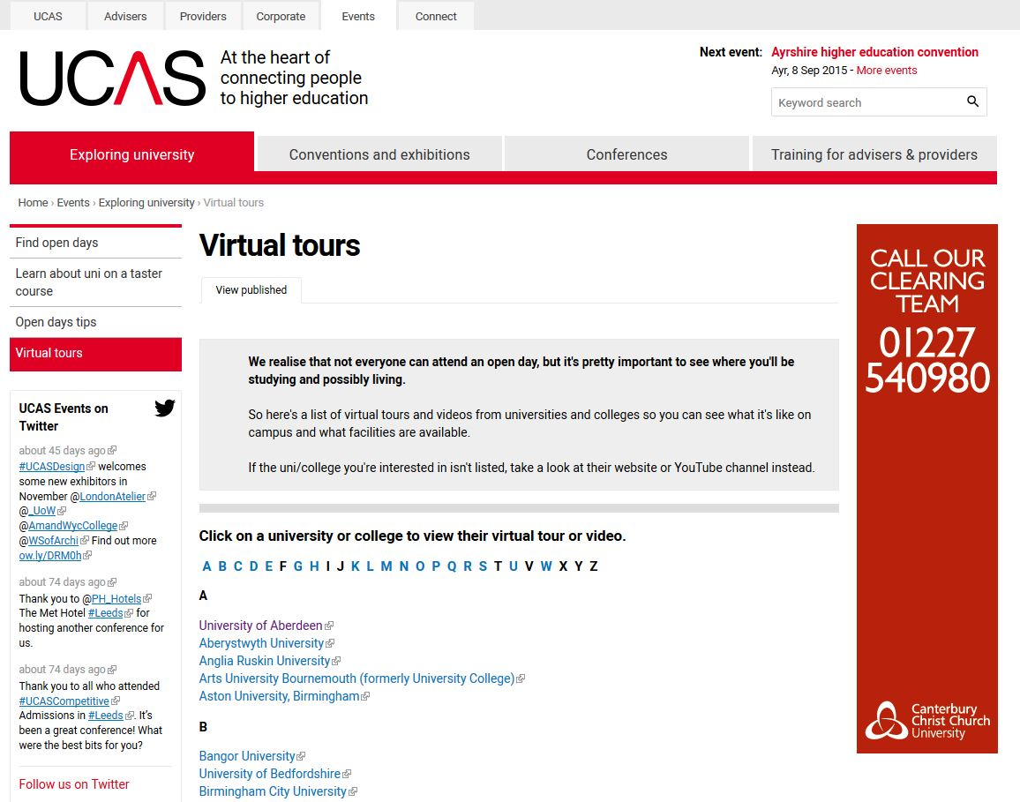
Virtual Tours
Applicants can also ‘tour’ Universities online at
ucas.com/virtual tours

Slide 8
How can parents support applications & course choice?
Sign up to the monthly UCAS Parents’ Newsletter
Download the UCAS Parent Guide from the UCAS website
Offer to attend open days together as you may have a different perspective
Try to remain impartial
Proof read draft Personal Statements
www.ucas.com/parents

Slide 9
Personal Statement
The Personal Statement is the first opportunity for applicants to market their own individual skills base and experience.
  Max. 4,000 characters, 47 lines
  Min. 1,000 characters
  No spelling/grammar check
  No formatting available
Only one personal statement covers all course choices.

Slide 10
Personal Statement
Areas expected to be addressed within the Personal Statement include:
  Why you are applying for your chosen course?
  Why the subject interests you?
  Why you’re suitable for the course?
  How your studies relate to the course?
  What other activities demonstrate your interest in the course?
  What appropriate skills you have for the course and for life at university?
  What relevant work experience (paid or otherwise) have you undertaken?
  What hobbies and interests do you have that demonstrate the skills and abilities required for your course?
  How does the course relate to what you want to do in the future?

Slide 11
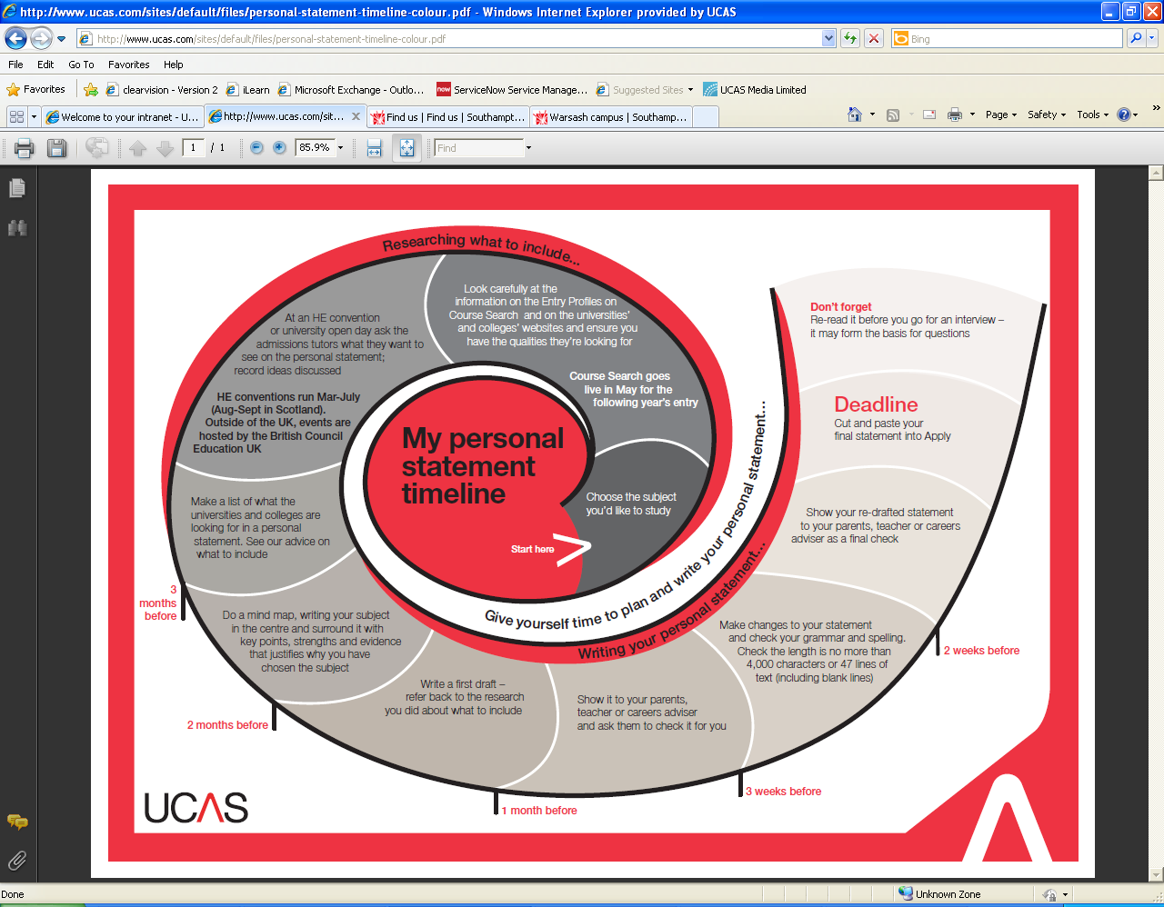
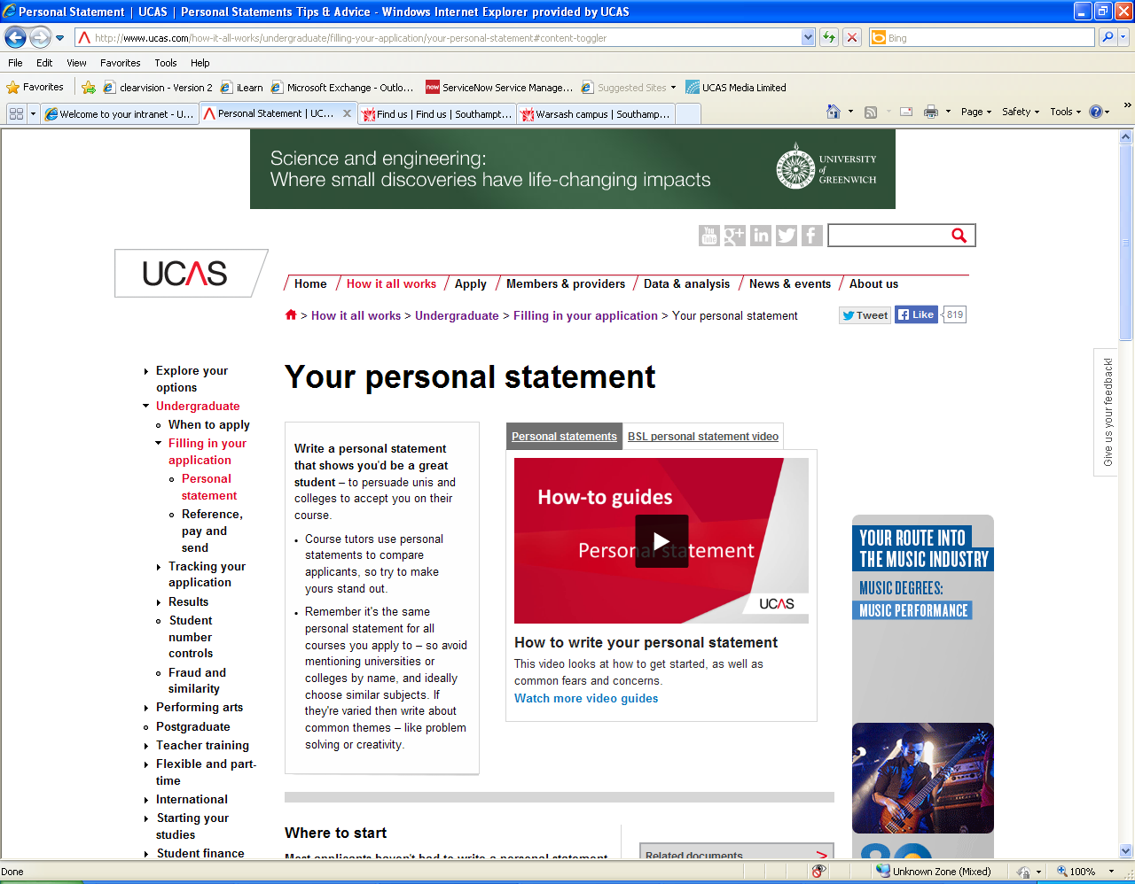
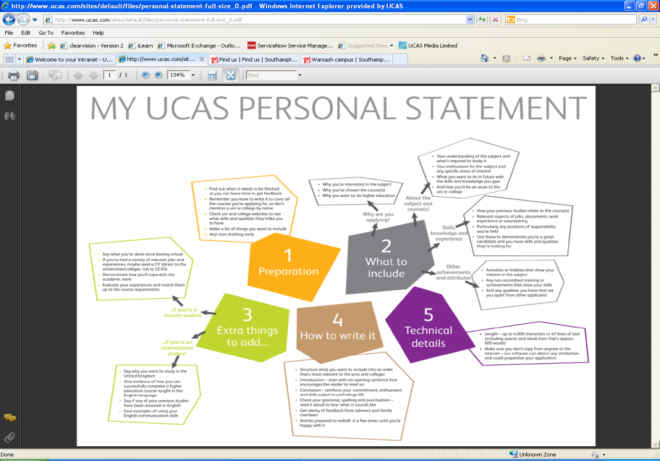
Personal Statement Support
Guidance on completing the Personal Statement will be covered in PSE and University Student Services staff are invited in each year to deliver a Personal Statement Workshop in school.
www.ucas.com/personalstatement

Slide 12
UCAS Submission Deadlines
1st October -
15th October -
15th January -
Conservatoire Applications - Most Music courses
Early Applications - Oxford or Cambridge & Medicine, Dentistry & Veterinary courses
General Applications - Most Undergraduate courses
Conservatoire Applications - Most Dance, Drama or Screen Production courses

Slide 13
Completion Deadlines
Completed applications can be submitted from 5th September however deadlines set in school are earlier than published UCAS dates.
Subject reports are required from current teachers in all curricular areas
Qualifications are verified and predicted grades obtained
Individual references are written
A significant amount of applications are managed by each Guidance Teacher (typically between 15-20).

Slide 14
Completion Deadlines
Your submission deadline will depend on what courses you are making application to.
There are 3 different application categories;
Early Applications
Conservatoire Applications
General Applications

Slide 15
Early Application Deadlines
Applications for all courses at Oxford or Cambridge and most Medical, Dental and Veterinary courses have early deadlines and must be sent through UCAS Apply to your Guidance teacher by:
Monday 1St October
Personal Statement deadlines for the above courses must be AGREED with your Guidance Teacher ASAP.

Slide 16
Conservatoire Application Deadlines
Application deadlines for Performing Arts courses through UCAS Conservatoires Apply vary greatly.
Check individual course details carefully as you are responsible for all stages of your own application.
Personal Statement deadlines for the above courses must be discussed and AGREED with your Guidance Teacher.

Slide 17
General Application Deadlines
Applications to all other courses must meet the following deadlines;
Fri 26th October – Final date to submit a draft Personal Statement to your Guidance Teacher for feedback.
Fri 30th November - Final date to send completed applications to your Guidance Teacher via UCAS Apply.

Slide 18
Submission Deadlines
1st October –
26th October –
30th November –
Applications to Ox-Bridge as well as all Medicine, Dentistry & Veterinary courses
Personal Statement Drafts (General Applications)
General Applications

Slide 19
Application Acknowledgment
Alert your Guidance Teacher on Monday 7th January if you have submitted your application but have not received any UCAS correspondence via text or email to confirm receipt.

Slide 20
UCAS Submission
Guidance staff will adhere to meeting all UCAS deadlines for submitting completed applications if applicants have adhered to meeting all deadlines set within school.
The turnaround period from applicant completion to UCAS submission will vary as each application is unique and Guidance staff will be dealing with a range of individual circumstances.

Slide 21
Application Review
Once submitted to UCAS, applications are quickly processed and passed on to Universities for consideration. The following factors are reviewed by admissions staff before a decision is made:
  Personal statement
  Reference
  Qualifications
  Admissions test results (if applicable)
  In many cases, applicants may also be required to attend an interview, take part in an audition or submit a portfolio to advance within the application process. Oxford and Cambridge applicants may have to complete a further written assessment in addition to any required admissions tests.

Slide 22
Application Decisions
An admissions tutor will make one of three decisions based on all aspects of each individual application:
  Unconditional offer
  Conditional offer
  Unsuccessful
Each University is different and timescales for offers will vary.

Slide 23
Replying to Offers
In June applicants must reply through UCAS once all course choice decisions have been reached if offers have been made. Applicants can then hold a maximum of two offers:
  Firm – the first choice / If applicants meet the conditions of the offer they will be placed
  Insurance – the back-up choice / Only accepted if applicants do not meet the conditions of their firm choice
All offers will automatically be declined if applicants fail to reply to their offers.

Slide 24
Unsuccessful Applications
Applicants who do not receive an offer from any of their choices can use UCAS Extra to make one further application to another course in June. Applicants are eligible for Extra if all five choices have been unsuccessful, cancelled or declined.
  If applicants are also unsuccessful within Extra they can enter Clearing to allow applications to be made one course at a time through UCAS. Applicants within Clearing must contact Universities directly to discuss vacancies. Clearing begins in July.

Slide 25

UCAS Exhibition
Thursday 30th August (9.30am – 4.00pm)
University of Dundee
Representatives from universities, colleges, gap year companies, training providers, employers and recruiters will be available to discuss your opportunities beyond school.
eTickets can be booked at www.ucas.com/ucas/events

Slide 26

Find out more

