Slide 1
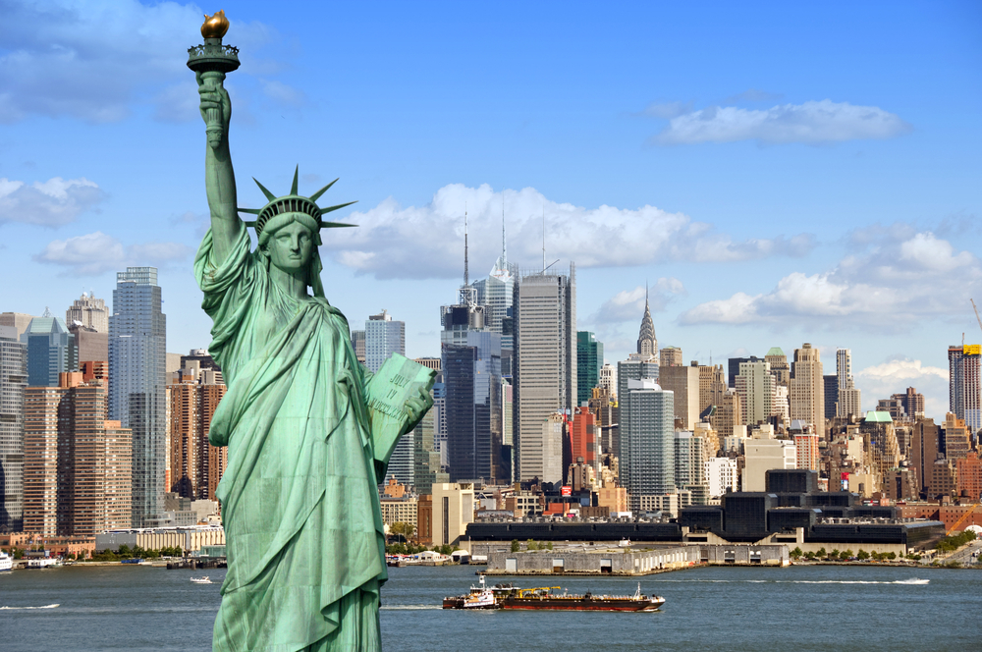
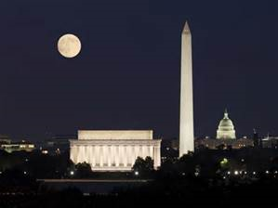
USA Trip October 2016
Parent Information Evening

Slide 2
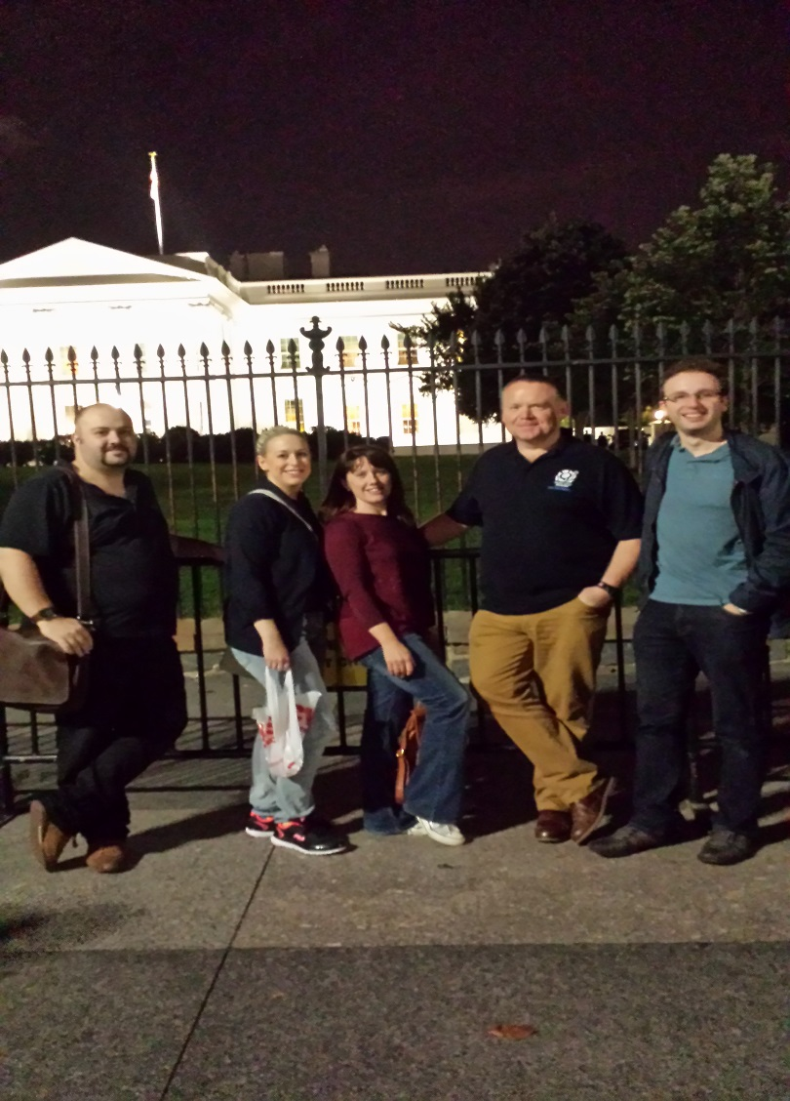

Teachers
Debbie Nicoll
Ruth Jack
Matthew Robertson
Sarah Crabb
Fiona McIntosh
TBC

Slide 3
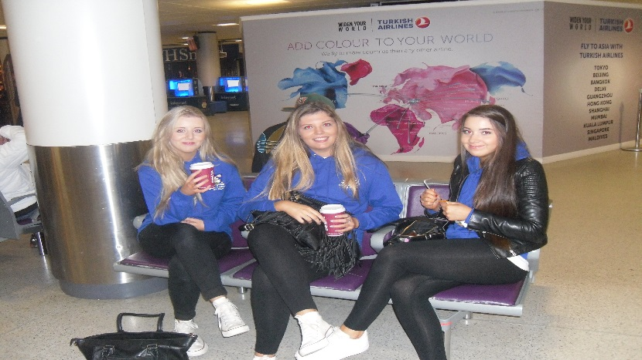
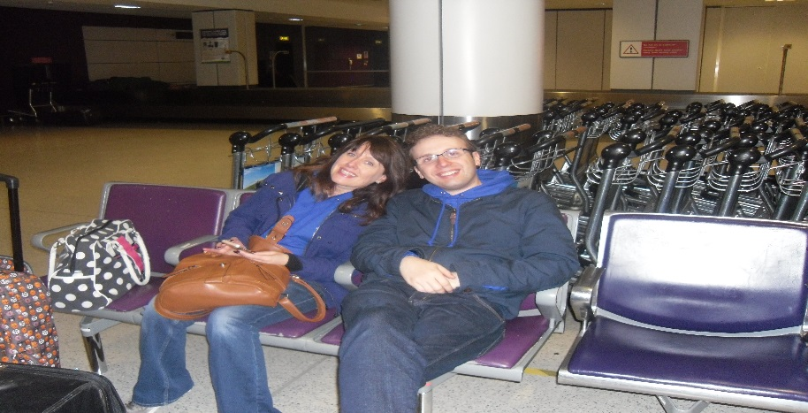
The Outward Journey – Day 1
Meet at the school at 09:00 am to get bus to Edinburgh Airport
Check in at 10.45 am
Departure Date | Departure Airport | Departure Time | Arrival Date | Arrival Airport | Arrival Time | Airline
05/10/2016 | Edinburgh | 13:45 | 05/10/2016 | Heathrow | 15:15 | British Airways
05/10/2016 | Heathrow | 17:20 | 05/10/2016 | Dulles | 20:25 | British Airways

Slide 4
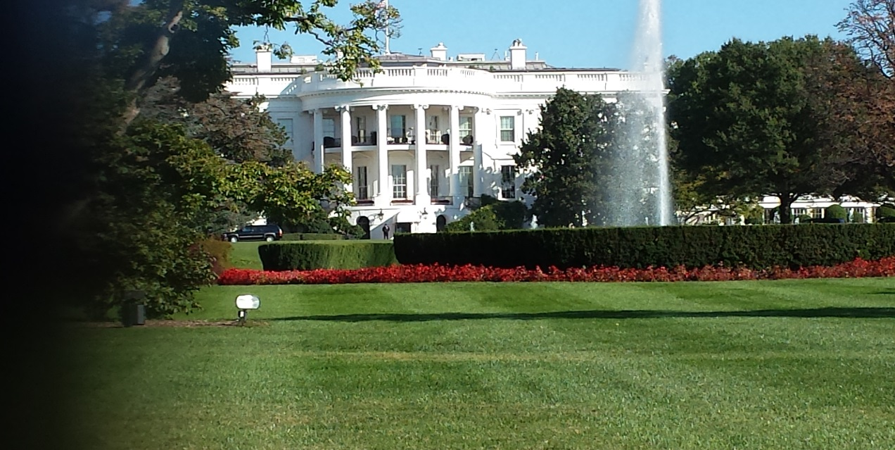
Arrival in Washington
Land in Washington at 20:25 local time where we will be met by an NST representative who will assist us during bus transfer to accommodation.
Estimated arrival at accommodation is 22.30.

Slide 5
Hotel Harrington Washington, USA
11th and E Street NW Washington DC 2004-1398

Slide 6
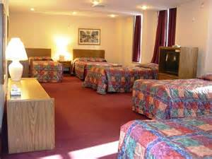
Situated on a busy street surrounded by shops and cafés. The hotel is 2 blocks from the nearest Metro station.
Accommodation Facilities
• Reception
• Cafe
• Restaurant
• Internet access
• 2 lifts

Slide 7
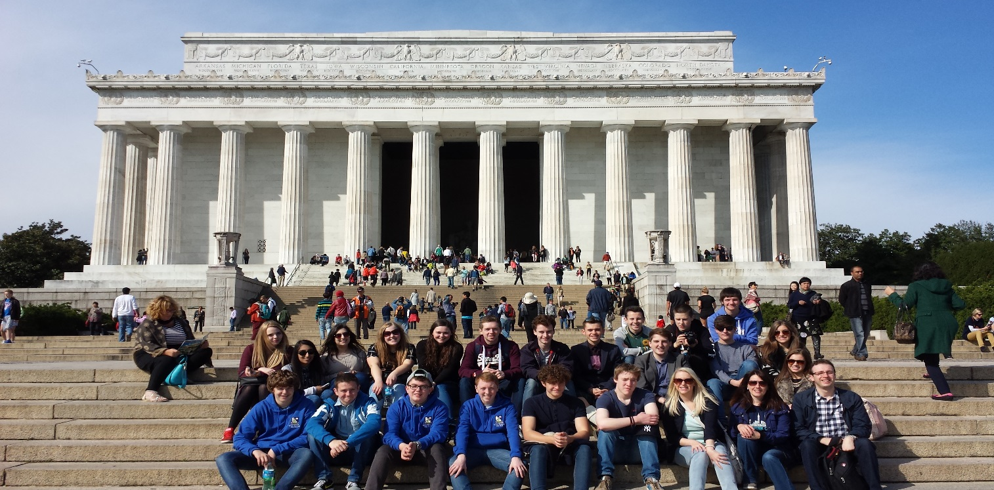
Washington – Day 2
Daytime
 | Historical and Political Walking Tours
 | Possible Whitehouse visit
Evening | Dinner – possible meet up with school in Alexandria

Slide 8
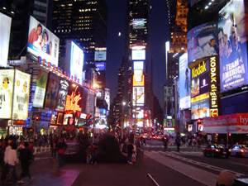
Washington/NYC - Day 3
Daytime
 | U.S Capitol Tour
13:00 | Travel to NYC – Estimated arrival 18.30
20:00 | Bowling and Pizza times square

Slide 9
Vanderbilt YMCA – New York
224 East 47th Street, 10017 New York
This youth hostel offers basic accommodation, which has been purpose built for young people. The hostel is open 24 hours a day with front door security personnel.
Conveniently located on the east side of the Midtown area, close to the United Nations Building, near to 2nd Avenue and Grand Central Station.

Slide 10
Vanderbilt YMCA – New York
224 East 47th Street, 10017 New York

Slide 11
Vanderbilt YMCA – New York
224 East 47th Street, 10017 New York
Accommodation Facilities
• Reception
• Telephones on each floor and at Reception
• Gift Shop
• Laundry room
• Water fountains on each floor
• Sports facilities including two swimming pools, large fitness room, weights, gymnasium, games hall, sauna & steam room.
• Luggage storage

Slide 12
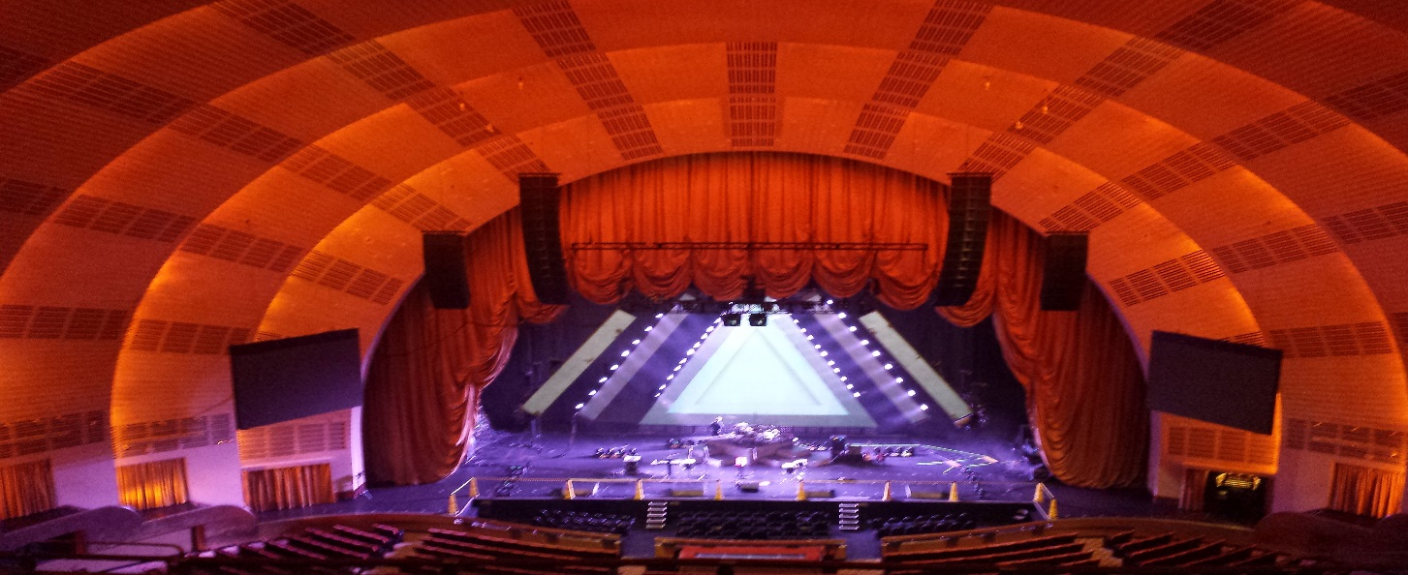
New York Itinerary – Day 4
10:00 hrs | VISIT – Rockerfeller Guided Tour
14:00 hrs | VISIT – Radio City Tour
20:00 | EVENING PERFORMANCE – Broadway show T.B.C.

Slide 13
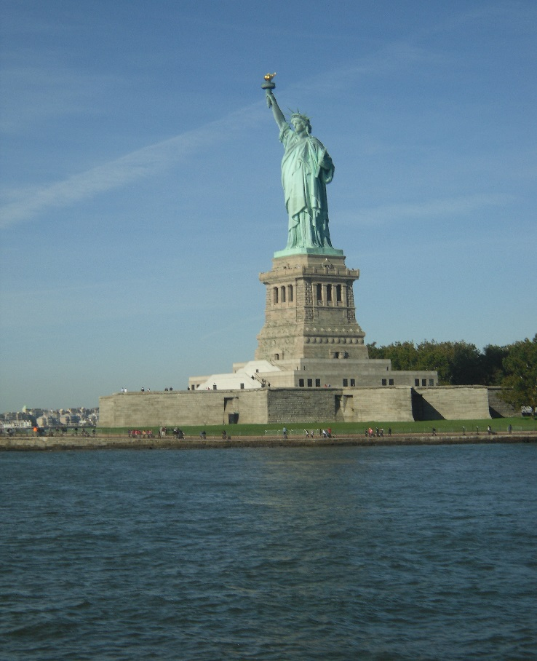
New York Itineray – Day 5
09:00 | VISIT – Statue of Liberty and Ellis Island
13:00 | Shopping and downtime
19:00 | Broadway Show

Slide 14
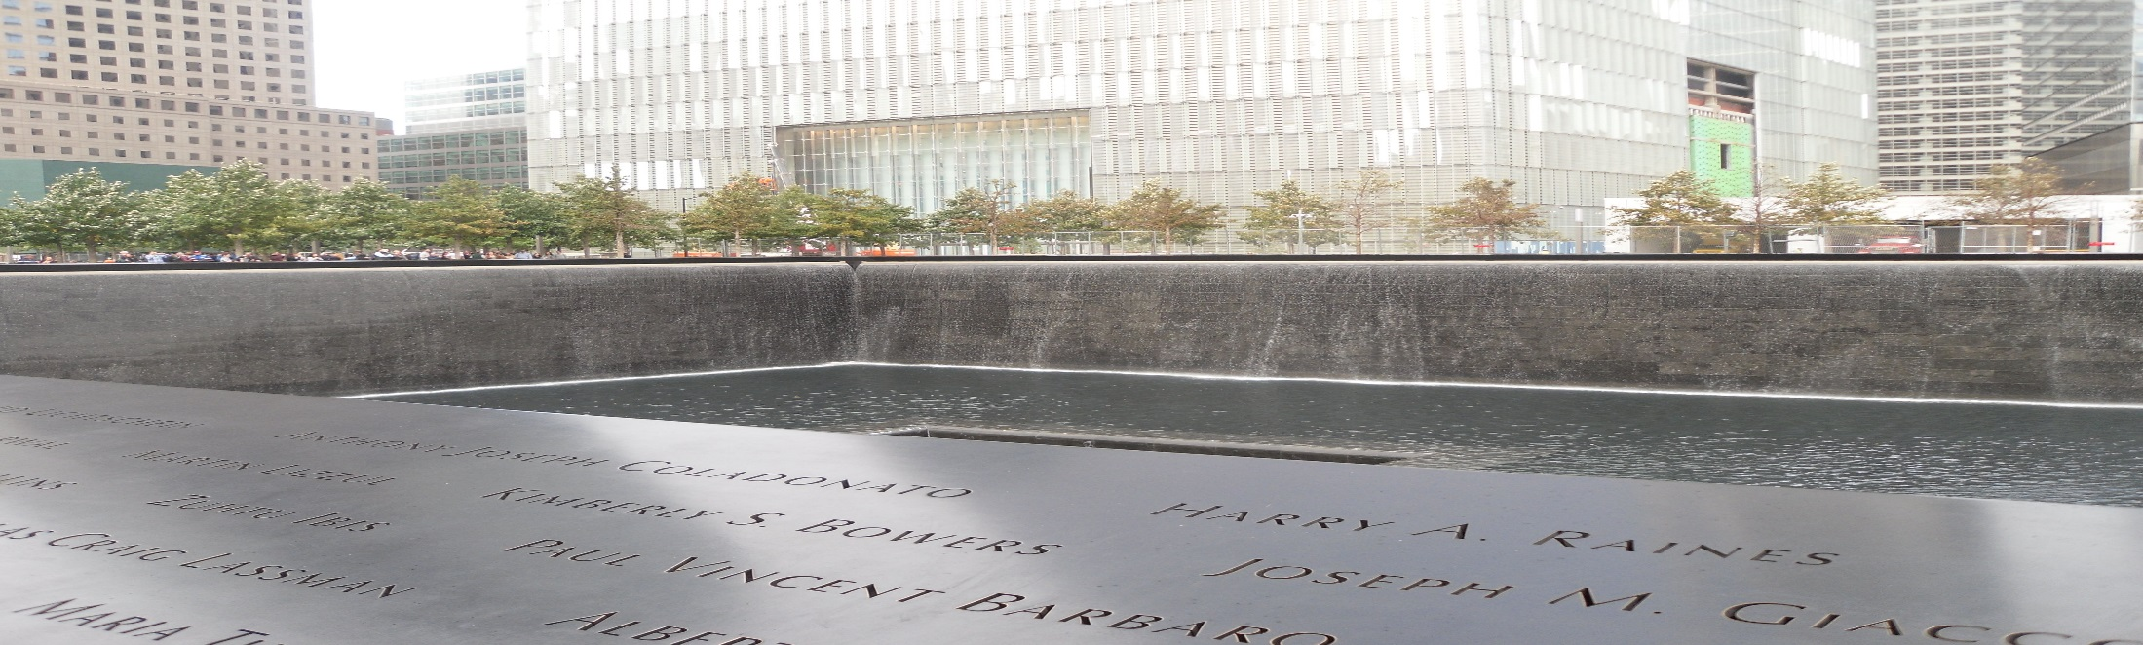
New York Itineray – Day 6
09:00 | VISIT – 9/11 Memorial and Memorial Museum
13:00 | Central Park
21:00 | Top of the Rock

Slide 15

New York Itineray – Day 7
09:00 | Check out
11:00 | VISIT – UN Building and Tour
14:00 | Shopping and Down Time
18:00 | Depart for airport

Slide 16

The Return Journey
Departure Date | Departure Airport | Departure Time | Arrival Date | Arrival Airport | Arrival Time | Airline
11/10/2016 | JFK Airport | 22:55 | 12/10/2016 | Heathrow | 11:00 | British Airways
12/10/2016 | Heathrow | 14:15 | 12/10/2016 | Edinburgh | 15:40 | British Airways

Slide 17

Important Information
The US Visa Waiver Programme (VWP) allows most British Citizen passport holders to visit the US for up to 90 days without a visa, but you may need to get authorisation from the Electronic System for Travel Authorisation (ESTA) before you travel. If you don’t qualify for the VWP, you’ll need to apply for a visa from the nearest US Embassy or Consulate. Please use the official USA embassy website to purchase visa as it is cheaper than using third party.
From 1 April 2016, all travellers wishing to enter the US under the VWP will need to hold a passport with an integrated chip (an ePassport).

Slide 18

Key Checklist
Photo copy of valid ePassport by June 17th
ESTA visa submitted by June 17th
Trip to be paid in full by Friday 17th June
Medical Form submitted
Any letters required from GP for medication to be carried in hand luggage needed in month before travel.
Spending Money – recommended no more than $50 per day.

