Slide 1

Grove Academy
Primary to Secondary Transition 2020
Notes:
Good Evening and Welcome to Grove.

Slide 2
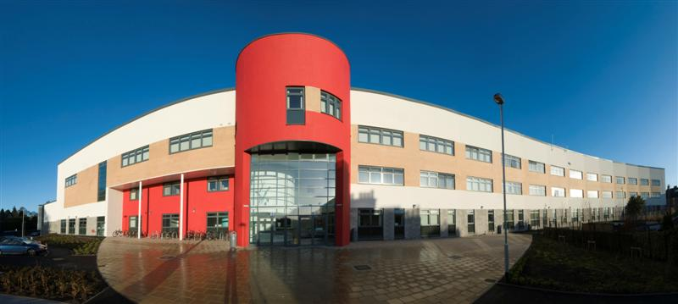

New Environment
New Classmates
New Subjects
New Opportunities
Grove Academy
Our Values: Honesty, Respect, Responsibility, Fairness, Determination

Slide 3
Curriculum for Excellence
S1-3
Broad General Education
S4-6
Senior Phase
Grove Academy
Our Values: Honesty, Respect, Responsibility, Fairness, Determination

Slide 4
Curriculum Areas
Primary
Languages/Literacy
Mathematics/Numeracy
Health and Wellbeing
Sciences
Expressive Arts
Secondary
English
Literacy
German/French
Mathematics / Numeracy
Social Education
Tutor Time
HE
PE
Science
Art and Design
Music
Drama
PE
Grove Academy
Our Values: Honesty, Respect, Responsibility, Fairness, Determination

Slide 5
Curriculum Areas
Primary
Social Subjects
Technologies
Religious and Moral Education
Secondary
Geography
History
Modern Studies
CDT
HE
Computing
Business Studies
RMPE
Grove Academy
Our Values: Honesty, Respect, Responsibility, Fairness, Determination

Slide 6
BGE Curriculum
Subject S1 S2
English and Literacy 4+1 4
German/French 3 3
Mathematics and Numeracy 4+1 4
Science 4 3
Social Subjects 3 3 +1
Computing 1 1
Business Enterprise 1 1
Technical 1 2
HE 2 1
Art and Design 2 1
Music 1 2
Drama 1 1
Inter-Disciplinary Learning - 2
PE 2 2
RMPE 1 1
Social Education 1 1
33 33
Grove Academy
Our Values: Honesty, Respect, Responsibility, Fairness, Determination

Slide 7
BGE Curriculum
Subject S3
English 4.5
German/French 3
Mathematics 4.5
Any 5 choices from all other 15
subjects
Masterclasses 2
PE 2
RMPE 1
Social Education 1
33
Grove Academy
Our Values: Honesty, Respect, Responsibility, Fairness, Determination

Slide 8
Senior Phase
7 Courses in S4
5 courses in S5
A meaningful curriculum in S6 (minimum 4 courses)
EMPLOYABILITY
SQA Courses (Nat 4, Nat 5, Higher, Advanced Higher)
Apprenticeships Pathways (Plumbing/Electrical/Finance/ Engineering/ Social Care))
D & A College Link courses
HNC (Computing) / HND
Ethical Hacking and Cyber Security (NPA)
Life-saving and Fitness Instructor Awards
Childcare
Grove Academy
Our Values: Honesty, Respect, Responsibility, Fairness, Determination

Slide 9
HMIE National Inspection on Curriculum and Leadership of Learning
Curriculum Rationale – Rich document, solid, thoughtful
Consistent thread of skills for learning, life and work shown through school
Ever increasing range of pathways
Individualised curricula - very positive for those young people
Partnerships are proper and providing something we can’t do in school - working to co-create a Curriculum that creates a range of pathways
There is a clearly understood standard of teaching and learning across the school.
Grove Academy
Our Values: Honesty, Respect, Responsibility, Fairness, Determination

Slide 10
Typical S1 Day (C-19 Mitigations)
Wednesday
Period 1 German Mrs McGill
Period 2 Modern Studies Miss Dow
Interval
Tutor Time Mrs Kerr
Period3 Music Mr Taylor
Period 4 Technical Mr Waghorn
Lunch
Period 5 English Miss Dick
Period 6 Science Mrs Crabb
Period 7 Business Enterprise Mrs King
Grove Academy
Our Values: Honesty, Respect, Responsibility, Fairness, Determination

Slide 11
Important Areas
Grove Academy
Our Values: Honesty, Respect, Responsibility, Fairness, Determination
App / Website
Home Learning / Show My Homework
Assessment/Reporting
Discipline
Uniform

Slide 12
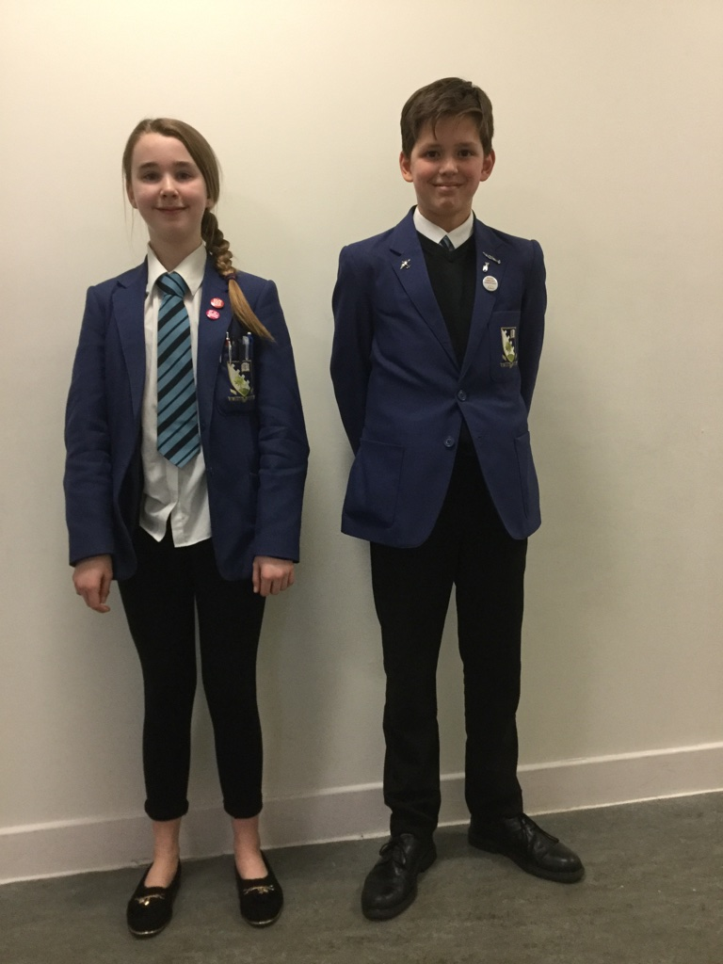
Grove Academy
Our Values: Honesty, Respect, Responsibility, Fairness, Determination

Slide 13

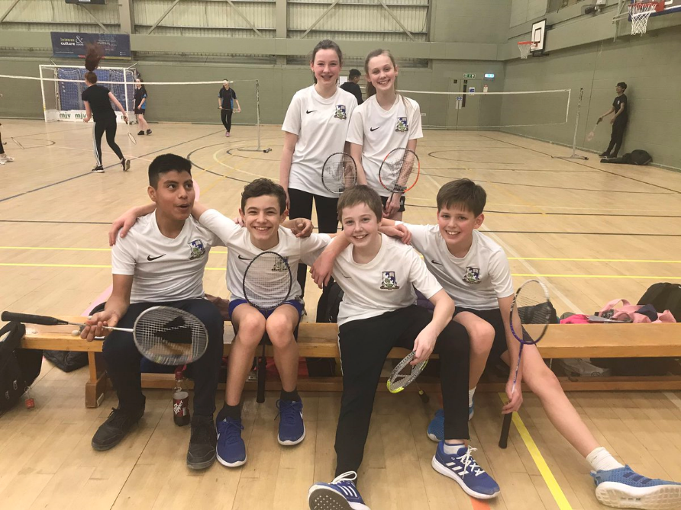
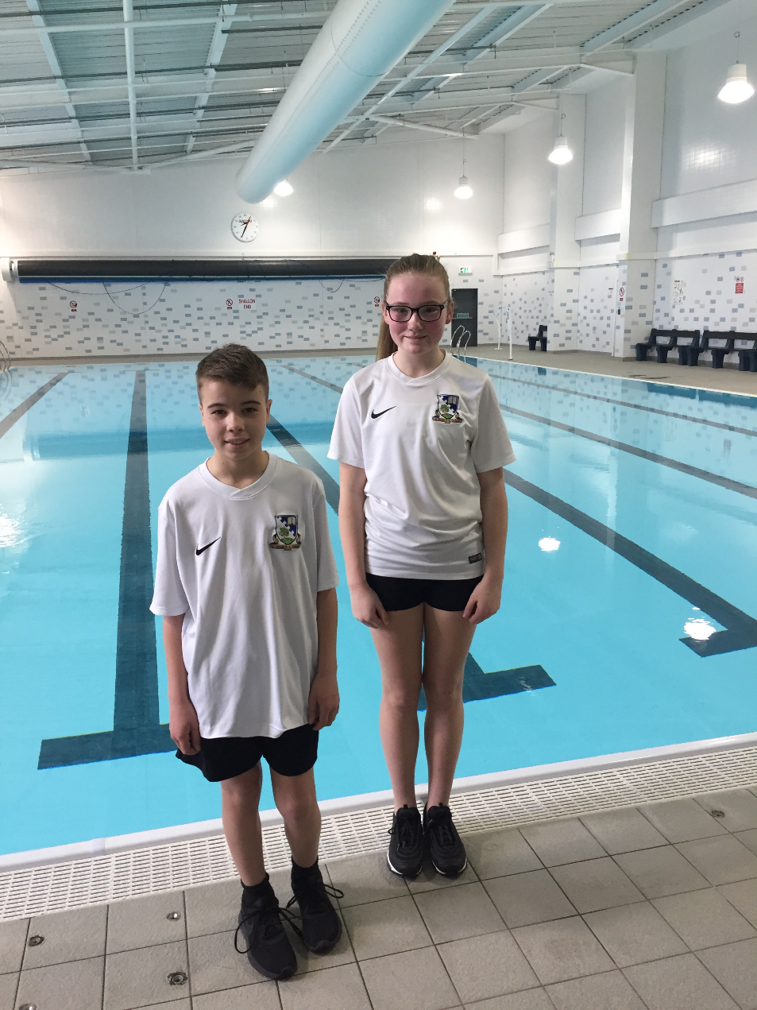
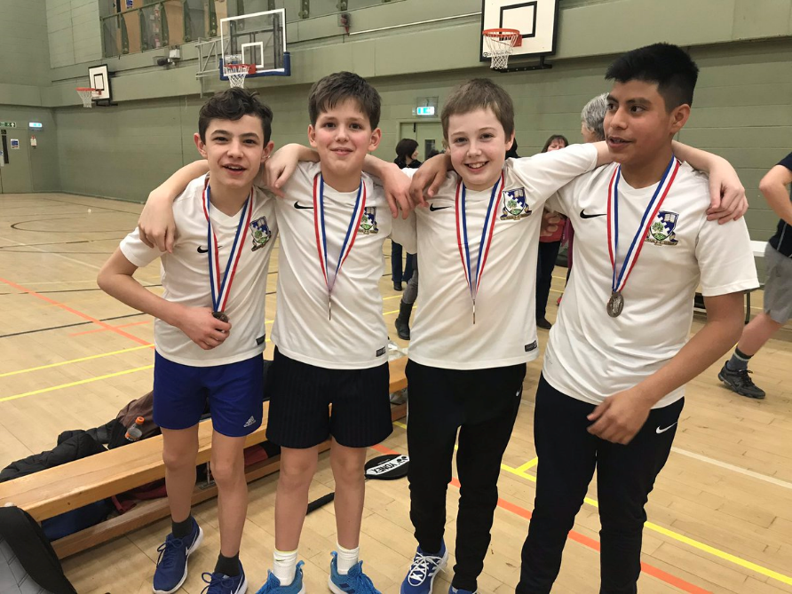
Grove Academy
Our Values: Honesty, Respect, Responsibility, Fairness, Determination

Slide 14
Extra-Curricular Activities
Grove Academy
Our Values: Honesty, Respect, Responsibility, Fairness, Determination
Music
  Instrumental tuition
  Regional orchestras and bands
  School orchestras, bands, choirs and ensembles
  Music Festival
  School shows
Sports
Hockey Football Badminton
Basketball Volleyball Netball
Dance Athletics Cricket
Swimming Rugby Golf
Tennis Fitness Gym House Competitions

Slide 15
Extra-Curricular Activities
Duke of Edinburgh Award
Science Club
Creative Writing
Code Club
Peer Supporters
Computer Club
Chess Club
Scripture Union
Debating
Eco schools
Grove Academy
Our Values: Honesty, Respect, Responsibility, Fairness, Determination

Slide 16
Trips
Theatre Visits
Film Showings
Field Trips - Summerlee, Scottish Parliament, V&A
Subject Conferences
University Lectures – Abertay Modern Studies Debate, Dundee University Chemistry Christmas Lecture
Grove Academy
Our Values: Honesty, Respect, Responsibility, Fairness, Determination

Slide 17
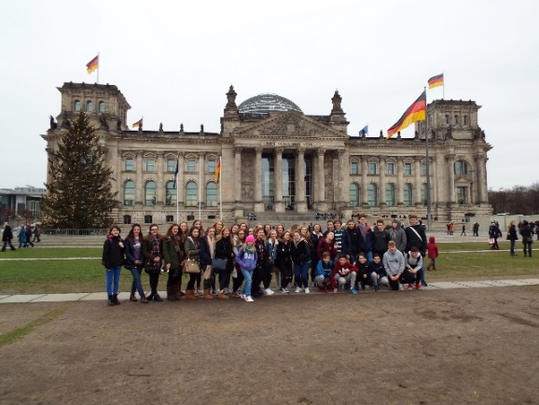
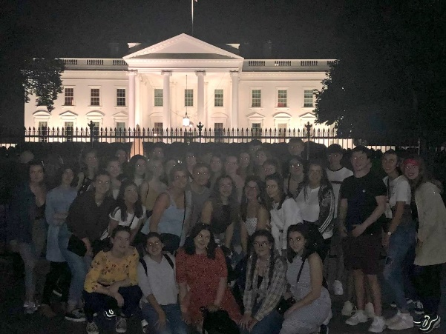
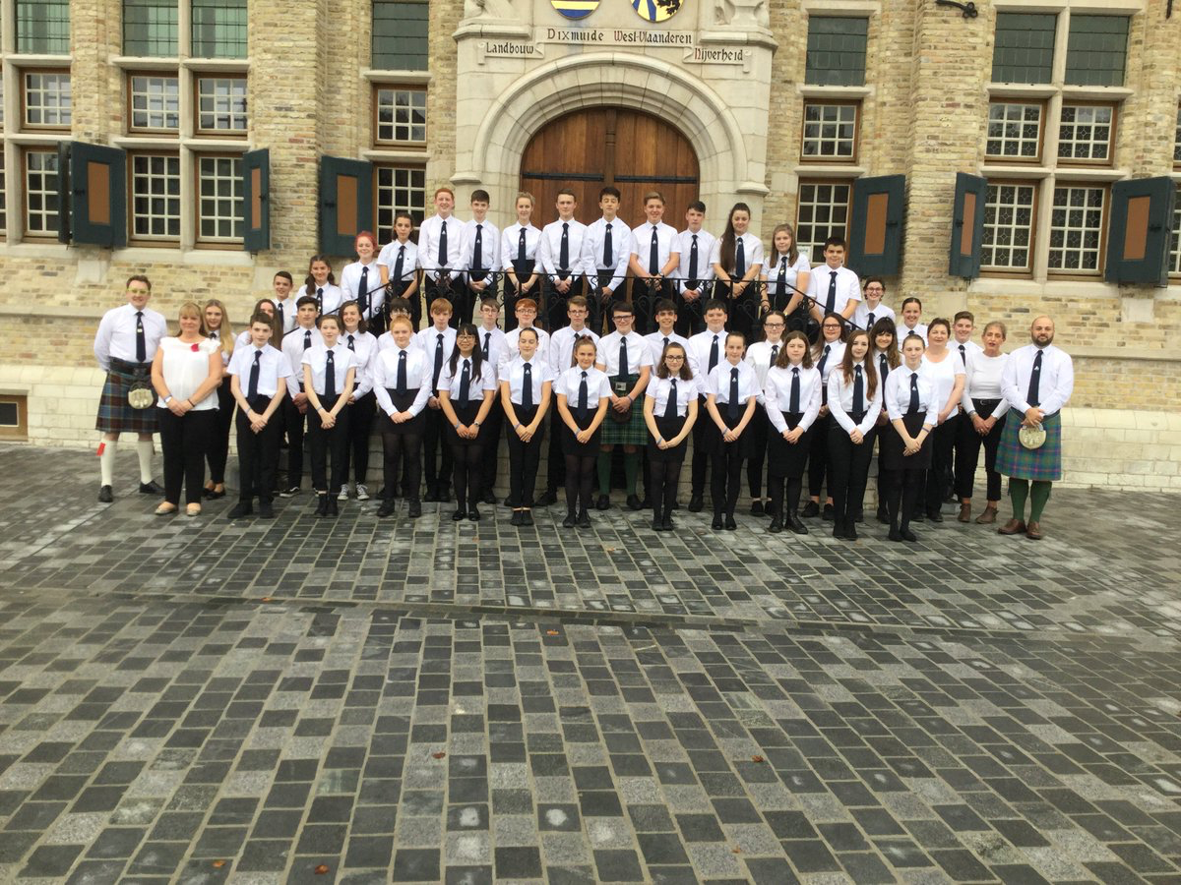
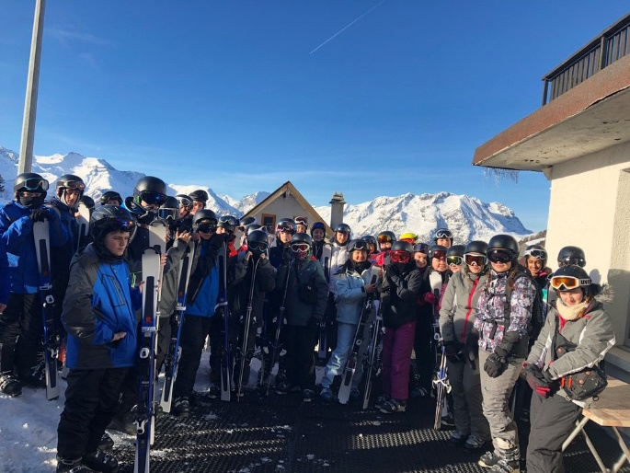
Foreign Excursions
S3 German/RMPE Trip to Berlin
S3/5 Music/ Modern Studies Trip to USA
S4-6 Battlefields Trip
S1/2 Ski Trip
Grove Academy
Our Values: Honesty, Respect, Responsibility, Fairness, Determination

Slide 18
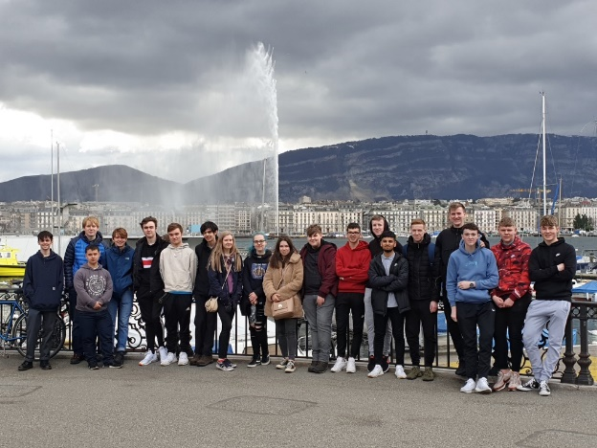

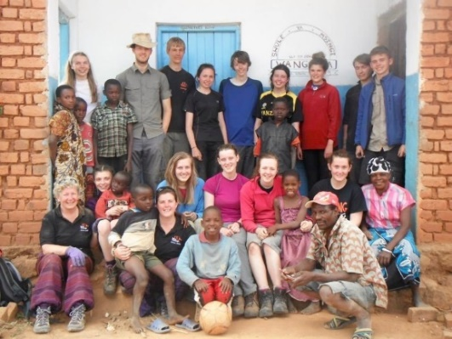
Foreign Excursions
AH Physics Trip to Cern in
Switzerland
Art and Design/Modern Studies/ Music Trip to London
Iceland Geography Trip
Auschwitz
Japan /Kenya Exchange
World Challenge/CAMPS
Grove Academy
Our Values: Honesty, Respect, Responsibility, Fairness, Determination

Slide 19
SQA Results
S4 | 2016 | 2017 | 2018 | 2019 | 2020
1+ Nat 5 | 87 | 92 | 87 | 91 | 91
3+ Nat 5 | 72 | 79 | 74 | 75 | 80
5+ Nat 5 | 49 | 63 | 59 | 64 | 64
Grove Academy
Our Values: Honesty, Respect, Responsibility, Fairness, Determination
Notes:
Down a bit on last year – BUT quality of the 55% @ 5+ Credits was not great – many Grade 2s – kind of expected.
Still 3rd best results ever. 5 + Highers could all be at C – 4 Highers at A and and Int 2 at A – do not count, but actually more points 240 cf 330

Slide 20
SQA Results
S5 (on S5) | 2016 | 2017 | 2018 | 2019 | 2020
1+ Higher | 82 | 78 | 83 | 83 | 87
3+ Higher | 56 | 55 | 67 | 62 | 71
5+ Higher | 31 | 26 | 33 | 38 | 37
Grove Academy
Our Values: Honesty, Respect, Responsibility, Fairness, Determination
Notes:
Down a bit on last year – BUT quality of the 55% @ 5+ Credits was not great – many Grade 2s – kind of expected.
Still 3rd best results ever. 5 + Highers could all be at C – 4 Highers at A and and Int 2 at A – do not count, but actually more points 240 cf 330

Slide 21
Leavers’ Destinations
Grove Academy 94.65%
Dundee 92.29%
Scotland 93.36%
Grove
  Higher Education 62.03%
  Further Education 22.46%
  Employment 8.56%
Grove Academy
Our Values: Honesty, Respect, Responsibility, Fairness, Determination

Slide 22
Pupil Achievements
Advanced Engineering Project –National Winners
Rotary (Britain and Ireland) National Short Story Competition Winners
ESU Scotland Public Speaking Award
ESU Debating Competition – Winners
Mock Courts Award – National Winners 2021
Young Enterprise
Winners of the S1-4 Dundee Active Schools water polo competition
S2 Giant Heptathlon winners in Dundee
Senior Netball – Winners of Dundee Schools
Winners of Inter-schools Squash competition
Grove Academy
Our Values: Honesty, Respect, Responsibility, Fairness, Determination

Slide 23
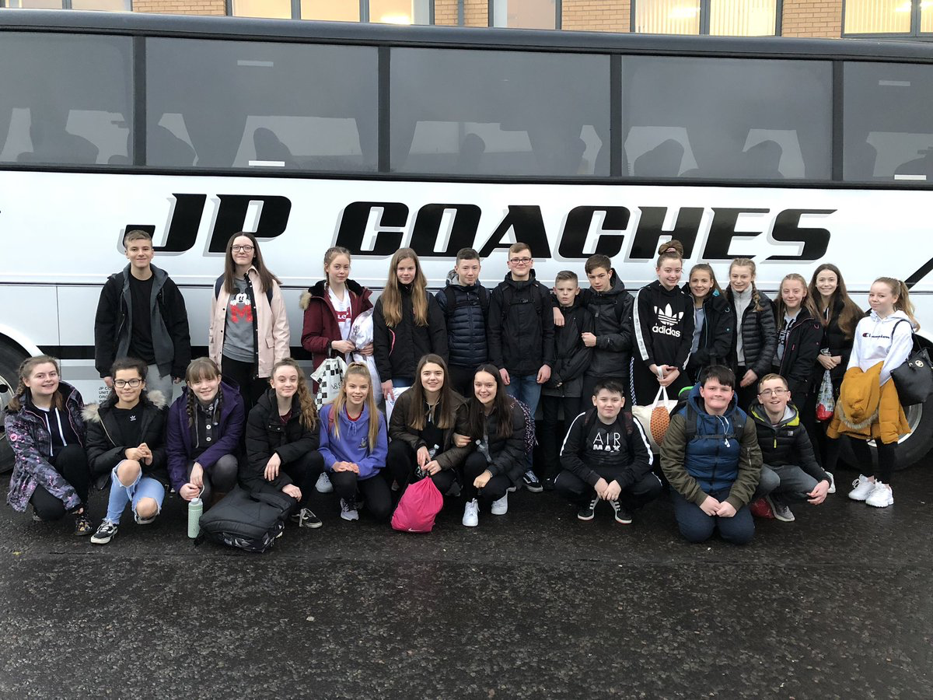
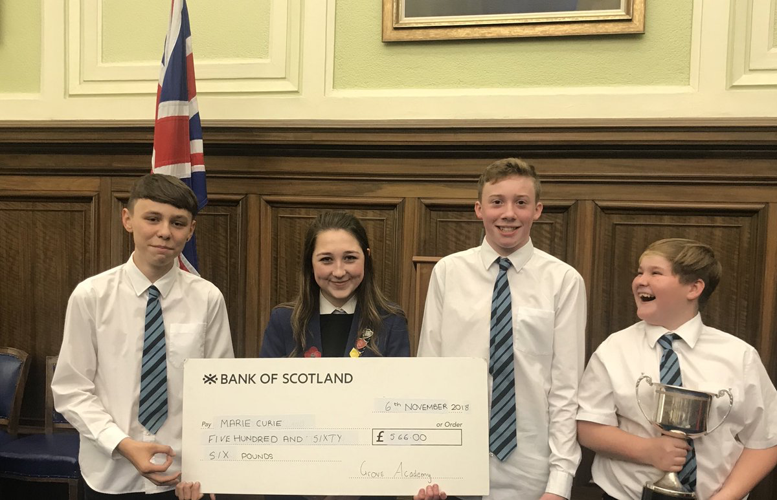
Pupil Achievements
S2 Skillforce Loch Eil leadership Residential
S2 Maths week
Maths Challenge Bronze, Silver and Gold Awards
Instrumentalist of Year
National Youth Jazz Orchestra
YPI
Bronze and Silver winners in the Duke of York’s Inspiring Digital Enterprise Awards
S3 girls into Physics
Grove Academy
Our Values: Honesty, Respect, Responsibility, Fairness, Determination

Slide 24

Pupil Achievements
  Christmas Fayre
  Santa Dash for Archie Foundation
  Big Sleep Over
  Christmas Hampers for
  Dundee Food Bank
Grove Academy
Our Values: Honesty, Respect, Responsibility, Fairness, Determination

Slide 25
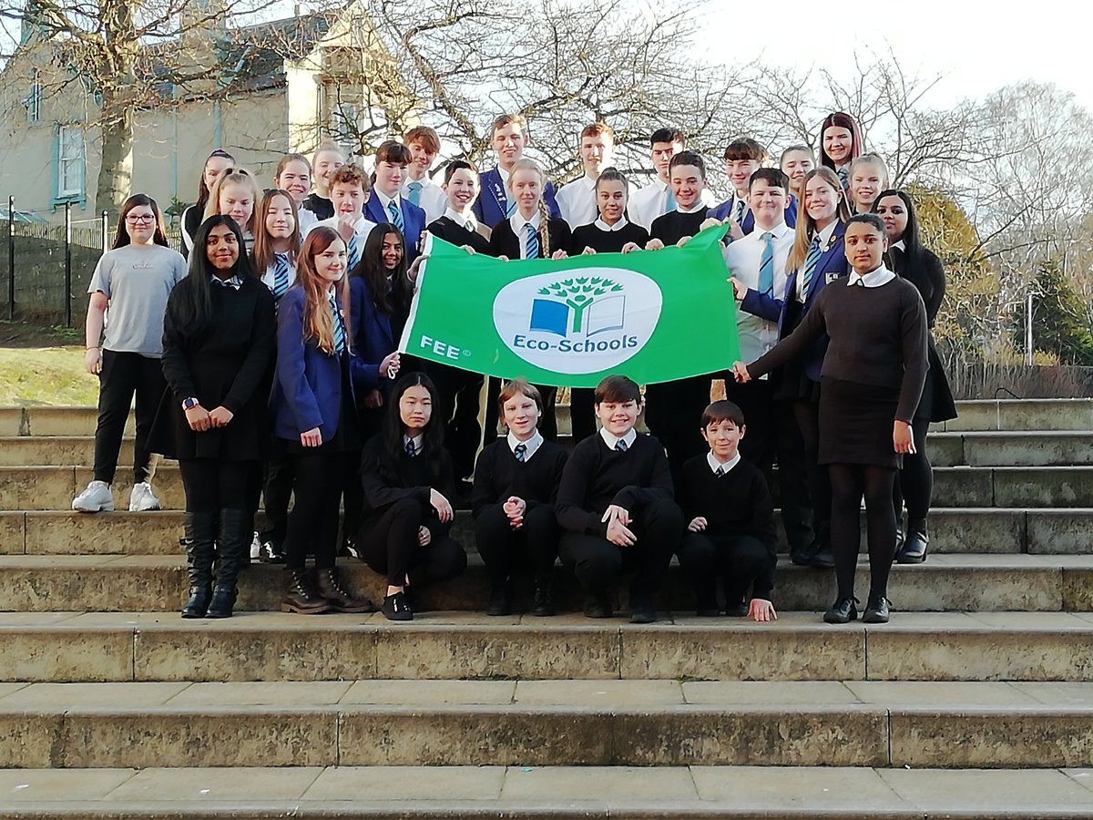

Pupil Achievements
  5th Green Flag
  sportscotland Gold School Sport Award
Grove Academy
Our Values: Honesty, Respect, Responsibility, Fairness, Determination

Slide 26
Values
School Recovery and Improvement
  Improvement in children and young people’s health and wellbeing
  Raise achievement in literacy and numeracy
  Closing the attainment gap between the most and least disadvantaged children
  Improvement in employability skills and sustained positive school leaver destinations for all young people
Grove Academy
Our Values: Honesty, Respect, Responsibility, Fairness, Determination

Slide 27

Vision
Grove Academy
Our Values: Honesty, Respect, Responsibility, Fairness, Determination

Slide 28

Values
Grove Academy
Our Values: Honesty, Respect, Responsibility, Fairness, Determination

Slide 29
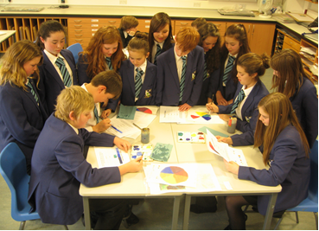
Values
Grove Academy
Our Values: Honesty, Respect, Responsibility, Fairness, Determination

Slide 30
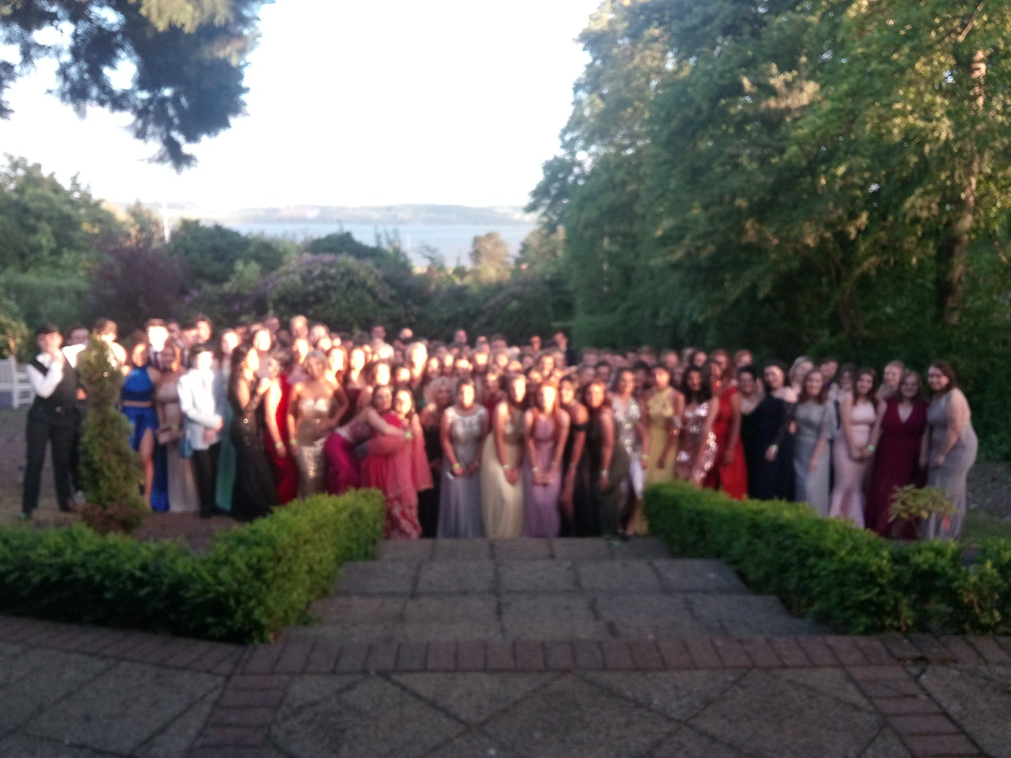
Values
Grove Academy
Our Values: Honesty, Respect, Responsibility, Fairness, Determination

Slide 31
Values
Grove Academy
  Thank you for listening.
  Questions?
  grove@dundeecity.gov.uk
  @ghutz1
Grove Academy
Our Values: Honesty, Respect, Responsibility, Fairness, Determination

